Slide 1
A few important Things to Know about Japan
Ted Bestor
Professor of Anthropology
Director, Reischauer Institute of Japanese Studies
Harvard University

Slide 2
Why Japan is important today?
In the 1970s and 1980s Japan burst onto the world scene as a major economic superpower. Brand names like Toyota, Sony, Panasonic, Nissan, Mazda, Nikon, Olympus became symbols of Japan’s high-tech economy
“Japanese management” practices became the ideal for Western corporations to emulate
Japan more or less disappeared from the business and economic news in the early 1990s, as its economy went into a long recession (from roughly 1990 to the 2010s)

Slide 3
Why Japan is important today?
Japan remains the world’s third largest economy in terms of Gross National Product (2014 figures)
US $17.3 trillion
China PRC $10.4 trillion
Japan $4.6 trillion
Germany $3.9 trillion
UK $2.9 trillion
France $2.8 trillion
Notes:
https://en.wikipedia.org/wiki/List_of_countries_by_GDP_%28nominal%29

Slide 4
Why Japan is important today?
2015 US-Japan trade balances:
US imports from Japan -- $131 billion
US exports to Japan -- $62.5 billion
Largest categories of US exports to Japan include:
Jet aircraft
Lumber
Grain
Seafood
Notes:
https://www.census.gov/foreign-trade/balance/c5880.html#2015

Slide 5
Why Japan is important today?
Notes:
https://en.wikipedia.org/wiki/List_of_the_largest_trading_partners_of_the_United_States

Slide 6
Why Japan is important today?
Notes:
Image from Miyazaki Hayao’s “Tonari no Totoro” of “My Neighbor Totoro” – released in Japan in 1988
http://io9.gizmodo.com/my-neighbor-totoro-surprised-me-all-over-again-1759217774

Slide 7
Japanese popular culture
Japan is a leading producer of popular culture and arts that has world-wide influence -- Japan’s “Gross National Cool”
Anime (animation)
Manga (comics)
Video games
Fashion
Architecture
Cuisine
Notes:
https://en.wikipedia.org/wiki/List_of_countries_by_GDP_%28nominal%29

Slide 8
Japanese popular culture
Notes:
http://pokemon.wikia.com/wiki/Pikachu

Slide 9
Japanese popular culture

Slide 10
Japanese popular culture

Slide 11
Japanese popular culture
Creation of so-called “content industries”
Linked to youth-oriented domestic market for playful products, very rapid product cycles
“Kawaii” fashion -- Cuteness

Slide 12
Japan’s Bubble Economy
During the 1970s and 1980s, the domestic Japanese economy was ”economic miracle”
Japan’s economy depended on exports (cars, cameras, electronics, high tech industrial products) that were possible because of artificial exchange rates
The domestic economy was inflated by real estate speculation and inflated stock market prices
And the international reputation of Japan as an economic superpower sustained this

Slide 13
Japan’s Bubble Economy
By the late 1980s, Japanese economic fundamentals could no longer sustain the speculative bubble
Inflated land values, inflated stock prices, high levels of corporate debt
The inherent inefficiencies of domestic economy, including “life-time employment,” large conglomerate structures, complicated distribution systems

Slide 14
Japan’s sense of precarity
Despite Japan’s leading role in the world, Japan today suffers from a national crisis of confidence
Long recession – early 1990s to 2010s -- hollowed out mainstream Japanese economy, leading to major changes in Japanese employment practices, and heavy impact on the white-collar middle class
“lost generation” – young people unable to find long-term employment, end up in part-time employment and a “floating” lifestyle that the media reports as disconnected to social stability and cultural norms

Slide 15
Japanese sense of precarity
The effect of the “lost generation” for youth
Concerns about the impact of aging population
Impact of alienated cults such as Aum Shinrikyō and the sarin gas attacks in Tokyo in 1995
The devastation of Triple Disasters of 2011 – Tohoku earthquake, tsunami, and Fukushima nuclear reactor
Fundamental fears about Japan’s future

Slide 16
Precarity – Aum Shinrikyō 1995
Notes:
March 20, 1995 – 12 deaths and approximately 1100 injuries – release of sarin nerve gas in Tokyo subway system

Slide 17
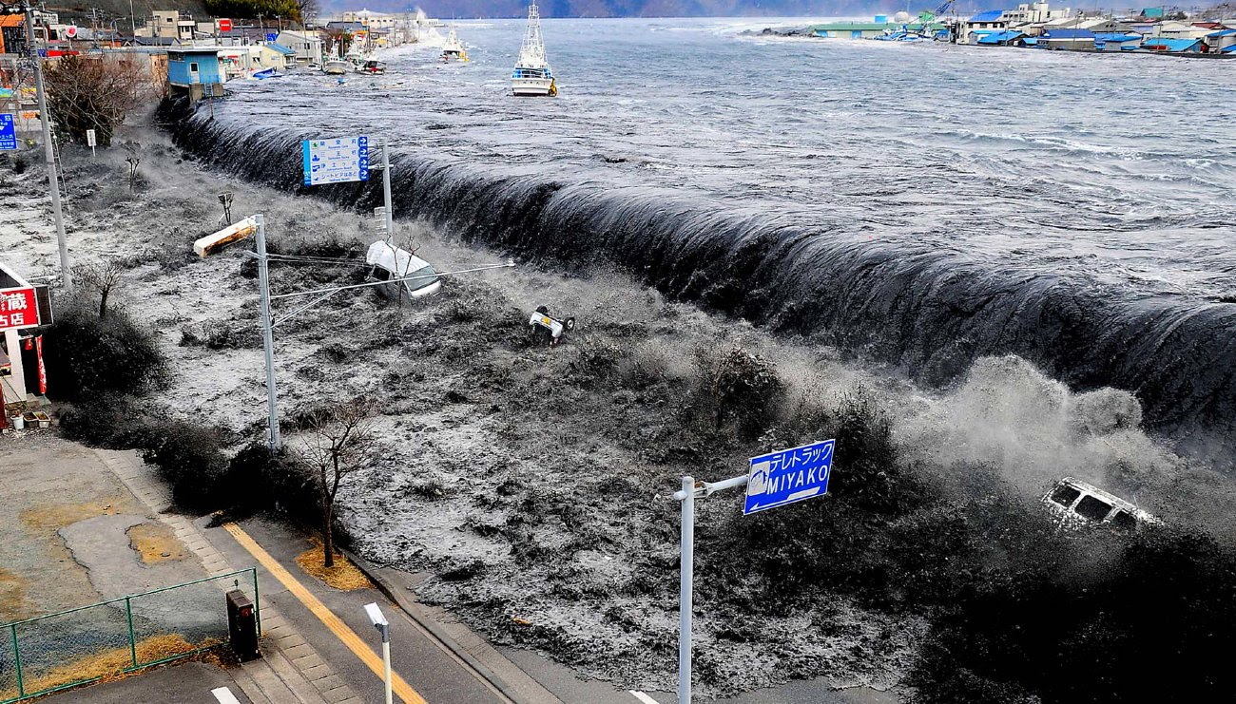
Precarity – Tohoku tsunami, 2011
Notes:
Approximately 16,000 killed, 2,500 missing

Slide 18
Precarity – Fukushima reactor, 2011

Slide 19
Japan’s aging population
Figures from the OECD (Organization for Economic Co-operation and Development) – major industrial nations
Japan – 82.7 years -- number 1
Australia – 81.5
France – 81.2
Canada – 80.7
Korea – 79.9
UK – 79.7
OECD average – 79.3
Slovenia – 78.8
USA – 77.9
China (PRC) – 73.1
Russian Federation – 67.8

Slide 20
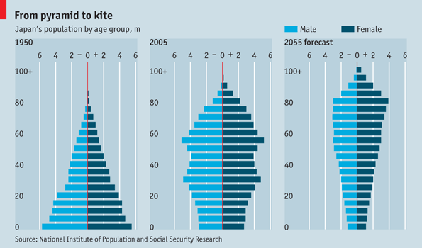
Japan’s aging population
Notes:
http://thehigherlearning.com/2014/06/20/japans-prime-minister-is-planning-to-host-the-worlds-first-robotic-olympics-in-2020/

Slide 21
Japan’s aging population
Dependency ratio – fewer and fewer young workers to pay taxes to pay for benefits for more and more elderly
Rising costs of medical care
Economic stagnation by the mid 21st century?

Slide 22
Japan’s aging population
Solutions?
Increase the size of the economy by creating more opportunities for women to work
Allow more foreign workers to come to Japan
Or . . .

Slide 23
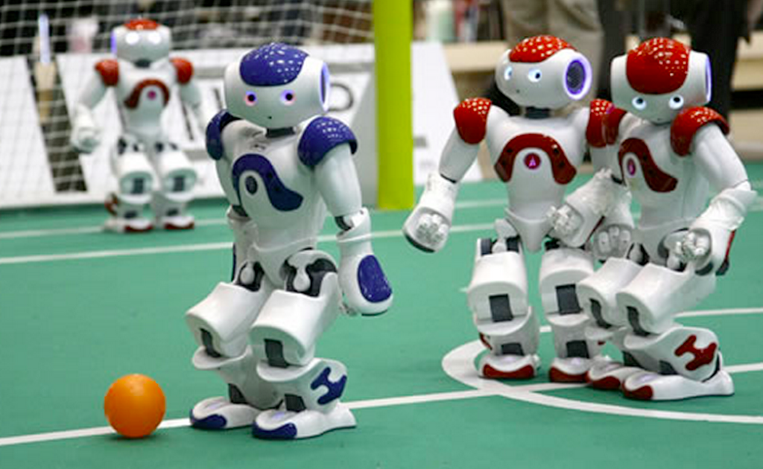
Japan’s aging population
Are robots the answer?

Slide 24
Japan’s aging population
Japan is a leader in robotic technology
Many researchers and companies are working to develop robots not only to provide a labor force, but also to assist in medical care for the elderly

Slide 25
Japan and the Oceans
Notes:
Great Wave off Kanagawa
Hokusai,

Slide 26
Japan and the Oceans
Notes:
http://www.pbs.org/food/the-history-kitchen/history-of-sushi/

Slide 27
Japan and the Oceans
global per capita consumption of seafood, 2007 – kilograms per person
Iceland 91.0
Japan 58.6
South Korea 57.4
Portugal 57.2
Norway 51.5
France 34.8
China Taiwan 30.8
New Zealand 26.5
China 26.3
Australia 26.0
Italy 25.2
US 24.2
UK 21.3
Notes:
Data from report by US NMFS on “Per Capita Consumption”

Slide 28
Japan and the Oceans
Japan has a long tradition as a fishing nation
21st century exploitation of sea beds holds great promise for Japan because of the extent of ocean zones it legally controls

Slide 29
Japan and the Oceans
4,479,358
square kilometers
South Korea
225,214 sq. km.
China (PRC)
877,019 sq. km.
(undisputed) – 3.8
million including
disputed claims
Notes:
http://chinamatters.blogspot.com/2013_07_01_archive.html
https://en.wikipedia.org/wiki/Exclusive_economic_zone#Japan

Slide 30
Japan and the Oceans
Territorial disputes with neighboring countries have great importance, both symbolically and economically
South Korea – Takeshima or Dokdo Islands
South Korea – the Sea of Japan or the East Sea
China (PRC) – Senkaku or Diaoyu Islands
Russia – Kurile Islands
Potential disputes with Taiwan
China PRC suggests that Okinawa is Chinese territory
China PRC vs. US – who controls the Western Pacific?

