Slide 1
Ten Things We Think We Know about Tibet Today But are Wrong
Robbie Barnett Columbia University February 2015

Slide 2
Wrong!
No. 1:
Tibet is small and remote

Slide 3
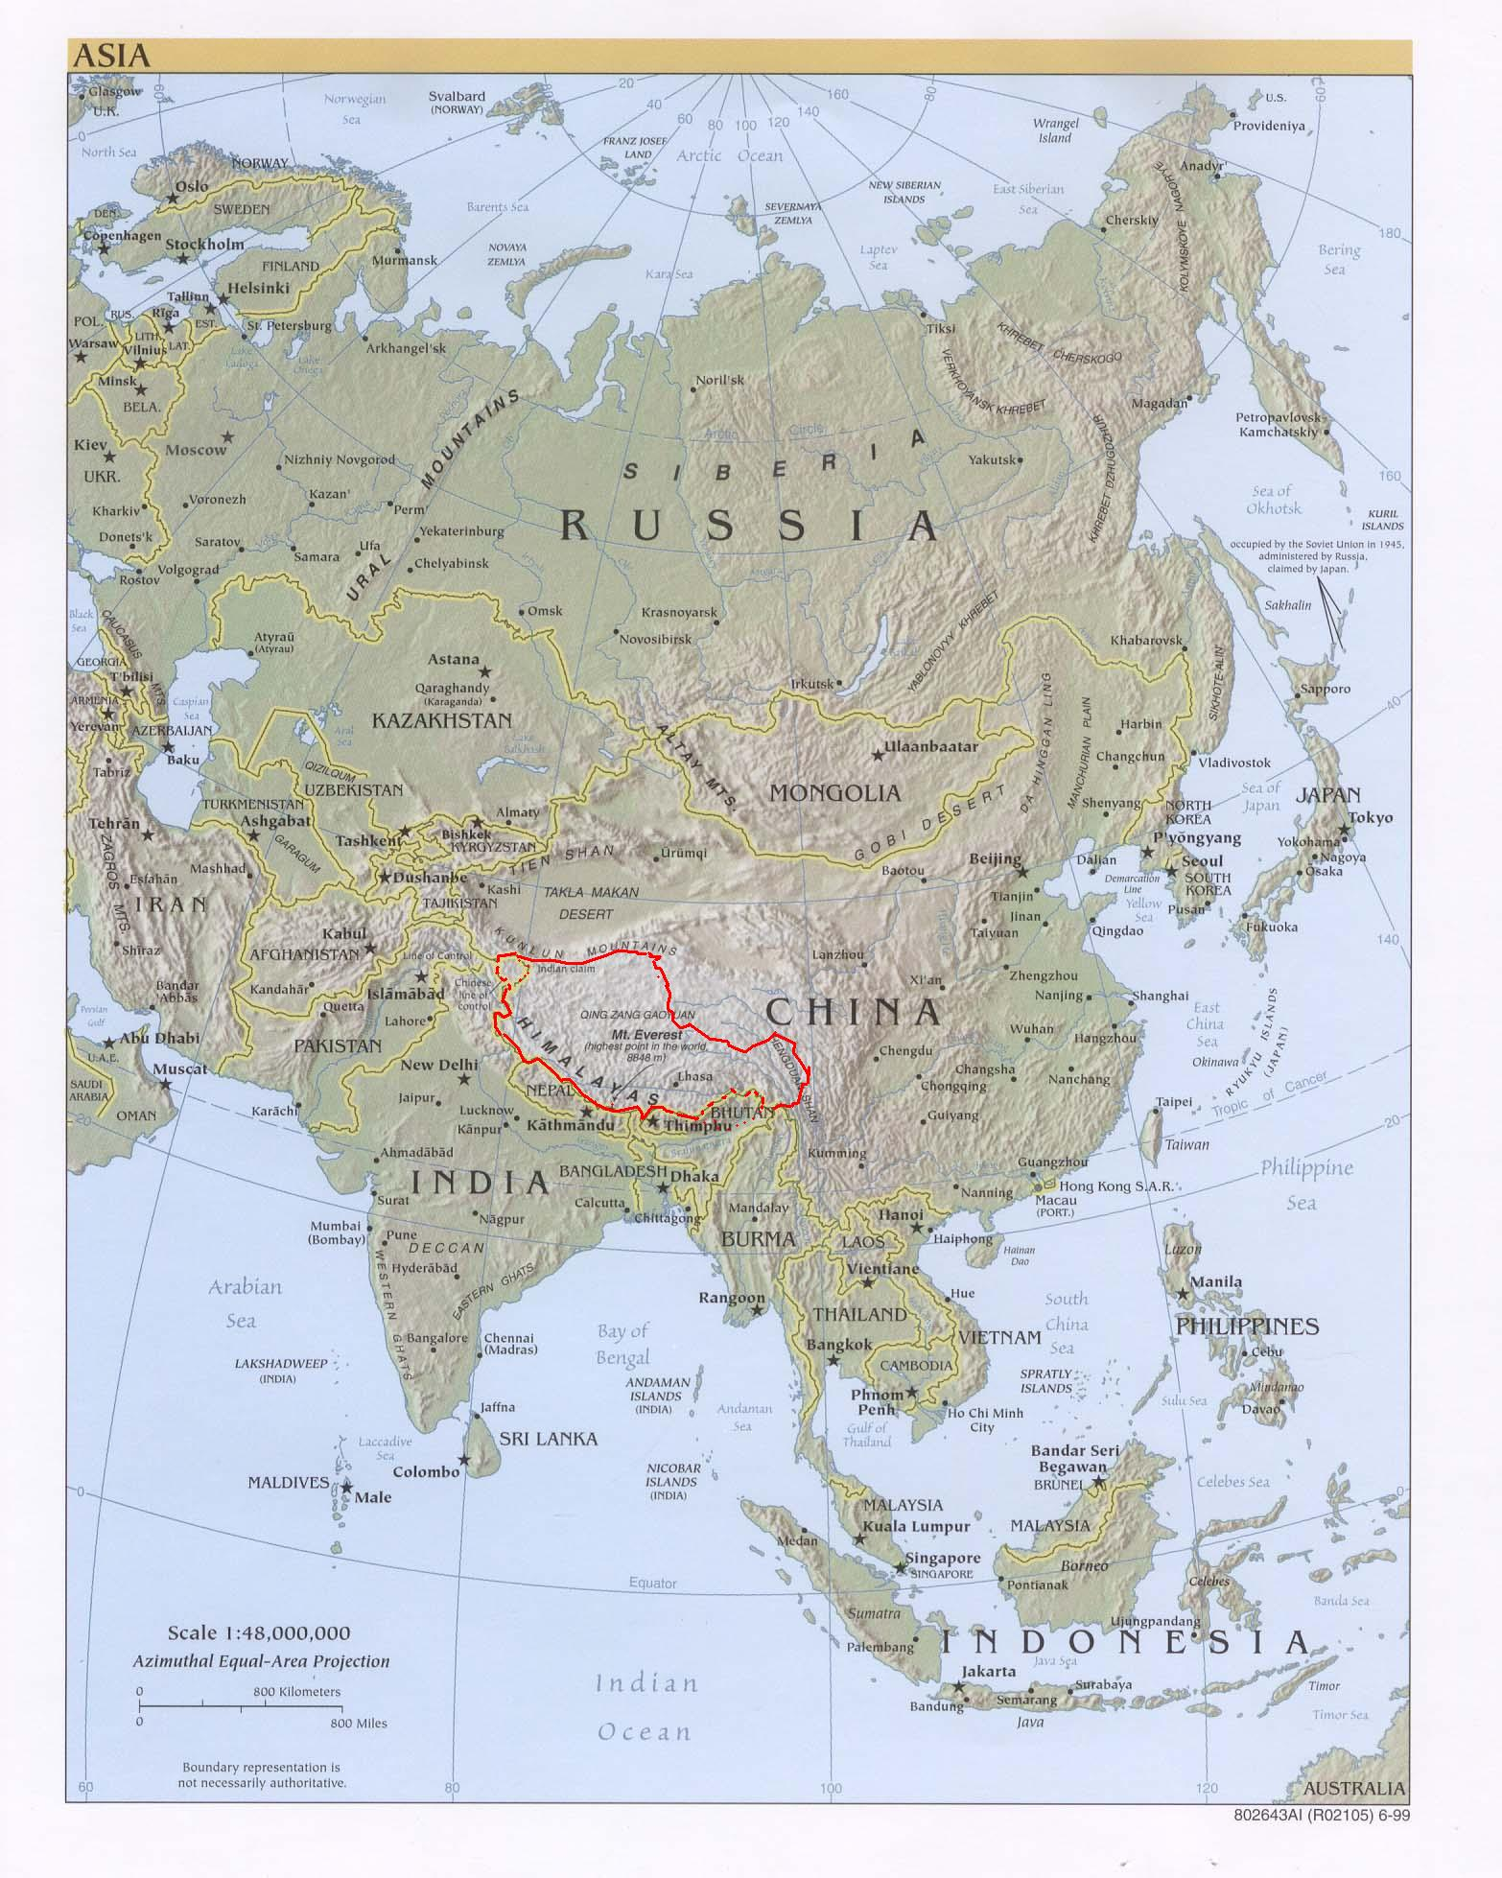
Tibet covers a large part of China’s area. This shows Tibetan Autonomous Region (founded in 1965), roughly the area directly ruled by the former Tibet government in 1950.
The Tibetan plateau – the area which is populated by Tibetans within China. In Chinese, the term “Tibet” is applied only to the western half of the Plateau

Slide 4
The Tibetan Plateau, including the Eastern Tibetan areas of Kham and Amdo.

Slide 5
The Tibetan Plateau is about 3.5 times the size of Texas and the size of western Europe minus Scandinavia.

Slide 6
Wrong!
No. 2:
Tibet is not important

Slide 7
The Tibetan Plateau, including the Eastern Tibetan areas of Kham and Amdo, constitutes an even larger part of China’s area.

Slide 9
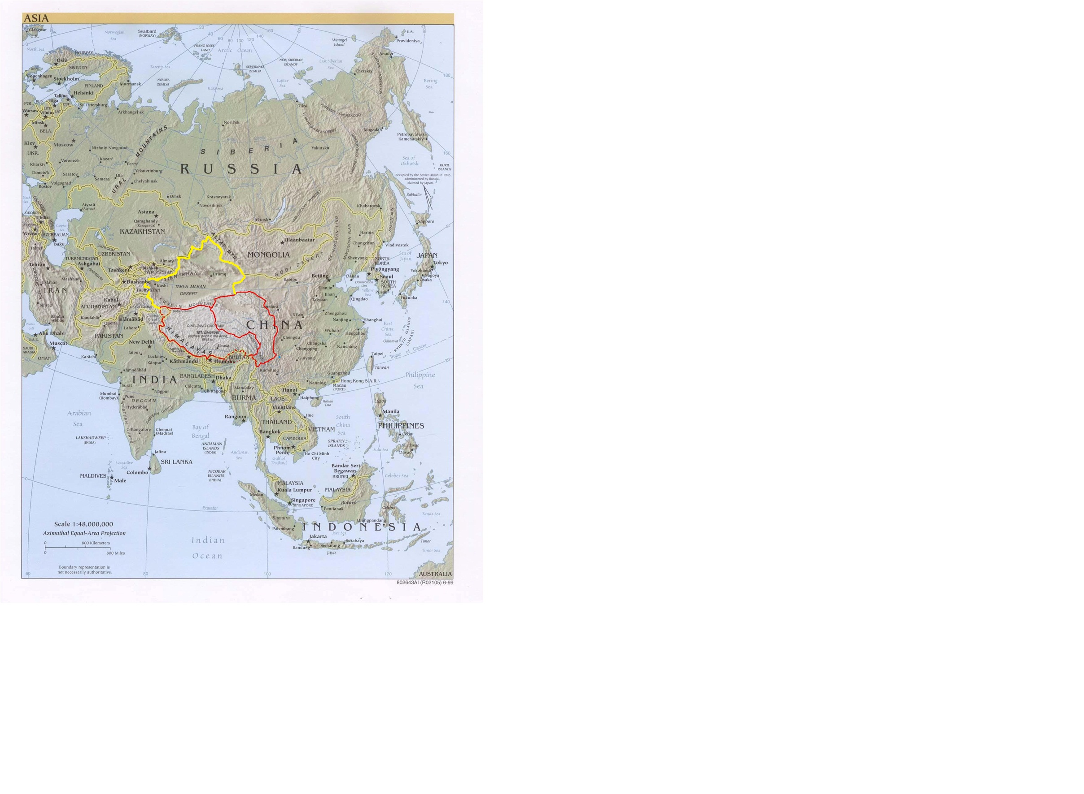
The Tibetan area plus the Uighur area: about 40% of China

Slide 10
Chinese Inner Asia: over 2m sq miles (5.3m sq km) in area and over one third of the size of Russia
The areas that are home to major nationalities that are not ethnically Chinese – the Tibetan, Uighur and Inner Mongolian areas.

Slide 11
55% of China's territory

Slide 12
The Tibetan Buddhist cultural : the areas where Tibetan Buddhism has traditionally been a major influence, and where people saw Lhasa as their spiritual or cultural centre.

Slide 13
The Yellow River
The Sutlej
The Indus
The Yangtse
The Brahmaputra
The Irrawaddy
The Mekong
The Salween
Eight of the major rivers of Asia flow from the Tibetan Plateau, including two of China’s most important water sources, the Yellow and the Yangtse. Some say these rivers feeding a fifth of the world’s population.

Slide 14
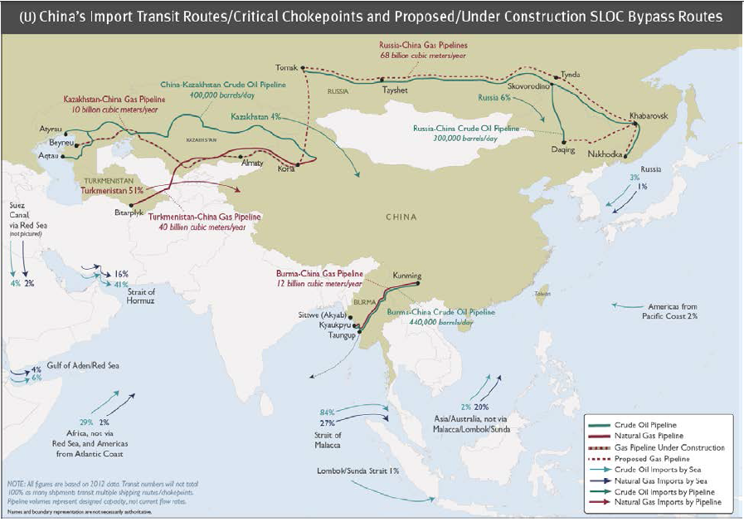

Slide 16
LADAKH
Key disputes on the Indo-Tibetan /Chinese borders

Slide 17
TAWANG
Key disputes on the Indo-Tibetan /Chinese borders

Slide 18
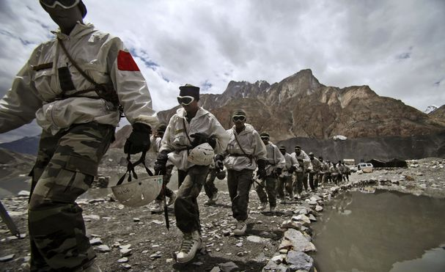
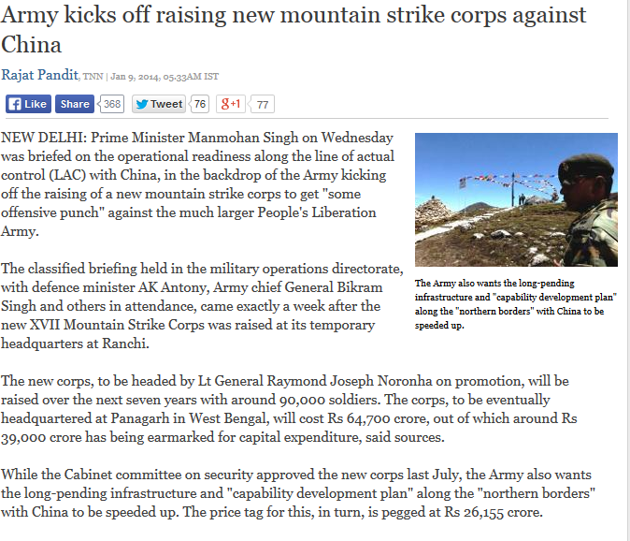
Mobilization of troops and forces

Slide 19
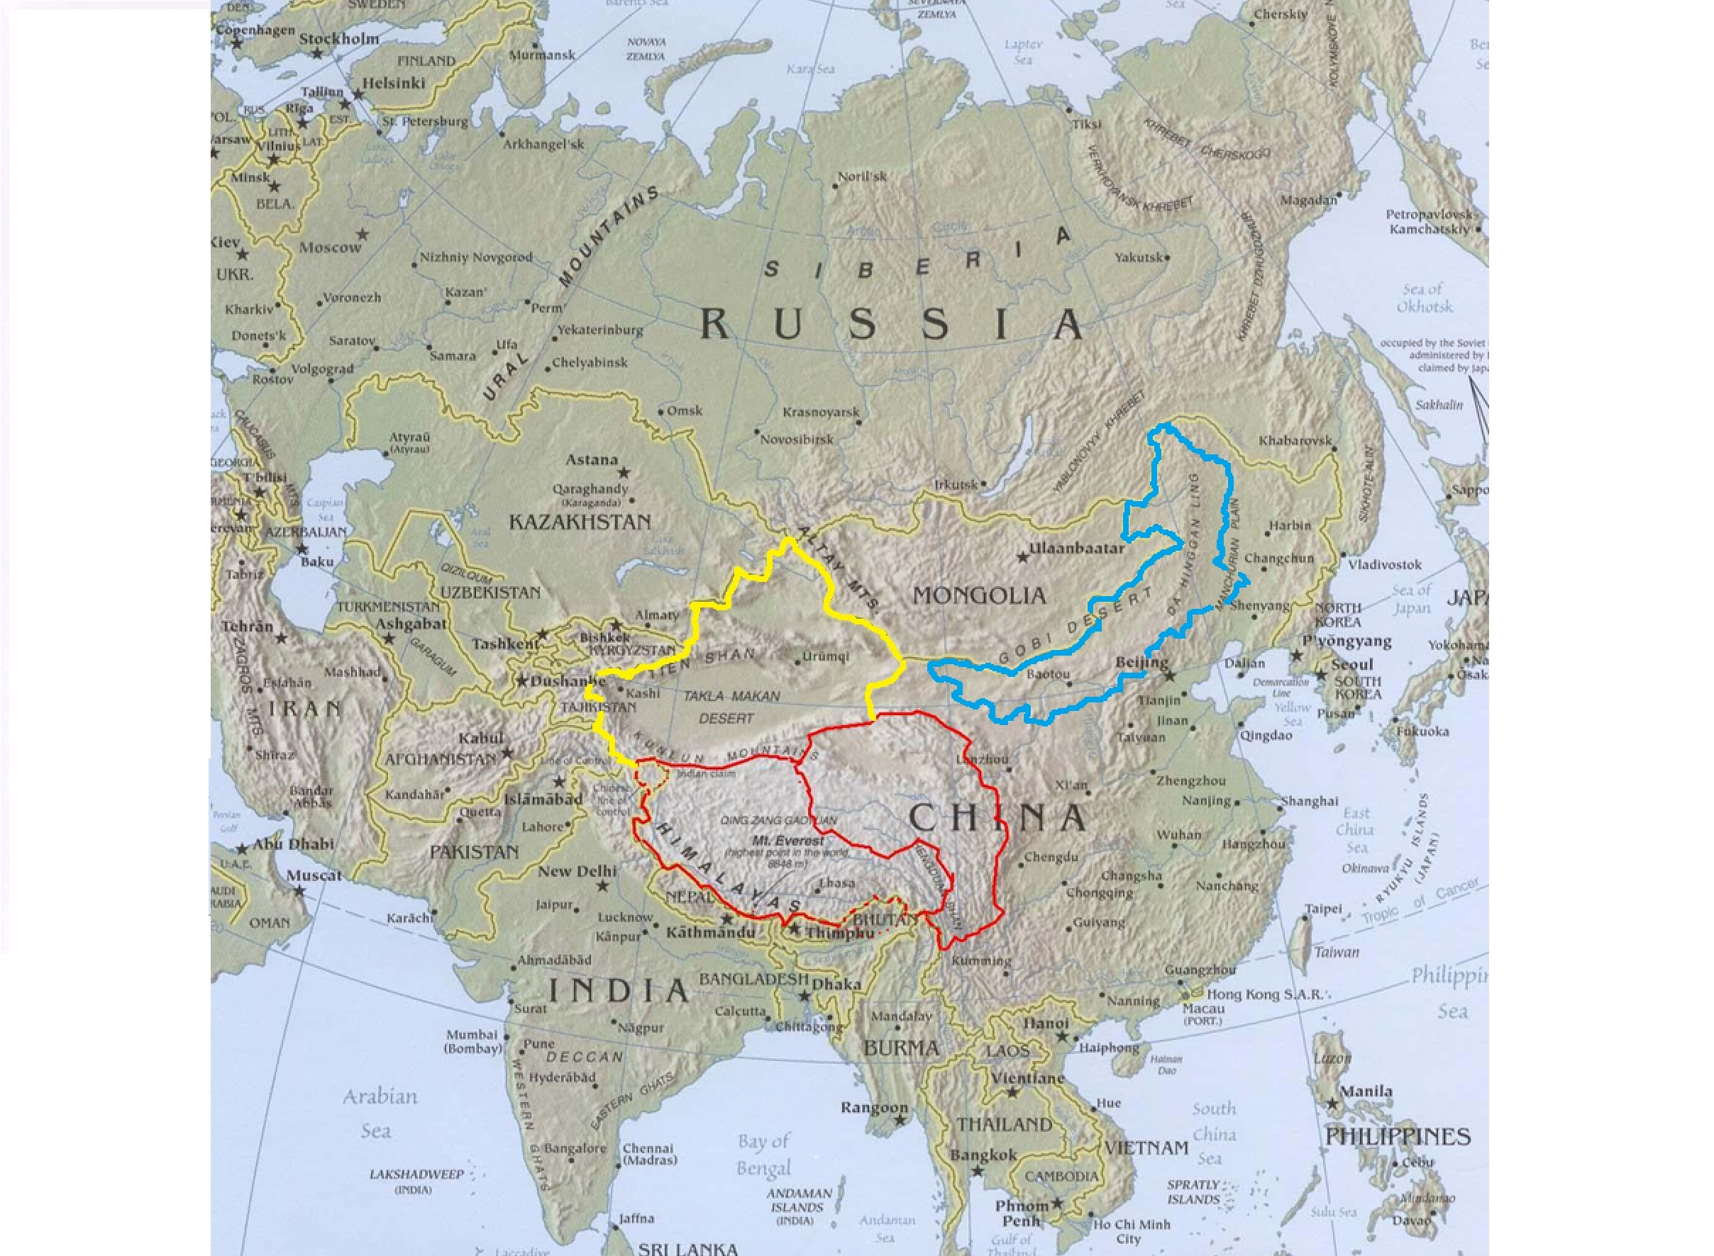
1998: the Tibetan- Xinjiang area became the world’s only nuclear trijunction

Slide 20
Fear of disruption from the peripheries
The Inner Periphery: the Tibetan, Uighur and Inner Mongolian areas within China

Slide 21
The Outer Periphery: Neighbouring mini-states

Slide 22
RUSSIA
IRAN
KOREA
JAPAN
INDIA
The Periphery: Neighbouring major powers

Slide 23
Partly Wrong!
No. 3:
Tibetans are spiritual
and non-violent

Slide 24
War in Amdo, 1958-62
Uprising in Lhasa, 1959
War in Kham, 1956-59
CIA-backed guerillas in Nepal, 1960-74
Military challenges to the PRC by Tibetans

Slide 25
The Tibetan-China issue
Conflict type
1956-62: Widespread military conflict
1962-74: Guerilla fighting
1987-2013: Street protests

Slide 26
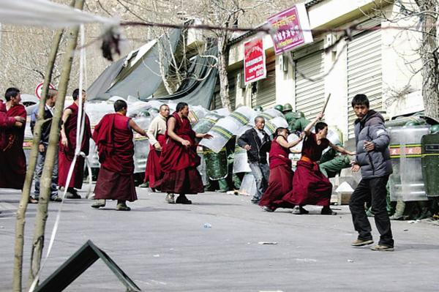
CCTV: attacks on Chinese shops, Lhasa 14th March 2008

Slide 27
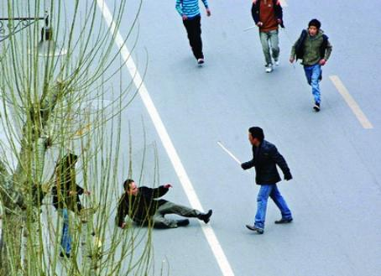
CCTV: attacks on Chinese migrants, Lhasa 14th March 2008

Slide 28
The Tibetan-China issue
Deaths as a result of political protests
Since 1979 (approx.)
Chinese Tibetans
1980s: 1 c. 150
1990s: 0 c. 40
2000s: 1 c. 2
2008: 20 c. 200

Slide 29
The Tibetan-China issue:
Protests by Tibetans since 1979
(approx.)
1987-96: 200
1996-2000: 10
2000s: 20
2008: 150

Slide 30
Bombings since 1979
(approx.)
Bombings Casualties
1980s: 1 0
1990s: 9 0
2000s: 4 1
2010: 3 0

Slide 32
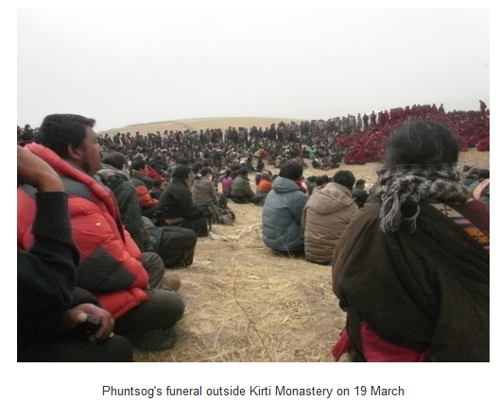
Funeral for the second Tibetan to self-immolate, Ngawa (Sichuan), 2011. Since 2008, almost all protests have been peaceful, even though thousands of people have taken part. Many were funerals to mark the deaths of people who self-immolated and called for the Dalai Lama to return.

Slide 33
Wrong!
No. 4:
Tibet was always independent
or
Tibet has been part of China for centuries

Slide 34
Tibet was independent in practice from 1913 to 1950

Slide 35
Historical status
1884 Xinjiang was made into a province
1910 The Qing tried to make Tibet into a province
So what were Tibet and Xinjiang before 1884 and 1910?

Slide 36
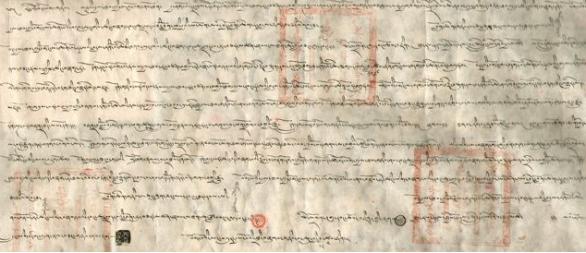
Treaty Between Tibet and Mongolia, January, 1913, Signed at Urga
Whereas Mongolia and Tibet, having freed themselves from the Manchu dynasty and separated themselves from China, have become independent States, and whereas the two States have always professed one and the same religion, and to the end that their ancient mutual friendships may be strengthened: on the part of the Government of the Sovereign of the Mongolian people- Nikta Biliktu Da Lama Rabdan, acting Minister of Foreign Affairs and Assistant Minister-General and Manlai Caatyr Bei Tzu Damdinsurun; on the part of the Dalai Lama, Ruler of Tibet- Gujir Tsanshib Kanchen Lubsan-Agwan, Denir Agwan ChoinzinTschichamtso, manager of the bank, and Gendun-Galsan, secretary, have agreed on the following:--
ARTICLE 1
The Dalai Lama, Sovereign of Tibet, approves of and acknowledges the formation of an independent Mongolian State, and the proclamation on the 9th day of the 11th month of the year of the Pig, of the master of the Yellow Faith Je-tsun Dampa Lama as the Sovereign of the land.
ARTICLE 2
The Sovereign of the Mongolian people Je-tsun Dampa Lama approves and acknowledges the formation of an independent State and theproclamation of the Dalai Lama as the Sovereign of Tibet.

Slide 37
Tibet was within the Qing empire from the late 17th century until 1911

Slide 38
Wrong!
No. 5:
Tibet was a hell on earth before the Chinese came

Slide 39
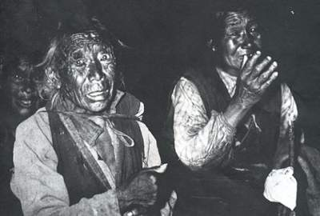
The serfs had nothing but beg in the streets.

Slide 40
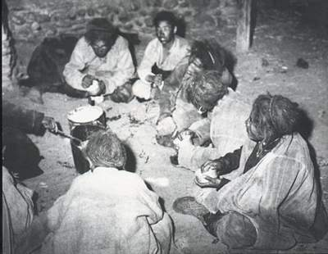
After a day's heavy work, the serfs of Jinglong manor of Xigaze had their meals with coarse food.

Slide 41
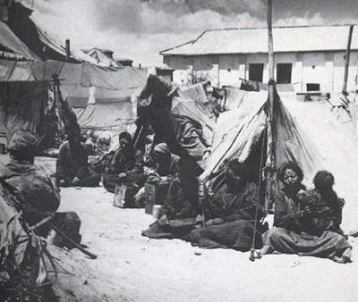
The serfs grouped into "beggar village".

Slide 42
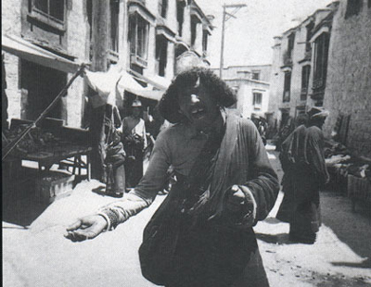
An old man begged along the street. Copyright© China Tibet Information Center E-mail:e-editor@tibetinfor.com Tel: 0086-1058880347

Slide 43
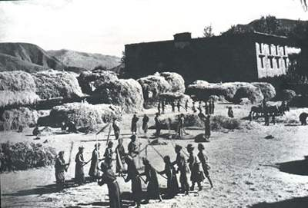
The serfs were threshing grain in the manor.

Slide 45
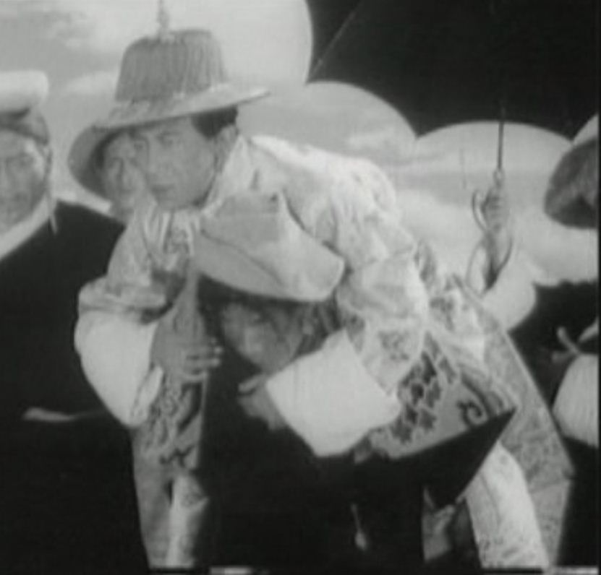

Slide 46
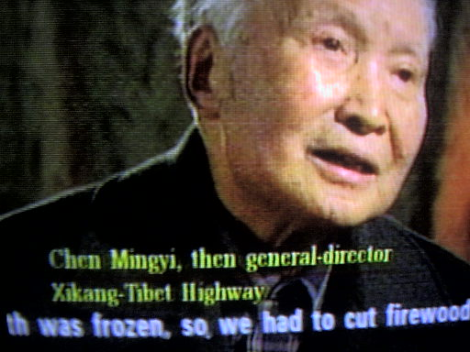
Chen Mingyi

Slide 47
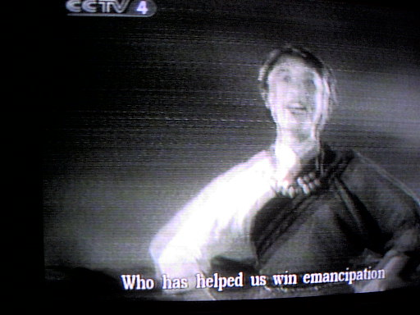
emancipation

Slide 48
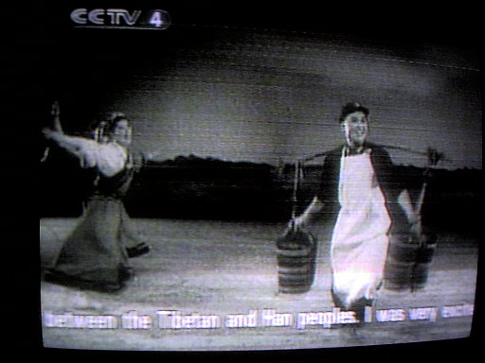
Washing clothes

Slide 49
Wrong!
No. 6:
China aims to wipe out
Tibetan culture and religion

Slide 50
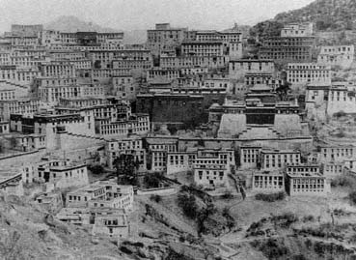
Ganden Monastery, 40 km east of Lhasa, in the 1930s

Slide 51
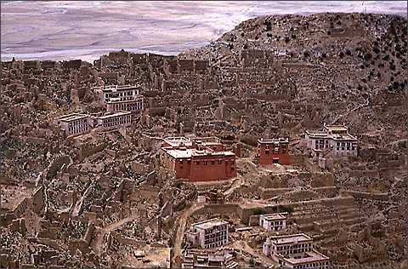
Ganden Monastery, mid-1980s

Slide 52
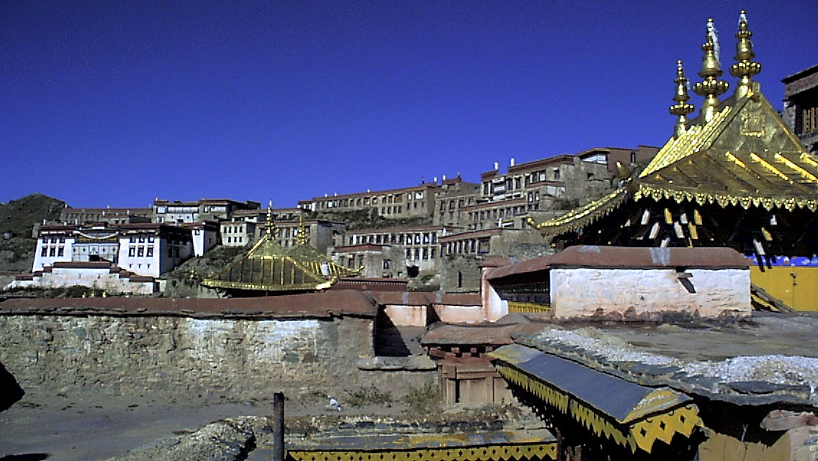
Ganden golden rooves
Ganden Monastery today

Slide 53
Source: China’s 2000 census

Slide 54
Source: China’s 2000 census

Slide 55
Source: China’s 2000 census

Slide 56
Non-Tibetan males outnumber Tibetan males among 20-39 year old urban residents of TAR.
Source: China’s 2000 census

Slide 57
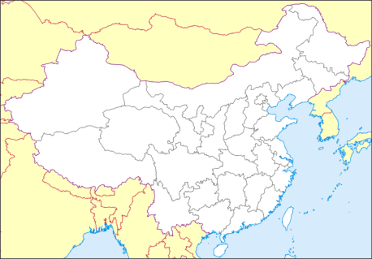
Ditsa
Tibetan Cultural Revival, 1980s -
Xinjiang
Poetry
Xining
Film
Gansu province
Qinghai Province
Fiction
Amdo
Tibetan Autonomous Region
Religious publications
Kardze
Religious teachings & rituals
U-tsang
Nagchu
Fine Art
Kham
Lithang
LHASA
Sichuan Province
Examples of forms of Tibetan culture that have flourished since the 1980s in certain areas

Slide 58
Ditsa
Major Tibetan Cultural Restrictions, 1980s -
Xinjiang
Xining
Poetry
Gansu province
Qinghai Province
Film
Fiction
Amdo
Tibetan Autonomous Region
Religious teachings & rituals
Religious publications
Kardze
U-tsang
Nagchu
Painting
Kham
LHASA
Lithang
Sichuan Province
Examples of forms of Tibetan culture that have flourished since the 1980s in certain areas

Slide 59
Ditsa
Major Tibetan Cultural Restrictions, 1980s -
Xinjiang
Poetry
Xining
Discussion of history
Gansu province
Qinghai Province
Film
Fiction
Prayers to the Dalai Lama
Nomadic pastoralism
Discussion of migration policy
Amdo
Tibetan Autonomous Region
Religious activity by Tibetans who are government employees or students
Religious publications
Kardze
Religious teachings & rituals
U-tsang
Nagchu
Fine Art
Kham
Lithang
LHASA
Sichuan Province
Examples of aspects of Tibetan culture that have been restricted since the 1990s or later in certain areas

Slide 60
Wrong!
No. 7:
China has banned religion in Tibet

Slide 61
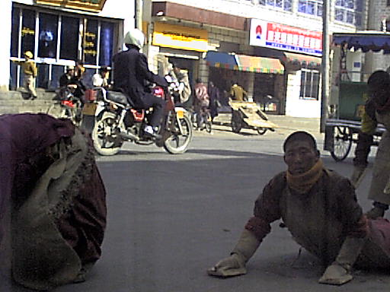
Prostrating

Slide 62
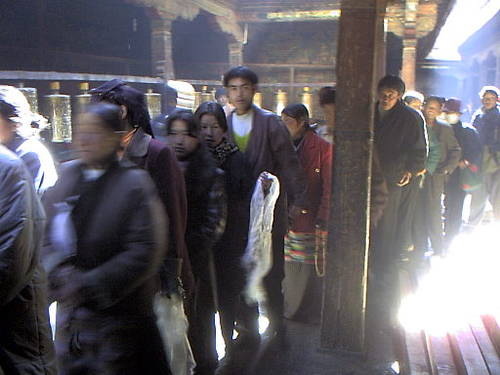
Queuing up

Slide 63
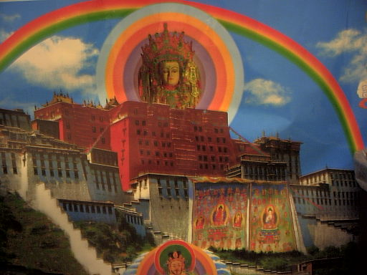
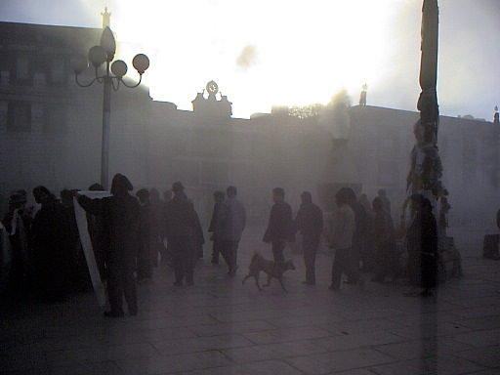

Slide 64
Part 3: The key Internal policies
The 1994 Policy Reversal: Religion and the Dalai Lama

Slide 65
Third Forum policies on religion, 1994
“Adapting religion to socialism”
patriotic education drives in each monastery
management committees with lay members
Dalai Lama pictures banned
minimum age requirement for monks
local residents only in monasteries
quotas on numbers in each monastery
no religious beliefs for Party members
Ban on religion for students (TAR)
Ban on religion for government employees and families (TAR)
Anti-Dalai Lama Campaign
Restrictions shown in red were completely new, such as banning pictures and worship of the Dalai Lama

Slide 66
Third Forum policies on religion, 1994
“Adapting religion to socialism”
patriotic education drives in each monastery
management committees with lay members
Dalai Lama pictures banned
minimum age requirement for monks
local residents only in monasteries
quotas on numbers in each monastery
no religious beliefs for Party members
ban on religion for students (TAR)
ban on religion for government employees and families (TAR)
Restrictions shown in red were completely new, such as banning pictures and worship of the Dalai Lama

Slide 67
The Ban on Dalai Lama pictures 1996+
“The hanging of the Dalai's portrait in temples should gradually be banned. We should convince and educate the large numbers of monks and ordinary religious believers that the Dalai is no longer a religious leader who can bring happiness to the masses, but a guilty person of the motherland and people."
Xizang Ribao (Tibet Daily), reporting on a meeting
of the Chinese Buddhist Association
5th April 1996, p.1

Slide 68
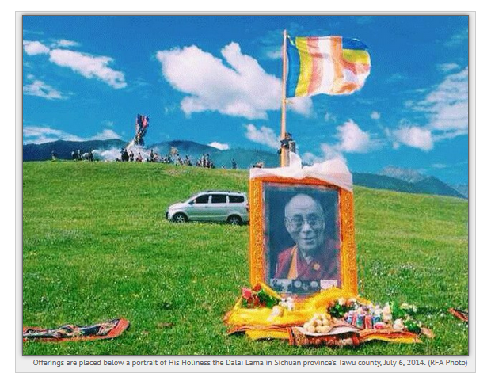
Offerings placed before a portrait of the Dalai Lama in Tawu in Kham (Sichuan), on the Dalai Lama’s birthday, July 6, 2014 (photo: RFA)

Slide 69
Restrictions on government employees and family members, 1994/5+
Not allowed:
possession of religious objects
religious activities
attending monasteries or temples
Note: “Government employees” refers to anyone working for the Government at any level, including officials, teachers, cleaners, caretakers, etc. Only a small proportion will also be Party members.

Slide 70
Restrictions on students, 1994/5+
Not allowed:
possession of religious objects
religious activities
attending monasteries or temples
Note: “Students” refers to anyone studying at the Tibet University and at the three other University level institutions, and also seems to apply to students at schools in the TAR. Enforcement might depend on individual local officials, as with all these semi-clandestine policies.

Slide 71
Queuing up
Tibetans queueing to enter the Jokhang temple, c. 2001

Slide 72
A closer look at people in the queue in the Jokhang temple: why the mask?

Slide 73
One of the four slogans denouncing the Dalai Lama. Tibet University, 2000

Slide 74
Chenrezig
Poster in a Lhasa shop showing the one time that hanging of the giant thangkas from the Potala Place was allowed (1995), overlooked by Chenrezig, the Bodhisattva of Compassion.

Slide 75
Partly Wrong!
No. 8:
China has created growth, prosperity and contentment in Tibet

Slide 76
Tibet Daily, the official Party paper in Tibet, front page, March 24, 2010

Slide 77
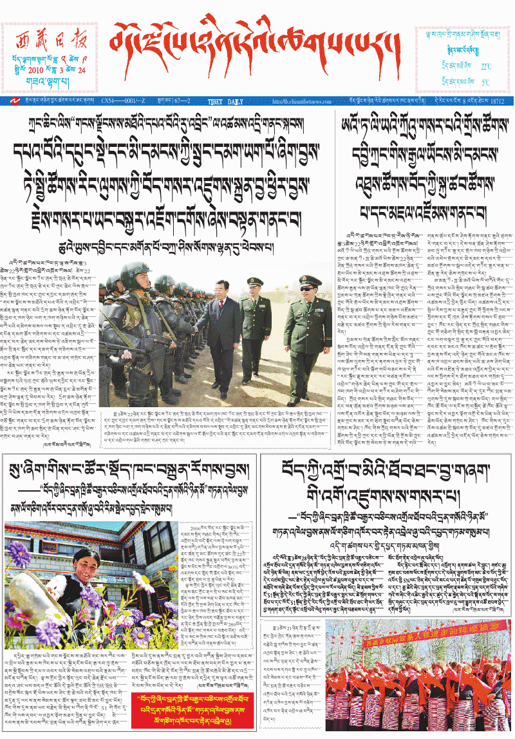
“Who helped us construct our homes? “Tibet Serf Liberation Remembrance Day” is celebrated and the third successive discussion recalls that year

Slide 78
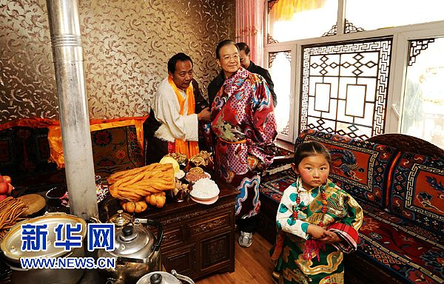
Premier Wen Jiabo in Jyeku (Yushu) in Qinghai on Dec 31 2012, is shown visiting a Tibetan home and wearing a Tibetan robe

Slide 79
Economic policy in the Tibet Autonomous Region
Boosting urban wealth and infrastructure
GDP growth
Modernization
Consumer wealth and commodities

Slide 80
Economic policy in the Tibet AR
Boosting urban wealth and infrastructure
GDP growth
Modernization
Consumer wealth and commodities
Achieved!

Slide 81
Double digit growth in GDP for the last 16 years.

Slide 82
The sudden surge in state investment in the TAR after 1992 Small Businesses in the TAR

Slide 83
Average Wages for government employees in yuan
Tibet Auton. Region
PRC average
1988
wages
2739
1810
benefits
583
527
1992
wages
3459
2878
2001
2009
2014
wages
wages
20112
48750
11178
32736
wages

Slide 84
Average salaries for government employees, 1988-2009 in yuan

Slide 85
Average rural income in Rmb
TAR average per capital rural income
TAR
National
Ranking out of 30 provinces
1985
352
397
20
1990
649
686
17
1995
1200
1577
22
2000
1330
2253
31
2009
3532
5919
2014
7471

Slide 87
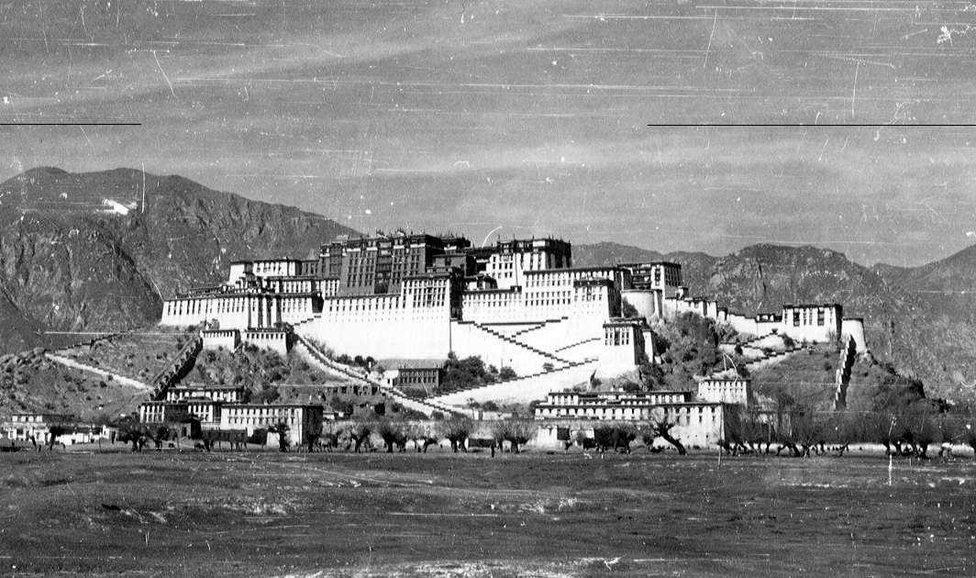
The Potala Palace in the 1930s

Slide 88
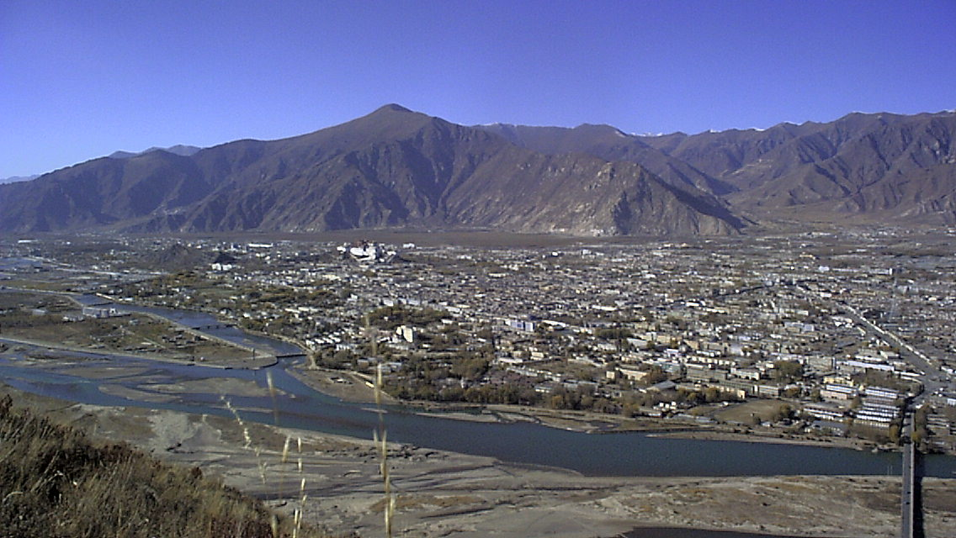

Slide 90
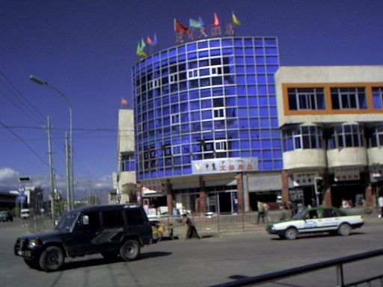
Blue glass

Slide 91
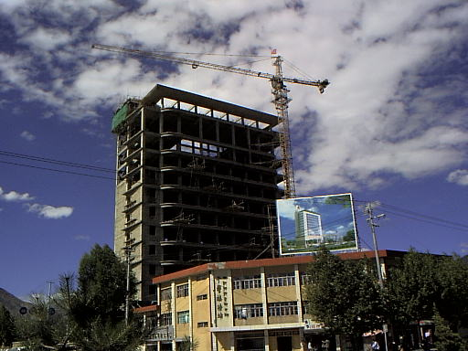

Slide 92
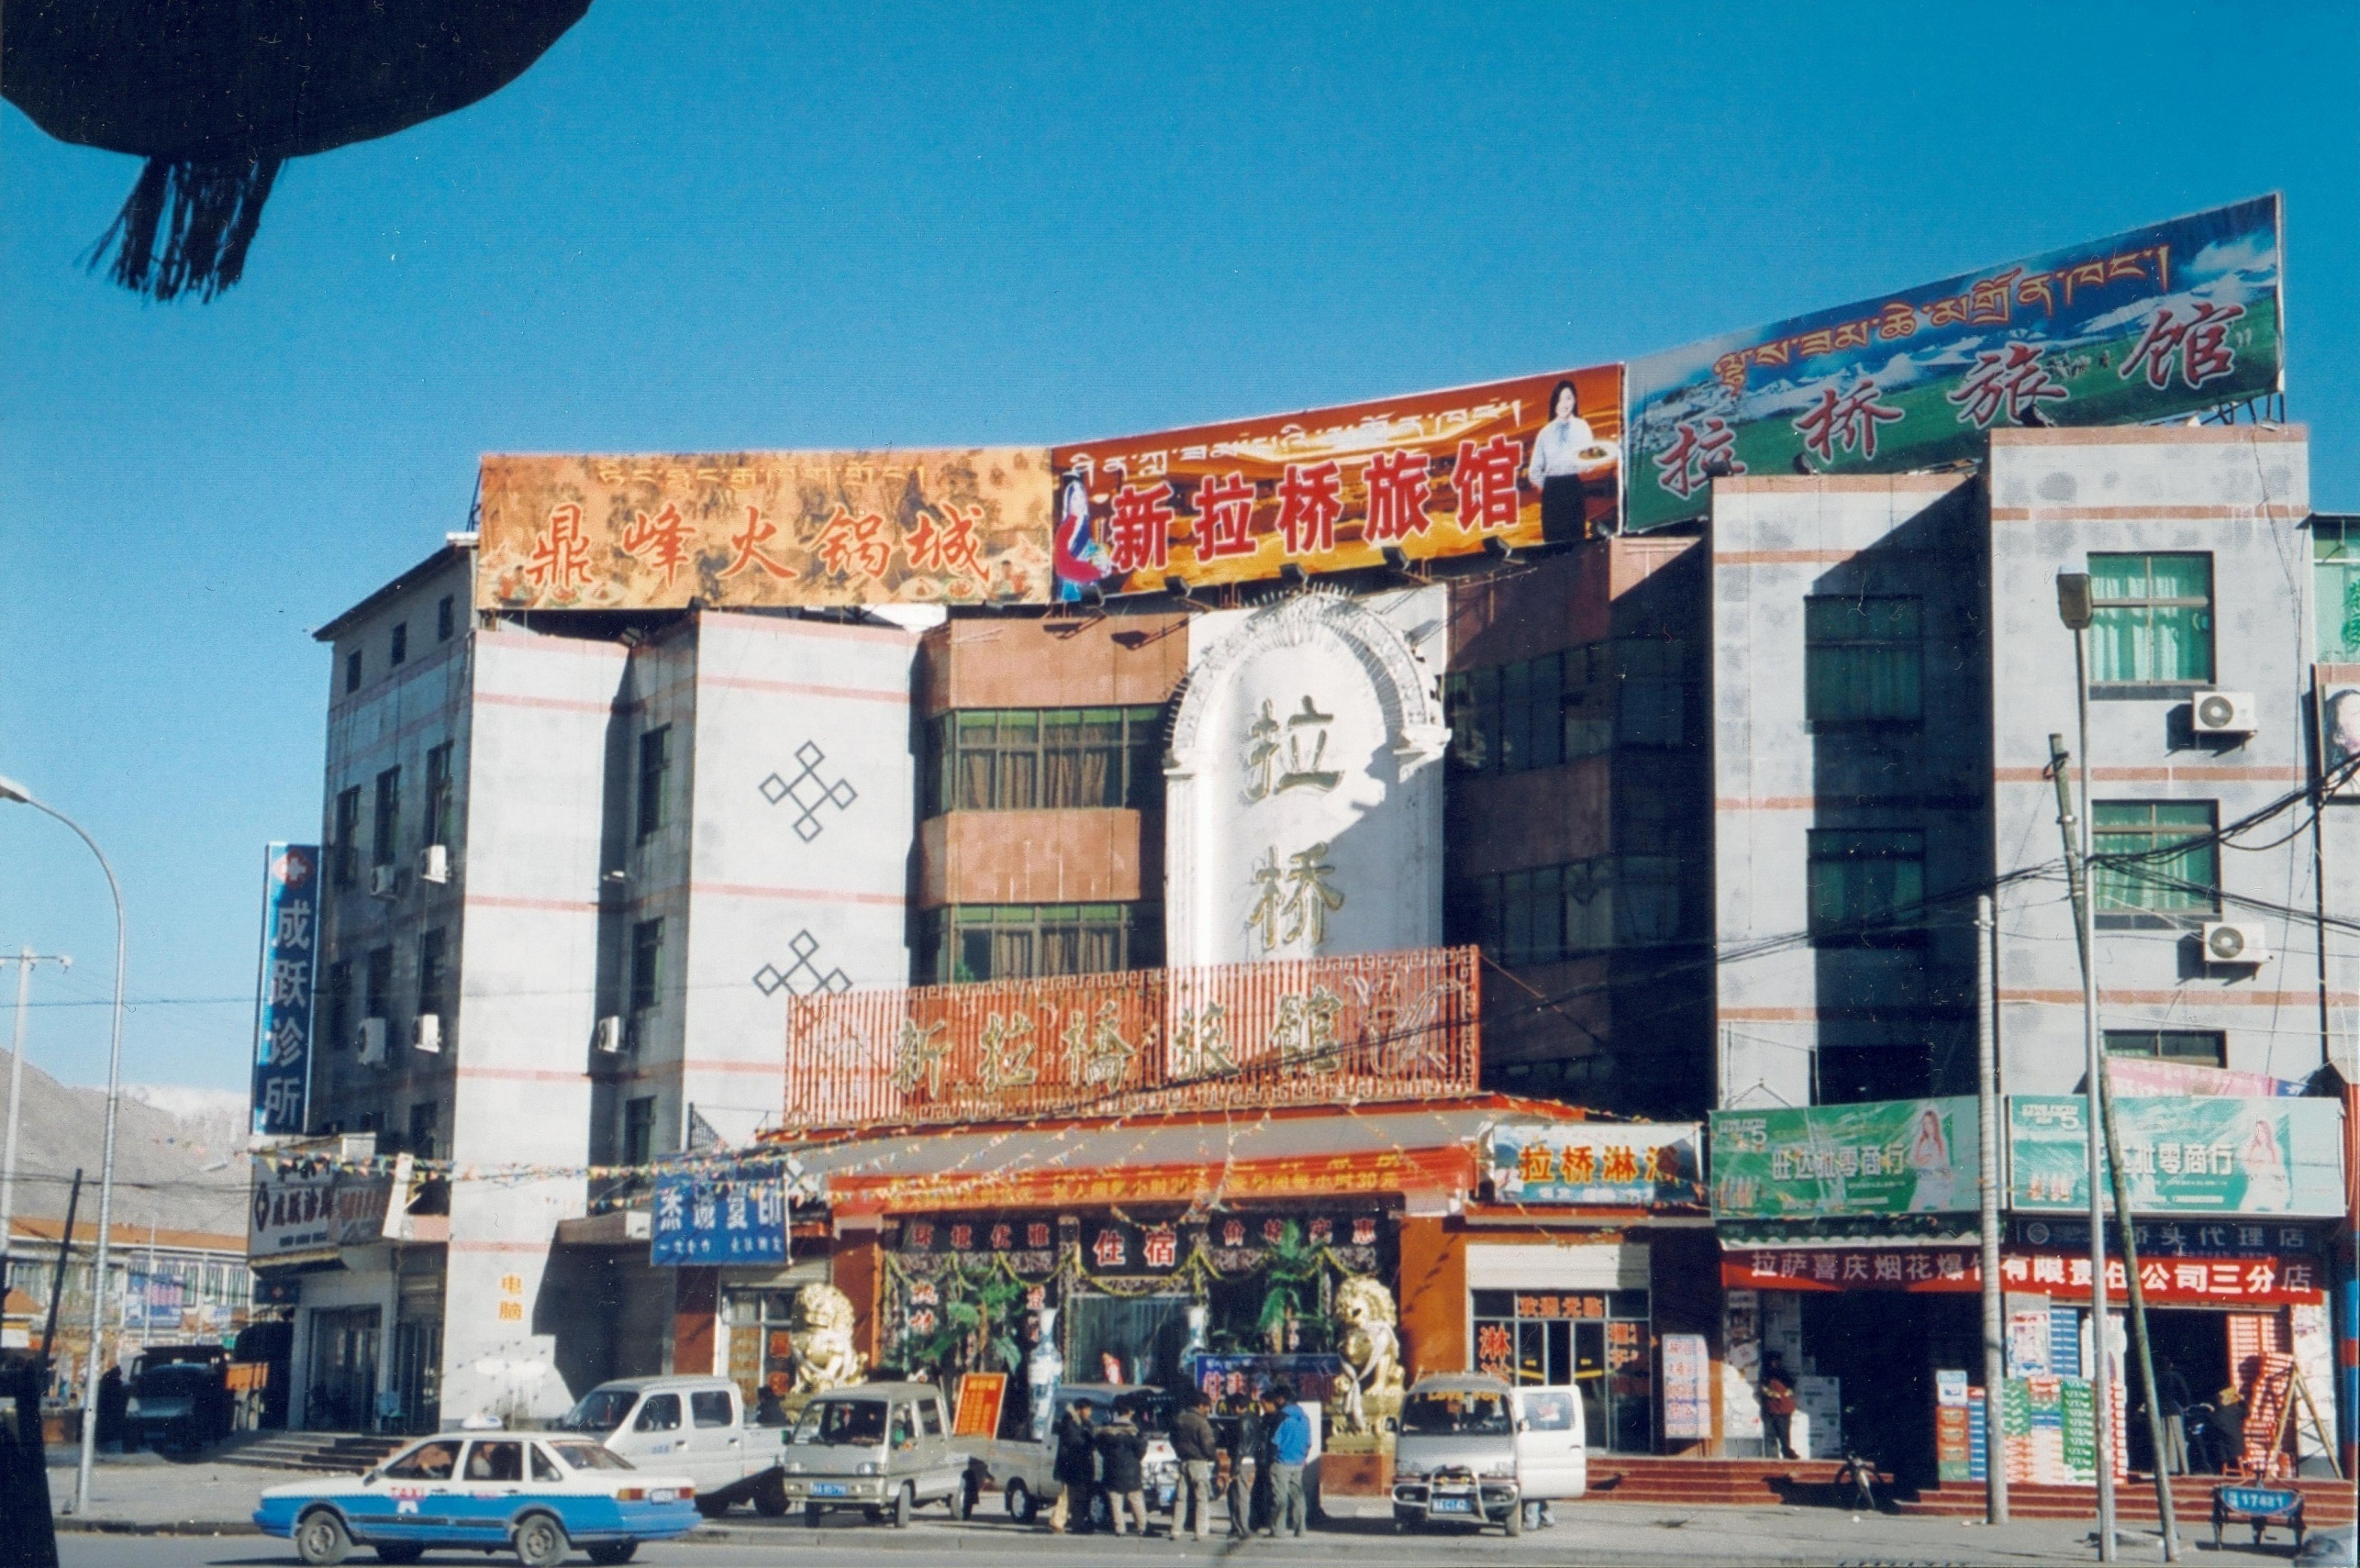
Lhasa Nightclub, 2005

Slide 93
The view from Beijing: gifts
1951 Self-rule

Slide 94
The view from Beijing: gifts
1951 Self-rule
1959 Socialism: class equality and land

Slide 95
The view from Beijing: gifts
1951 Self-rule
1959 Socialism: class equality and land
1980 Household economy and wealth

Slide 96
The view from Beijing: gifts
1951 Self-rule
1959 Socialism: class equality and land
1980 Household economy and wealth
1992 Modernization: infrastructure

Slide 97
The view from Beijing: gifts
1951 Self-rule
1959 Socialism: class equality and land
1980 Household economy and wealth
1992 Modernization: infrastructure
2008 Stablity & a World Power

Slide 98
The view from the periphery: the cost of gifts
Cultural and linguistic erosion
Subsidy dependency
Urban-rural gap
Non-Tibetan migration into towns

Slide 99
Lhasa Nightclub, 2005
Although the law says all signs must include Tibetan and Chinese in equal size, most commercial signs are in Chinese.

Slide 101
TAR Subsidies
TAR Subsidies
The new economy of Tibet expands rapidly because of massive subsidies from Beijing.

Slide 102
Wrong!
No. 9:
Most Tibetans are in exile and cannot return to their home

Slide 103
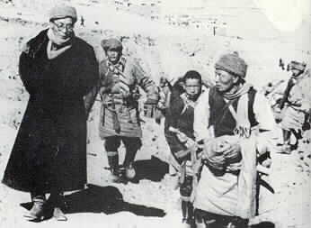
The Dalai Lama escaping from Tibet to India after the uprising of 1959

Slide 104
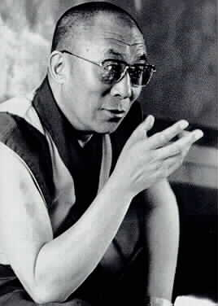

Slide 106
Wrong!
No. 10:
The Tibet-China conflict is hopeless and can’t be solved

Slide 107
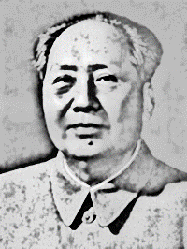
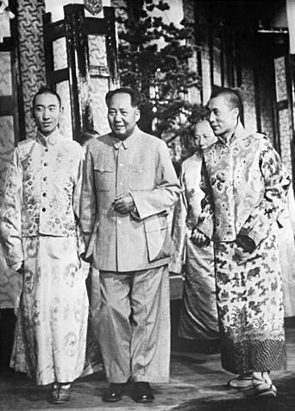
The Dalai Lama and the Panchen Lama meet Mao, Beijing 1954

Slide 108
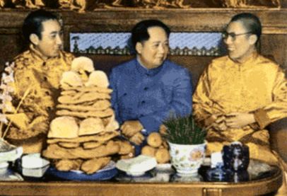
Banquet with Mao, Beiing 1954

Slide 109
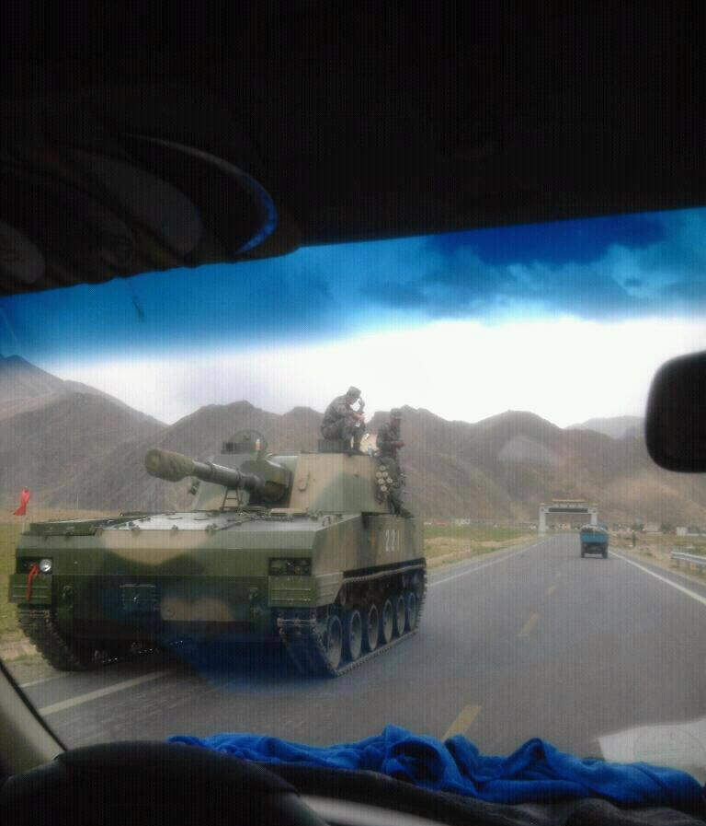
A tank on the main road near Lhasa on May 28 2008, possible evidence that military (PLA) as well as paramilitary (PAP) assets might have been mobilized in response to unrest at that time.

Slide 110
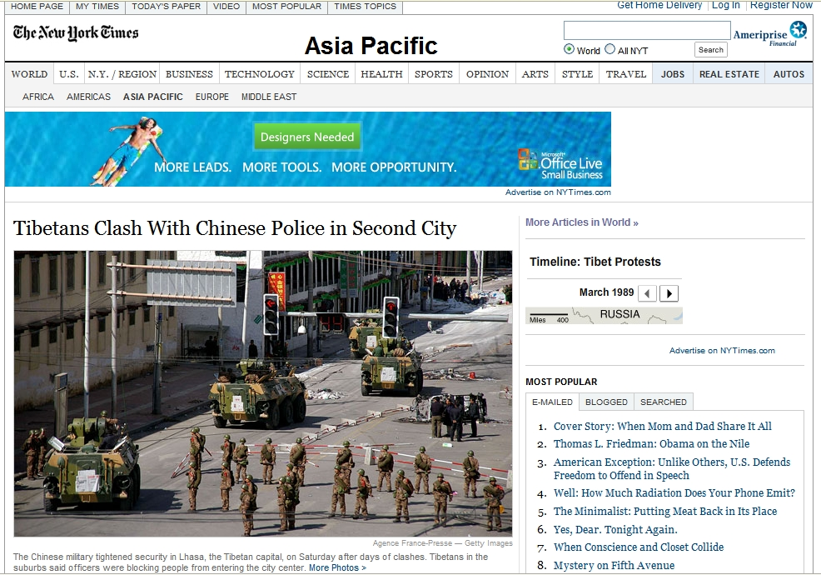
The New York Times, March 16, 2008

Slide 111
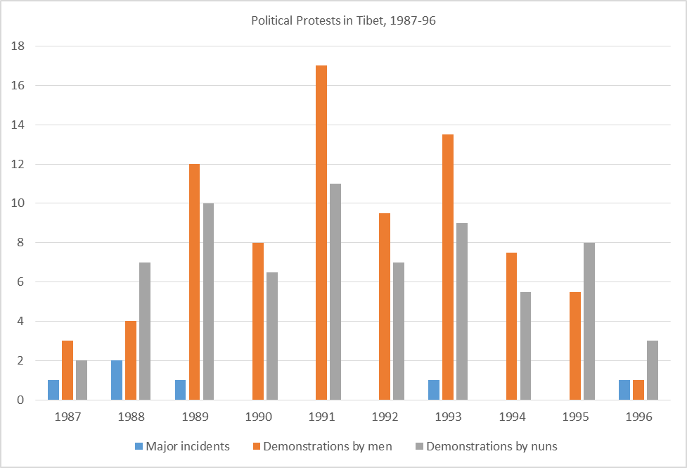
The Background

Slide 112
Ditsa
Map of Tibetan Protests, 1980s
Xinjiang
Xining
.
Gansu province
Qinghai Province
Rebgong
Amdo
Tibetan Autonomous Region
.
.
.
.
Kardze
.
U-tsang
.
Nagchu
.
.
.
Kham
.
Lhundrub
c.150
Maldro Gongkar
Lithang
Tagtse
LHASA
Sichuan Province
Red squares on the map indicate counties or cities (e.g., Lhasa), where protests have taken place. Within a county there may have been numerous protests in different villages or monasteries. Indicative only.

Slide 113
Ditsa
Map of Tibetan Protests, 2008
Gansu
.
.
.
.
Xinjiang
.
.
Xining
.
.
Hualong
.
Lanzhou
Qinghai Province
Chabcha
.
.
.
Chentsa
.
.
.
The eastern part of the Tibetan plateau was more relaxed than in central Tibet (the TAR) until around 2000: no unrest for 30 years
Tsigorthang
Rebgong
Hezuo
.
Mangra
.
Zeku
.
Sangchu
Gepasumdo
.
.
.
.
Chone
Amdo
Yulgan
Luchu
Machu
Thewo
.
.
Darlag
Chigdril
.
.
.
Dzoege
Tibetan Autonomous Region
Pema
.
Sershul
Serthar
.
.
.
Aba
Hongyuan
.
Kyegudo
.
Dzamthang
.
.
.
.
.
.
Dege
Barkham
Kardze
.
.
.
U-tsang
Nagchu
Sog
.
.
Jomda
Draggo
Tawu
.
.
.
Gonjo
Nyagrong
.
Chengdu
.
Damshung
Kham
.
.
.
Lhundrub
Dartsedo
Toelung Dechen
Lithang
Tagtse
Maldro Gongkar
Nyagchukha
LHASA
Markham
Dabpa
Shigatse
Sichuan Province
Sakya
Dranang
Red squares on the map indicate counties or cities (e.g., Lhasa, Xining, Lanzhou, Hezuo) where protests have taken place. Within a county there may have been numerous protests in different villages or monasteries. Sites compiled from various sources where protests are reported to have taken place since March 10, 2008.
April 9, 2008

Slide 114
Self-immolations in Tibet, 2011-14
135 Tibetans have committed self-immolation
since March 2011
22 were women, including two nuns and one schoolgirl
44 are from Ngaba (Aba) Prefecture in Sichuan province
24 were 18 years old or younger
110 have died

Slide 115
Ditsa
Map of Tibetan Immolations, 2011-14
.
Xinjiang
Sengge
Xining
Gansu province
Qinghai Province
18
Rebgong
.
25
.
.
.
Amdo
Machu
.
Darlag
.
Charu
Tibetan Autonomous Region
.
.
51
Thrindu
.
.
.
Dzamthang
Ngaba (Aba)
.
.
Kardze
3
U-tsang
Nagchu
Tawu
.
Karma Gon
Kham
2
Lithang
LHASA
Sichuan Province

Slide 116
Ditsa
Map of Tibetan Immolations, 2011-14
.
Xinjiang
Sengge
Xining
Gansu province
Qinghai Province
18
Rebgong
.
25
.
.
.
Amdo
Machu
.
Darlag
.
Charu
Tibetan Autonomous Region
.
.
51
Thrindu
.
.
.
Dzamthang
Ngaba (Aba)
.
.
Kardze
3
U-tsang
Nagchu
Tawu
.
Karma Gon
Kham
2
Lithang
LHASA
Sichuan Province

Slide 117
The perspective from Beijing:
The geographic range of unrest has spread inland, further from the borders.
The social class of protestors has widened to include all areas of society.

Slide 118
1990
“Tibet's stability affects the state's stability; …Tibet's security concerns national security.”
2006
Tibet is a “core interest” of China.
2013
“Bringing order to the border region first before bringing order to the nation, and bringing stability to Tibet first before bringing order to the border region.”
Line 1: People's Daily, ‘Milestone in Tibet's Reform, Development, and Stability’, Government White Paper, 19 July 2001

Slide 119
China 2012: 160,000 protests
BORDER
Tibet AR 2012: 28 protests
Only the Tibetan protests led to major military mobilization and only Tibet is closed off to individual foreigners

Slide 120
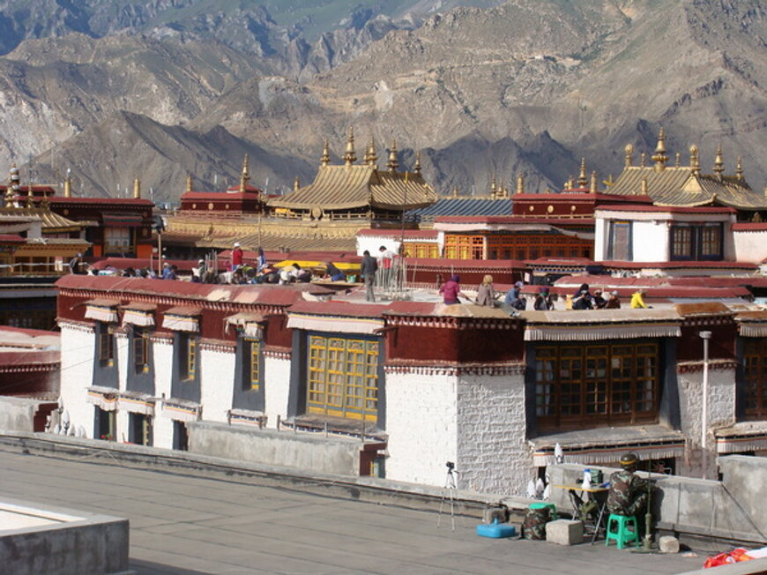
Since 2008, PAP snipers have been on posted on rooftops in some Tibetan areas of Lhasa .

Slide 121
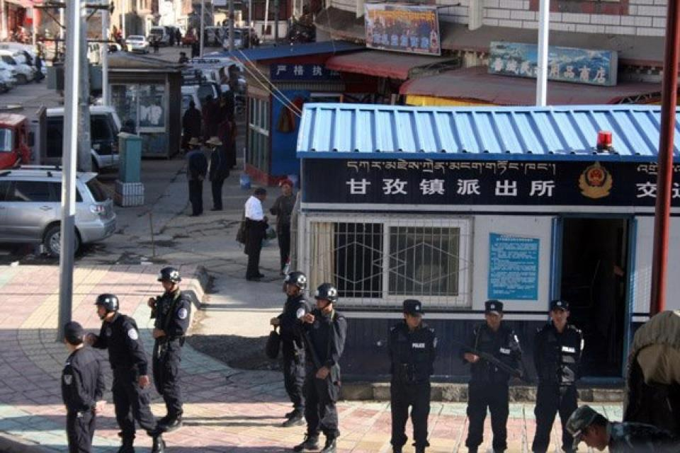
Armed Special Police on duty in Kardze (Ganzi) outside a police post in 2012.

Slide 122
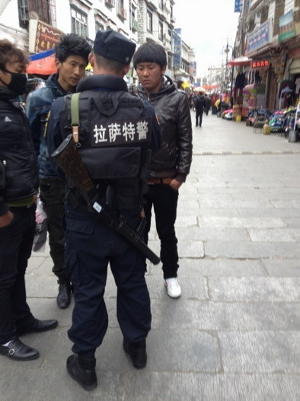
Since 2 immolations in Lhasa in May 2012, Tibetans from eastern area have been banned from Lhasa unless they have special guarantee letters from the police. Ethnic Chinese people and foreigners are rarely checked by police and do not need these special letters to ender Lhasa. Photo: Lhasa, June 12, 2012

Slide 123
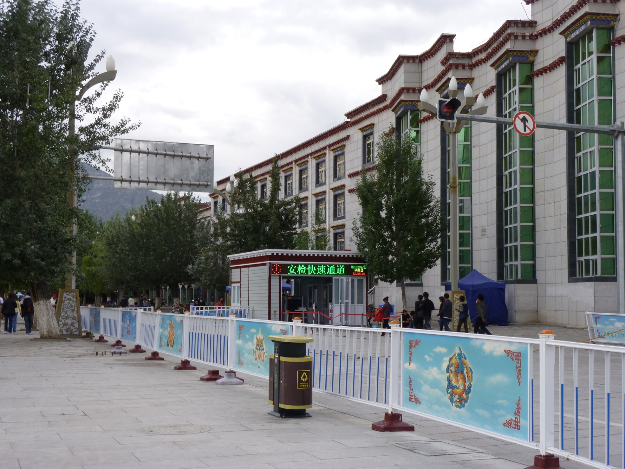
Since 2008, 670 new “convenience police posts” and X-ray checkpoints have been set up on street corners in the TAR

Slide 124
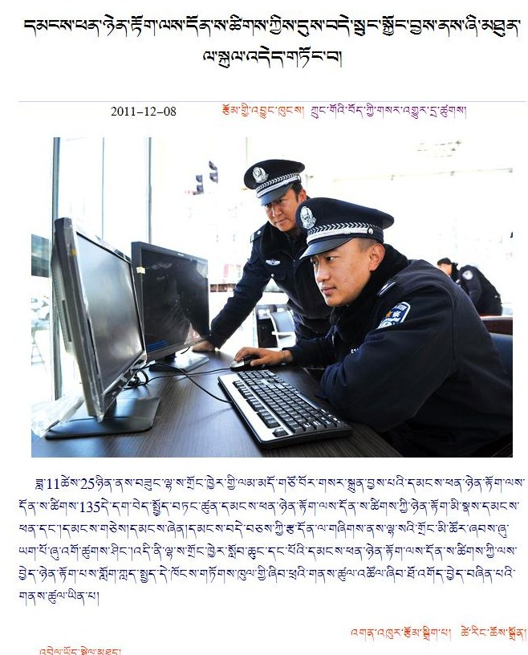
The new police posts are part of a complex new integrated digital system to integrate data management concerning local population, traffic and other issues as part of “stability maintenance” (December 8 2011)

Slide 125
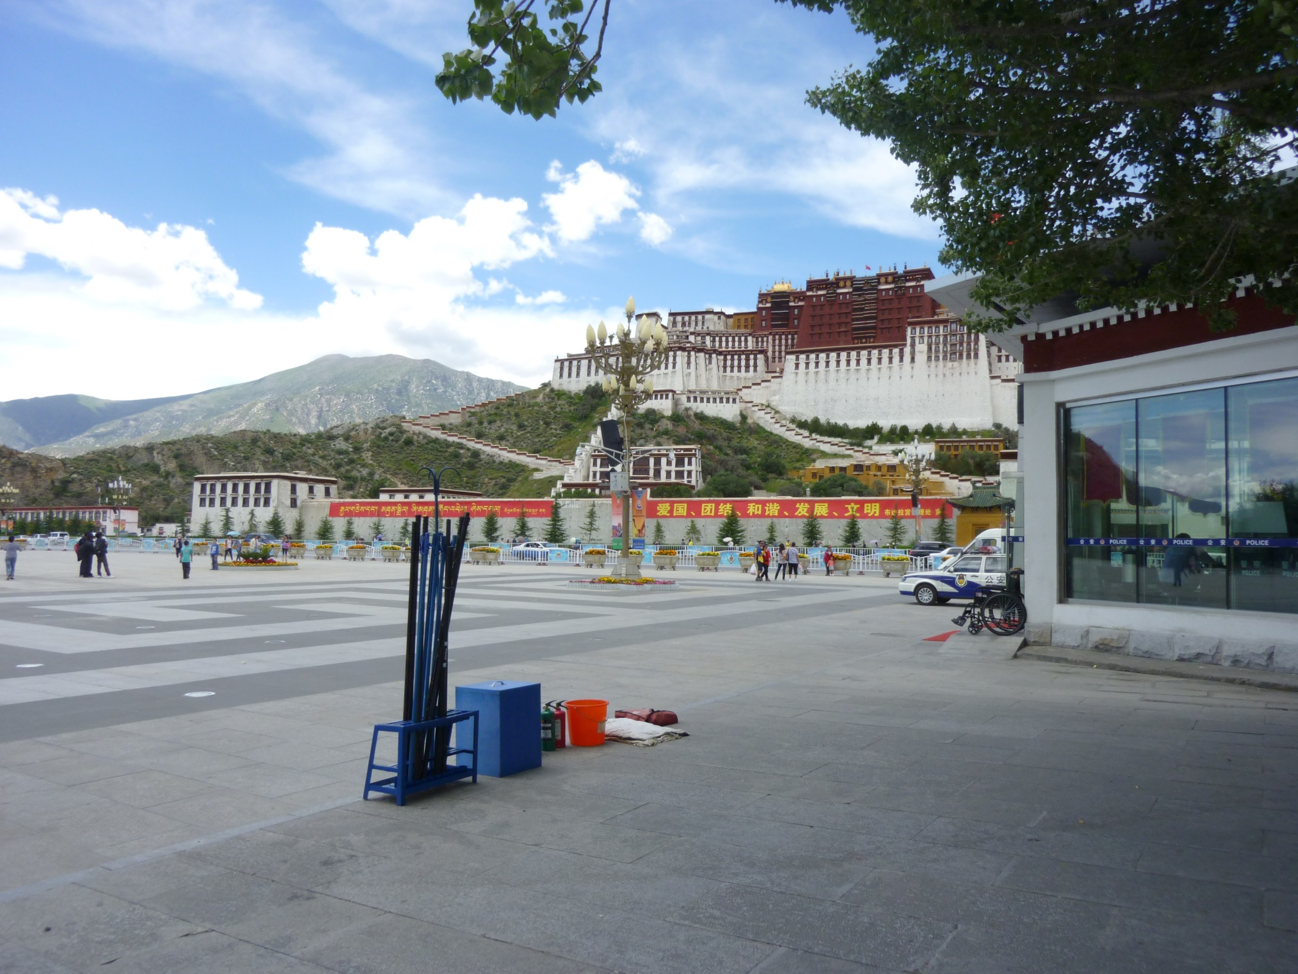
The new police post in front of the Potala Palace has fire-fighting equipment outside in case of a self-immolation.

Slide 126
‘“Patriotism! Unity! Harmony! Prosperity! Civilization!” From the Potala Palace Management Office’
The traditional forms of CCP political education have been stepped up.

Slide 127
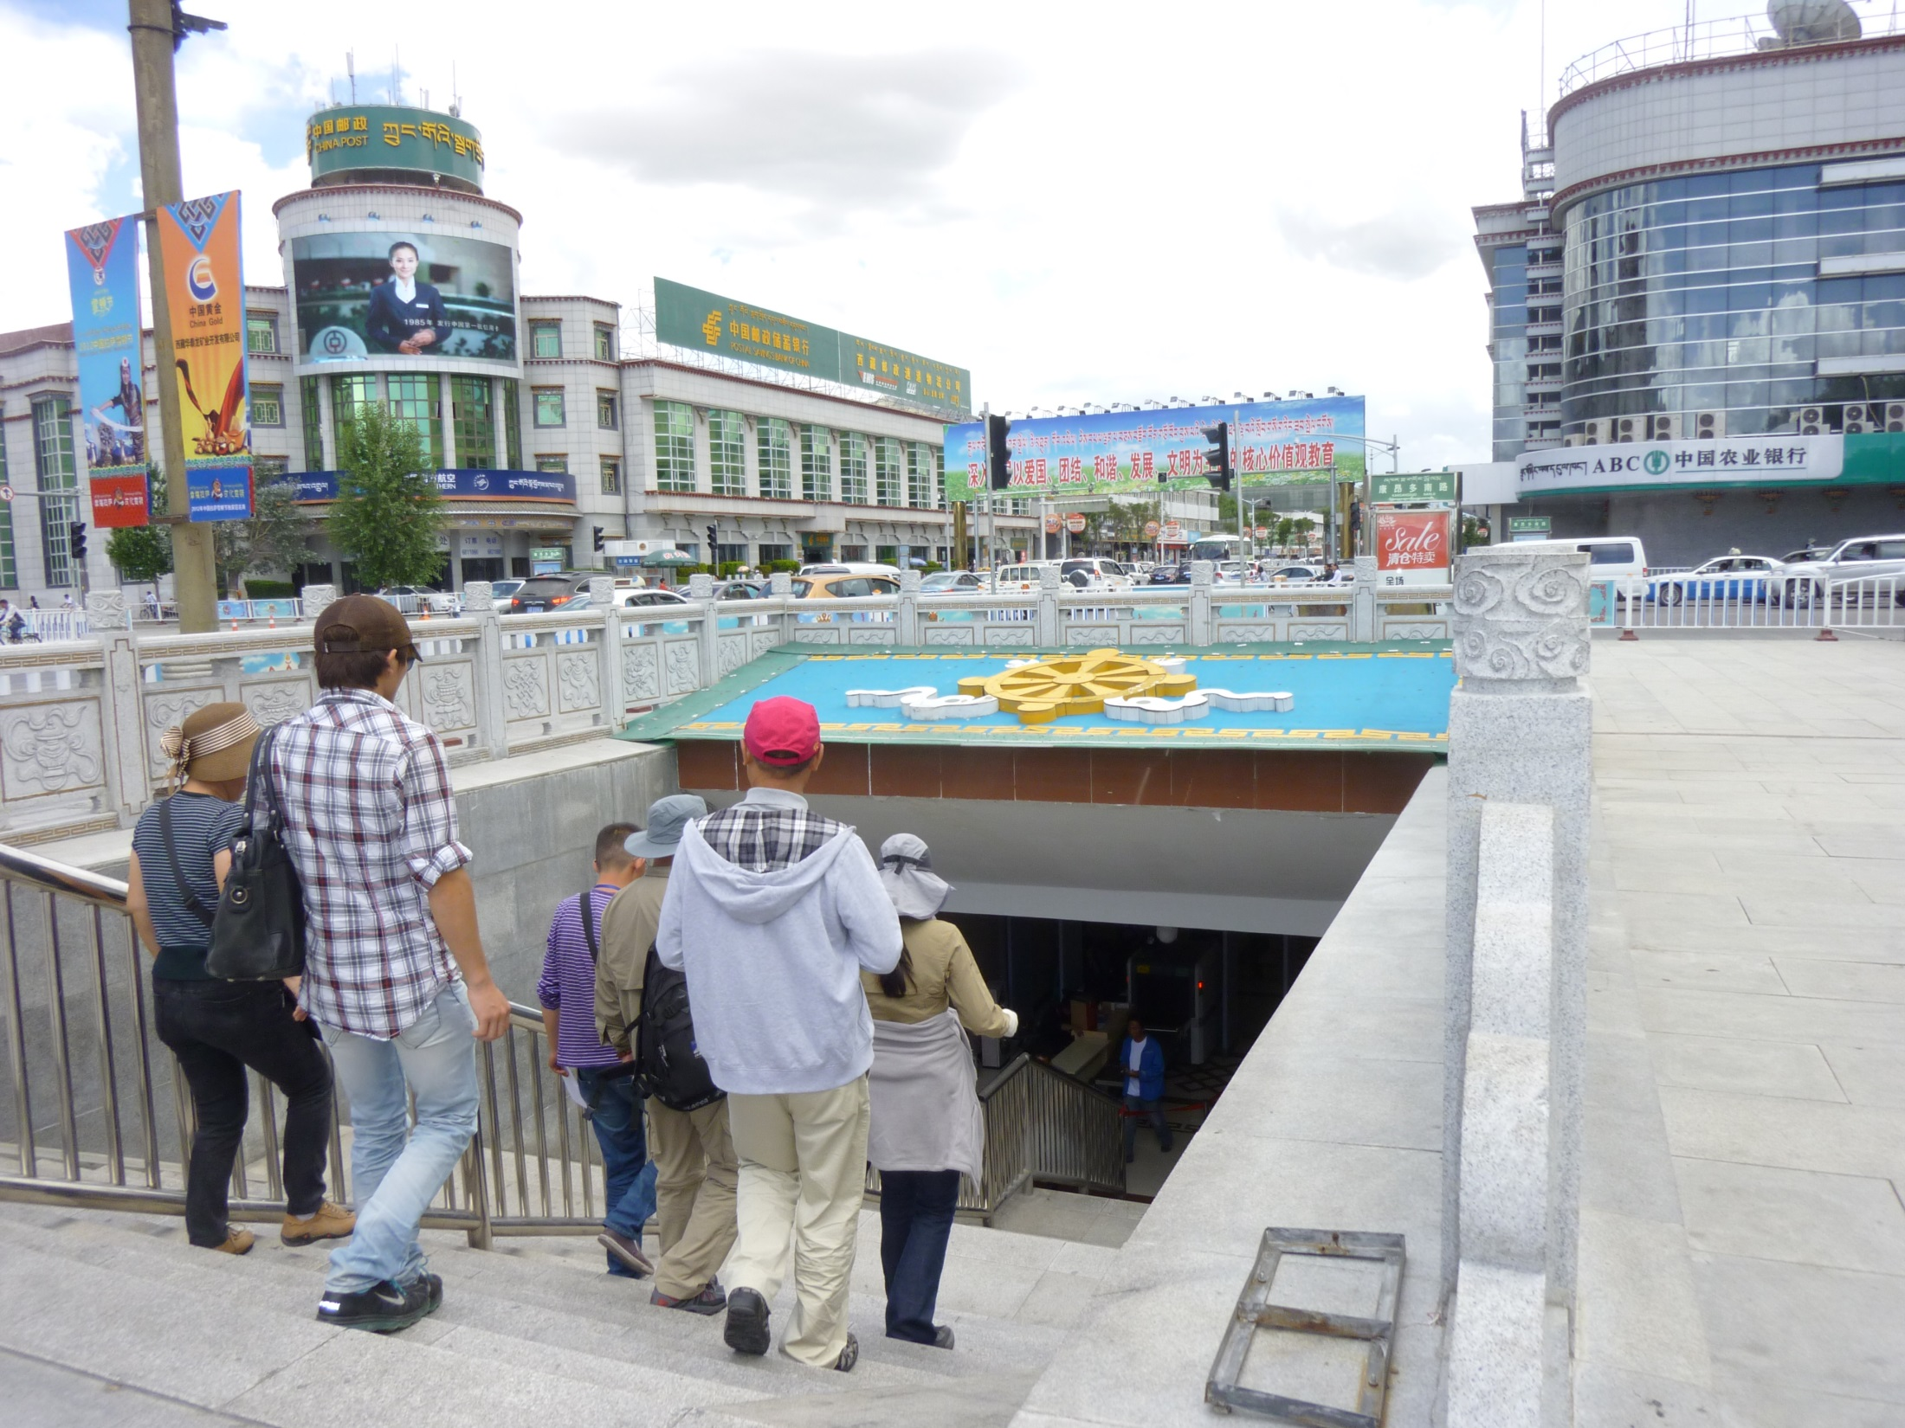
To enter the area around the Potala or around the Jokhang Temple, the two most important religious sites for many Tibetans, they have to go through X-ray checks. Here they have to go through an underpass and a checkpoint to get into the Potala square. Photo: July 2012.

Slide 128
All monasteries and many villages have been forced to accept posters of Mao and the other 3 Chinese leaders, along with Chinese flags. Reports indicate that In most cases, they are required to display these. Photo: November 2011

Slide 129
New buildings at the restored monastery of Ganden, just outside Lhasa, a major religious and tourist site.

Slide 130
These new buildings are nothing to do with religion. They have been built within the 600 year old monastery to house the resident cadre team that now runs the monastery. Since October 2011, every monastery at township level or above in the TAR has a permanent cadre team living in the monastery , for the first time in Chinese history. Photo: July 2012.

Slide 131
Some of the self-immolators left statements describing their reasons for their protests. The most senior of them was a Lama called Sobha Trulku, who committed suicide in Qinghai in January 2012

Slide 132
The Last Message of Lama Sobha, Sonam Wangyal
Golok (Qinghai), January 8, 2012 (extracts)
Especially I pray that His Holiness the Dalai Lama will return to Tibet and remain as Tibet’s temporal and spiritual leader. […]
To all my spiritual brothers and sisters, and the faithful ones living elsewhere: You must unite and work together to build a strong and prosperous Tibetan nation in the future. This is the sole wish of all the Tibetan heroes. […]
Therefore, you must avoid any quarreling amongst yourselves whether it is land disputes or water disputes. You must maintain unity and strength. Give love and education to the children, who should study hard to master all the traditional fields of studies. The elders should carry out spiritual practice as well as maintain and protect Tibetan language and culture by using all your resources and by involving your body, speech and mind. It is extremely important to genuinely practice Buddhist principles in order to benefit the Tibetan cause and also to lead all sentient beings towards the path of enlightenment. Tashi Delek.

Slide 133
The Last Message of Lama Sobha, Sonam Wangyal
Golok (Qinghai), January 8, 2012 (extracts)
Especially I pray that His Holiness the Dalai Lama will return to Tibet and remain as Tibet’s temporal and spiritual leader. […]
To all my spiritual brothers and sisters, and the faithful ones living elsewhere: You must unite and work together to build a strong and prosperous Tibetan nation in the future. This is the sole wish of all the Tibetan heroes. […]
Therefore, you must avoid any quarreling amongst yourselves whether it is land disputes or water disputes. You must maintain unity and strength. Give love and education to the children, who should study hard to master all the traditional fields of studies. The elders should carry out spiritual practice as well as maintain and protect Tibetan language and culture by using all your resources and by involving your body, speech and mind. It is extremely important to genuinely practice Buddhist principles in order to benefit the Tibetan cause and also to lead all sentient beings towards the path of enlightenment. Tashi Delek.

Slide 134
The Last Message of Lama Sobha, Sonam Wangyal
Golok (Qinghai), January 8, 2012 (extracts)
Especially I pray that His Holiness the Dalai Lama will return to Tibet and remain as Tibet’s temporal and spiritual leader. […]
To all my spiritual brothers and sisters, and the faithful ones living elsewhere: You must unite and work together to build a strong and prosperous Tibetan nation in the future. This is the sole wish of all the Tibetan heroes. […]
Therefore, you must avoid any quarreling amongst yourselves whether it is land disputes or water disputes. You must maintain unity and strength. Give love and education to the children, who should study hard to master all the traditional fields of studies. The elders should carry out spiritual practice as well as maintain and protect Tibetan language and culture by using all your resources and by involving your body, speech and mind. It is extremely important to genuinely practice Buddhist principles in order to benefit the Tibetan cause and also to lead all sentient beings towards the path of enlightenment. Tashi Delek.

Slide 135
The Last Message of Lama Sobha, Sonam Wangyal
Golok (Qinghai), January 8, 2012 (extracts)
Especially I pray that His Holiness the Dalai Lama will return to Tibet and remain as Tibet’s temporal and spiritual leader. […]
To all my spiritual brothers and sisters, and the faithful ones living elsewhere: You must unite and work together to build a strong and prosperous Tibetan nation in the future. This is the sole wish of all the Tibetan heroes. […]
Therefore, you must avoid any quarreling amongst yourselves whether it is land disputes or water disputes. You must maintain unity and strength. Give love and education to the children, who should study hard to master all the traditional fields of studies. The elders should carry out spiritual practice as well as maintain and protect Tibetan language and culture by using all your resources and by involving your body, speech and mind. It is extremely important to genuinely practice Buddhist principles in order to benefit the Tibetan cause and also to lead all sentient beings towards the path of enlightenment. Tashi Delek.

Slide 137
“On the Tibetan issue too, we need to think of mutual interests of both [Tibet and Beijing] instead of pursuing a ‘I win, you lose’ policy, which is not appropriate, and will not help resolve the situation.”
The Dalai Lama, 2014

Slide 138
Part 7
Tibet:
Resolving the dispute
A resolution of the Tibetan-China dispute depends on policy decisions in Beijing.
These decisions depend on the outcome of fierce debate among the policy elite in China about China’s Tibet policies.

Slide 139
Tibet Policy Competitors
Pragmatists
Neo-leftists
Hard-line management
Tibetan Cultural Advocates
China Nationalists
United Front
Hard-line management
Six main groups of opinion about Tibet policy can be listed. Some groups are driven by ideology, others by personal interests, and others have deep cultural or historical connections to the Tibetan issue.

Slide 140
Tibet Policy Competitors
Pragmatists
Neo-leftists
Hard-line management
Tibetan Cultural Advocates
China Nationalists
United Front
Hard-line management
The dominant school of policy now can be called the “Hard-line management” group. It is not driven by ideology, but by a pratical assumption that hard-line methods are the only way to manage the Tibetan issue and maintain stability. This view is associated with Hu Jintao.

Slide 141
Tibet Policy Competitors
Pragmatists
Hard-line management
Tibetan Cultural Advocates
China Nationalists
United Front
Hard-line management
Neo-leftists
The neo-leftists have a Marxist interpretation of the Tibetan issue, which sees the problem in terms of residual class emnity against the CCP. This group is led by Chen Kuiyuan, Party Secretary of the TAR 1992-2000, who pushed the Party to view elements of Tibetan culture, language and relgiion as sources of threat to the Party’s rule.

Slide 142
Tibet Policy Competitors
Pragmatists
Hard-line management
Tibetan Cultural Advocates
United Front
Hard-line management
Neo-leftists
China Nationalists
China nationalists see the Tibet issue as a remnant of imperialist efforts by western powers to humiliate and weaken China. They use this view, which has some historical basis, to ignore the legitimate concerns raised by Tibetans within Tibet.

Slide 143
Tibet Policy Competitors
Pragmatists
Hard-line management
United Front
Hard-line management
Neo-leftists
China Nationalists
Lhasa Appointees
The Party has continued to appoint loyal Tibetans from poor or disadvantaged family backgrounds as leaders in Tibet, since they have the most reason to be grateful to the Party, even though they may have limited cultural knowledge or leadership skills. They are rumoured to oppose any concessions or moderation of policy In case it weakens their positions. This view is associated with Ragti (Raidi).

Slide 144
Tibet Policy Competitors
Pragmatists
United Front
Hard-line management
Neo-leftists
China Nationalists
Lhasa Appointees
Tibetan Cultural Advocates
The Tibetans who were appointed to be leaders by the Party in the 1950s came from highly educated backgrounds, and expected the Party to respect Tibetan culture and religion. They are the strongest force for policy. But they are in the 90s now or have died, such as the 10th Panchen Lama, Ngapo Ngawang Jigme, Baba Phuntsog Wanggyal, and Yangling Dorje.

Slide 145
Tibet Policy Competitors
United Front
Hard-line management
Neo-leftists
China Nationalists
Pragmatists
Lhasa Appointees
Tibetan Cultural Advocates
The most important group is the Pragmatists – people who supported the hard-line approach of Hu Jintao when he was in power. But they will only support an approach that is successful – and Hu Jintao’s policies in Tibet have failed. They are open to whatever approach will bring stability to China and Tibet.

Slide 146
Tibet Policy Competitors
Hard-line management
Neo-leftists
China Nationalists
United Front
Pragmatists
Lhasa Appointees
Tibetan Cultural Advocates
Control of Tibet policy is largely in the hands of the United Front. Its current officials were promoted to carry out hard-line policies after 1991, and it is in their interest to persuade leaders to maintain the hard-line approach.

Slide 147
Tibet Policy Competitors
Hard-line management
Neo-leftists
China Nationalists
United Front
Pragmatists
Lhasa Appointees
Tibetan Cultural Advocates
Four of these groups have strong connections to the United Front. For different reasons, it carries out the policies that suit their interests and ideas. But the Pragmatists have only a weak connection to the United Front and the hard-line approach. Their connection will change if they think that policy is failing.

Slide 148
Thank you!

Slide 149
Tibet Policy Competitors
Hard-line management
Neo-leftists
China Nationalists
Is Tibetan unrest caused by outside instigation or by excessive policies?
United Front
Pragmatists
Lhasa Appointees
Will relaxing policy increase stability?
Tibetan Cultural Advocates
Under Hu Jintao, all the groups except the Cultural Advocates argued that unrest was caused by external forces, not by incorrect policies. And they believed that relaxing policy would increase instability. These were the key issues.

Slide 151
The perspective from Beijing:
Political unity brings social and economic happiness
Part 2: Viewed from China

Slide 152
Part 1: Viewed from outside
Part 2: Viewed from China
Part 3: Historical complexity
Part 4: The regional context
Part 5: China’s perspective and response
Part 6: Tibetan perspectives
Part 7: The current situation: what do we do know?
Part 8: Solutions?

Slide 154
The 14th Dalai Lama, aged 5 in 1940

Slide 156
Part 1: Viewed from outside
Part 2: Viewed from China
Part 3: Historical complexity
Part 4: The regional context
Part 5: Tibetan perspectives
Part 6: What we do know

Slide 157
Part 1: Viewed from outside
Part 2: Viewed from China
Part 3: Historical complexity
Part 4: The regional context
Part 5: China’s perspective and response
Part 6: Tibetan perspectives
Part 7: The current situation: what do we do know?
Part 8: Solutions?

Slide 158
China’s response

Slide 159
China’s external policy for Tibet
Get all countries to recognise Tibet as part of China
Get neighbouring countries to ban anti-Chinese activities on their soil
Get beyond-the-periphery countries to say they oppose Tibetan independence
Get all countries to refuse to meet the Dalai Lama

Slide 160
China’s external policy for Tibet
Get all countries to recognise Tibet as part of China
Get neighbouring countries to ban anti-Chinese activities on their soil
Get beyond-the-periphery countries to say they oppose Tibetan independence
Get all countries to refuse to meet the Dalai Lama
Achieved!
Achieved in India, Nepal, the Stans & Russia!
Achieved in the US, the UK, France, Denmark….
Nearly achieved except in the US, Slovenia, Latvia, Lithuania….

Slide 161
Part 1: Viewed from outside
Part 2: Viewed from China
Part 3: Historical complexity
Part 4: The regional context
Part 5: China’s perspective and response
Part 6: Tibetan perspectives
Part 7: The current situation: what do we do know?
Part 8: Solutions?

Slide 162
The cultural cost

Slide 163
Ideology

Slide 164
The question of precision: The “Cultural Genocide” accusation
Part 3: Internal policies

Slide 165
Part 1: Viewed from outside
Part 2: Viewed from China
Part 3: Historical complexity
Part 4: The regional context
Part 5: China’s perspective and response
Part 6: Tibetan perspectives
Part 7: The current situation: what do we do know?
Part 8: Solutions?

Slide 166
Part 1: Viewed from outside
Part 2: Viewed from China
Part 3: Historical complexity
Part 4: The regional context
Part 5: China’s perspective and response
Part 6: Tibetan perspectives
Part 7: The current situation: what do we do know?
Part 8: Solutions?

Slide 167
end

Slide 168
Part 4
Part 5: Assessing Conflict
The Tibetan China issue
Tibetan Exile Objectives
1950-59 Cultural Autonomy
1959-74 Independence
1974-89 Association
1992+/- “High Degree of Autonomy”

Slide 169
Part 4
Part 5: Assessing Conflict
The Tibetan-China issue
The Position of the US & the Western Bloc
1956-71 Pro-Independence
1971-87 (quiescent)
1987- Pro-Human Rights/Cultural Rights
2003 India restates its recognition of the TAR as part of the PRC
2008 UK accepts Tibet is part of the PRC, ends support for Tibet’s autonomous status

