Slide 1
10 Things to Know about Tibet
Gray Tuttle
Leila Hadley Luce Associate Professor of Modern Tibet
East Asian Languages and Cultures Department
Columbia University

Slide 2
1) Tibet Is Massive
Notes:
Map by Quentin Devers

Slide 3
Tibet
Notes:
Map by Quentin Devers

Slide 4
Tibet
Notes:
Map by Quentin Devers

Slide 5
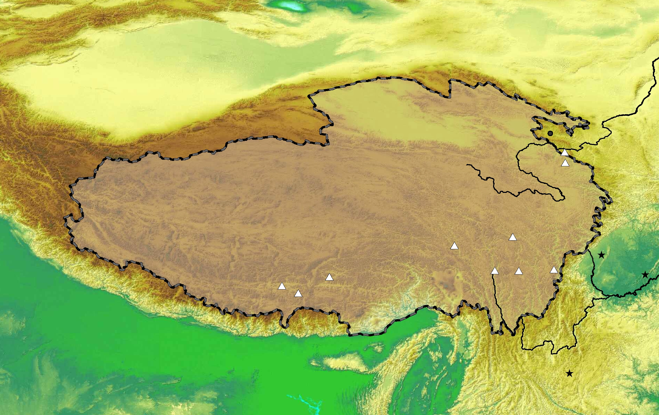
Tibetan Autonomous Units of PRC
Notes:
Map by Lex Berman

Slide 6
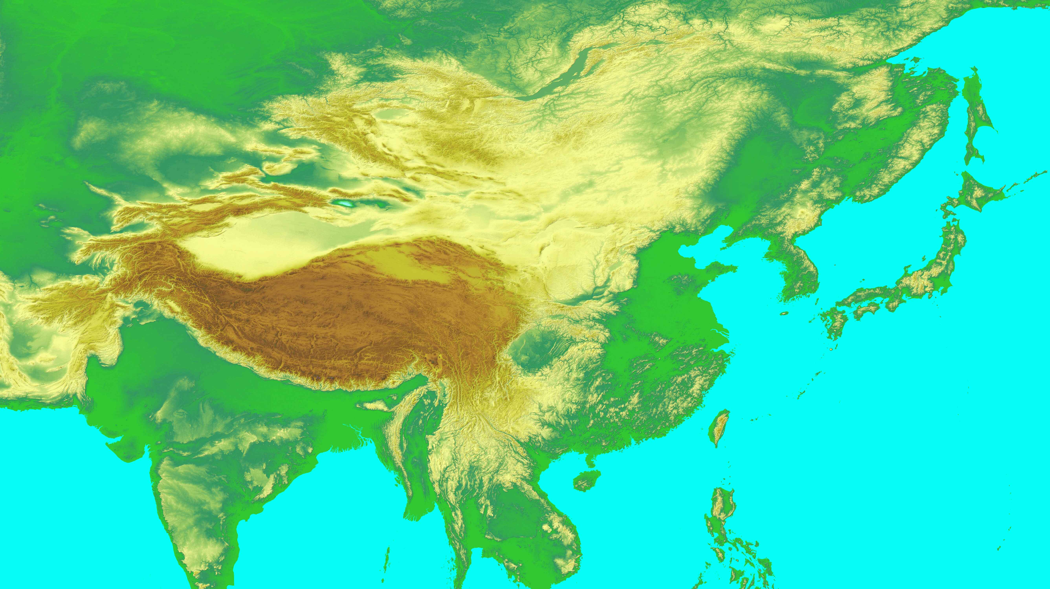
2) Tibet: Roof of the World
Notes:
High altitude, 15,000’ AVERAGE (higher than the highest point in lower 48 states)
and source of many of the world’s great rivers (watershed of Asia:
-- Indus, Sutlej, Ganges, and Brahmaputra to India;
Salween and Mekong to Southeast Asia;
Yangtze and Yellow Rivers to China proper).
In total, one seventh of the world’s potential hydro-electric power.
Map by Lex Berman.

Slide 7
Spread and evolution of Denisovans
Notes:
Map by John D. Croft –wikipedia; Denisovans “Paleolithic species of genus Homo or sub-species of Homo sapiens dating back 41,000, but only discovered 2010…in Siberia, where Neanderthals and modern humans also lived (and with whom they are known to have mated, including the ancestors of Tibetans. They seem to have been distinct from the later out-of-Africa migrations associated with modern human”
Why am I telling you this? Because one of the most impressive examples of human adaptation to tough environmental conditions is that of Tibetans to the low oxygen condition of the high-altitude Tibetan plateau, which can only be convincingly explained by DNA from Denisovans passing to humans. I quote from an article in Nature: “Scanning a larger set of worldwide populations, we find that the selected haplotype is only found in Denisovans and in Tibetans, and at very low frequency among Han Chinese.”
Emilia Huerta-Sánchez, Xin Jin, Asan, Zhuoma Bianba, Benjamin M. Peter, Nicolas Vinckenbosch, Yu Liang, Xin Yi, Mingze He, Mehmet Somel, Peixiang Ni, Bo Wang, Xiaohua Ou, Huasang, Jiangbai Luosang, Zha Xi Ping Cuo, Kui Li, Guoyi Gao, Ye Yin, Wei Wang, Xiuqing Zhang, Xun Xu, Huanming Yang, Yingrui Li, Jian Wang et al. (Scholars from U.S. UC-Berkeley, Iowa; PRC-including Guangzhou, Shenzhen, Tianjin, Hong Kong, Lhasa; Turkey; Saudi Arabia and Denmark, etc.” Altitude adaptation in Tibetans caused by introgression of Denisovan-like DNA” Nature 512, 194–197 (14 August 2014) doi:10.1038/nature13408.

Slide 8
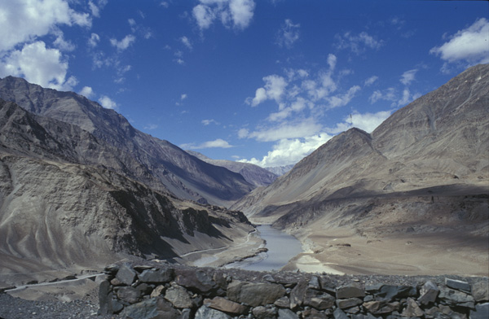
Ladakh, Indus River Valley
Notes:
Not my photo

Slide 9
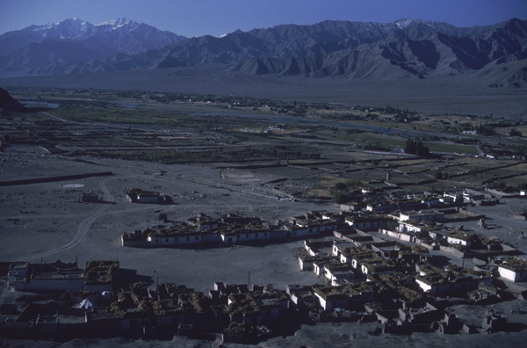
Indus River Valley
Notes:
Importance of irrigation, can quickly turn useless land into valuable asset. Not my photo

Slide 10
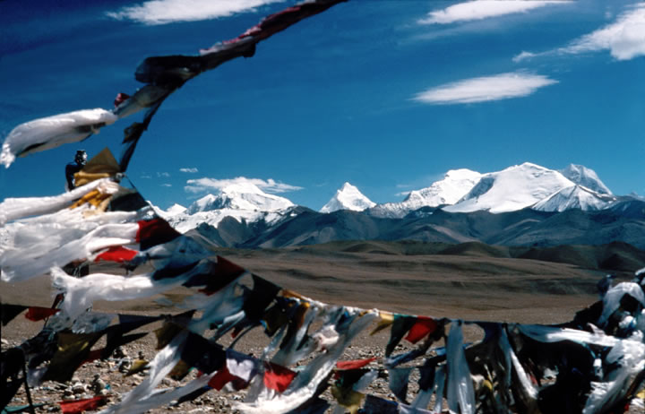
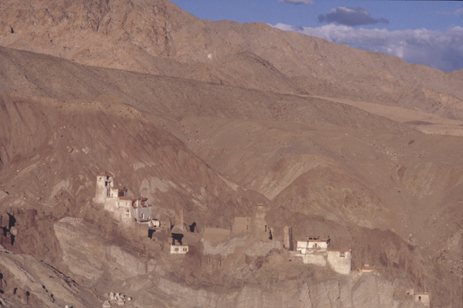
Ngari, Western Tibet
Notes:
Not my photo

Slide 11
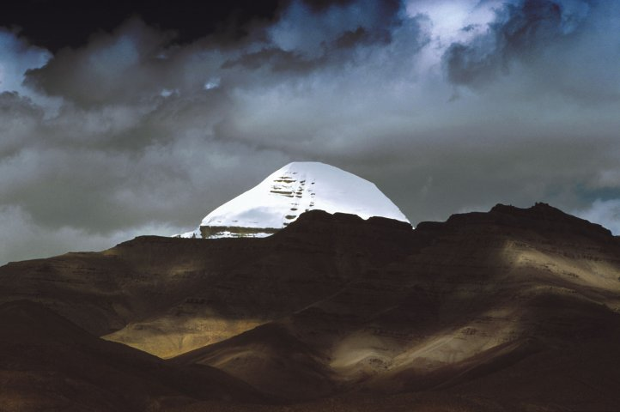
Mount Kailash, W. Tibet
Notes:
Not my photo

Slide 12
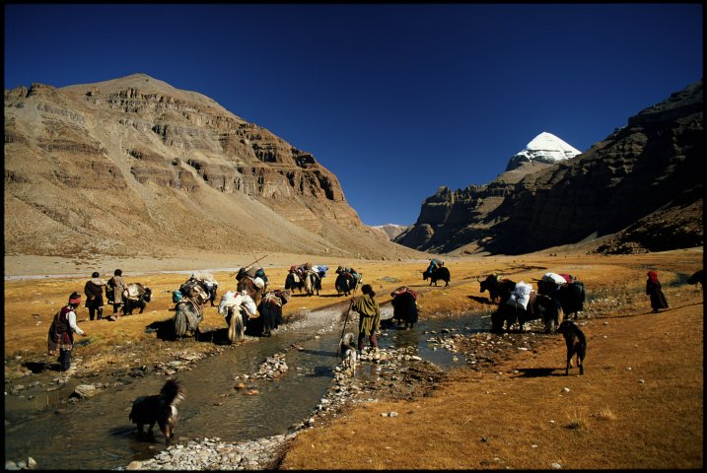
Notes:
Not my photo,

Slide 13
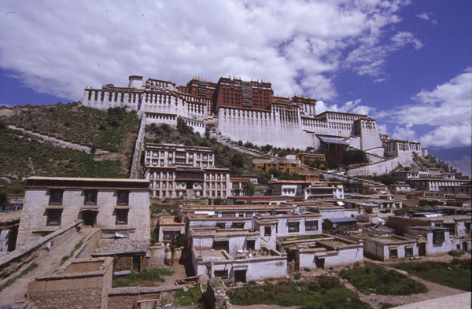
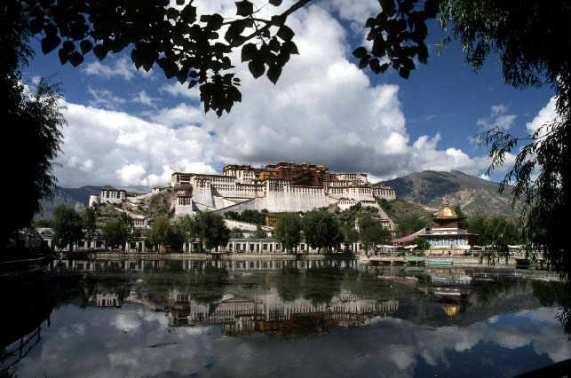
Central Tibet, Potala Palace
Notes:
My photo

Slide 14
Himalayan Tibetan Buddhist Cultural Area
Nepal
Bhutan
Notes:
Only one of these is my photo

Slide 15
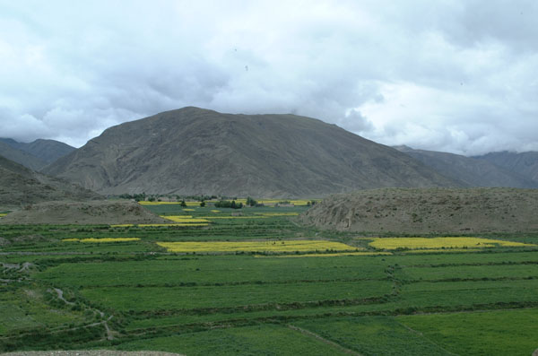
Yarlung Valley in Central Tibet
Notes:
Not my photo

Slide 16
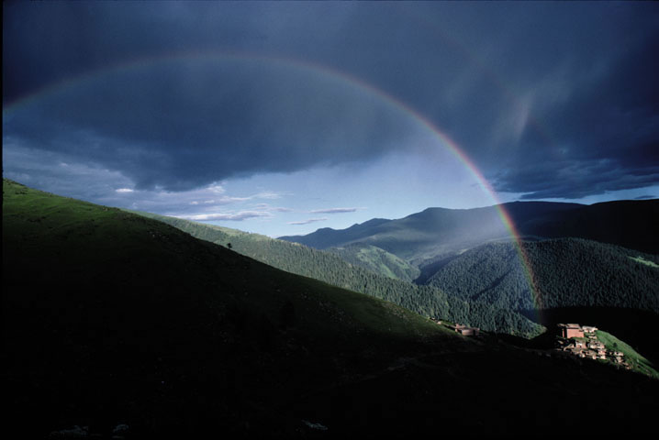
Khams, Eastern Tibet
Notes:
Not my photo

Slide 17
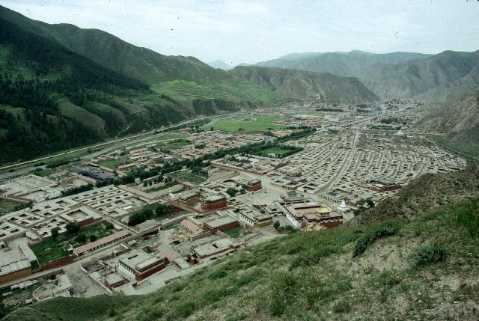
Amdo, Northeastern Tibet
Notes:
my photo

Slide 18
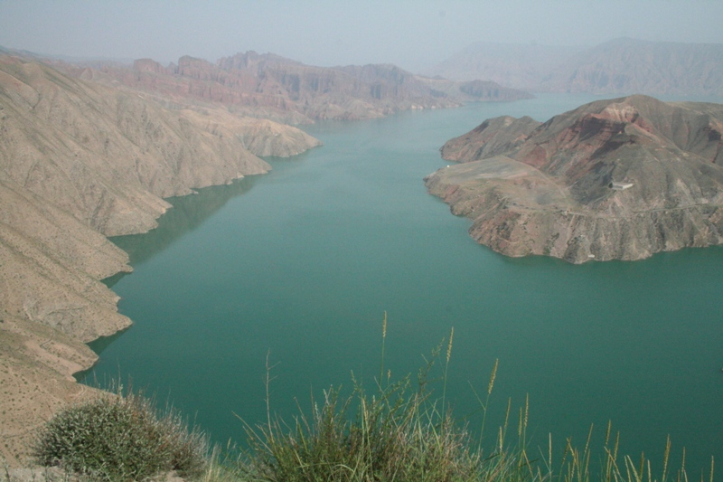
“Yellow” River in Tibet (Peacock River)

Slide 19
Eastern Grasslands & Woodlands
Notes:
my photos

Slide 20
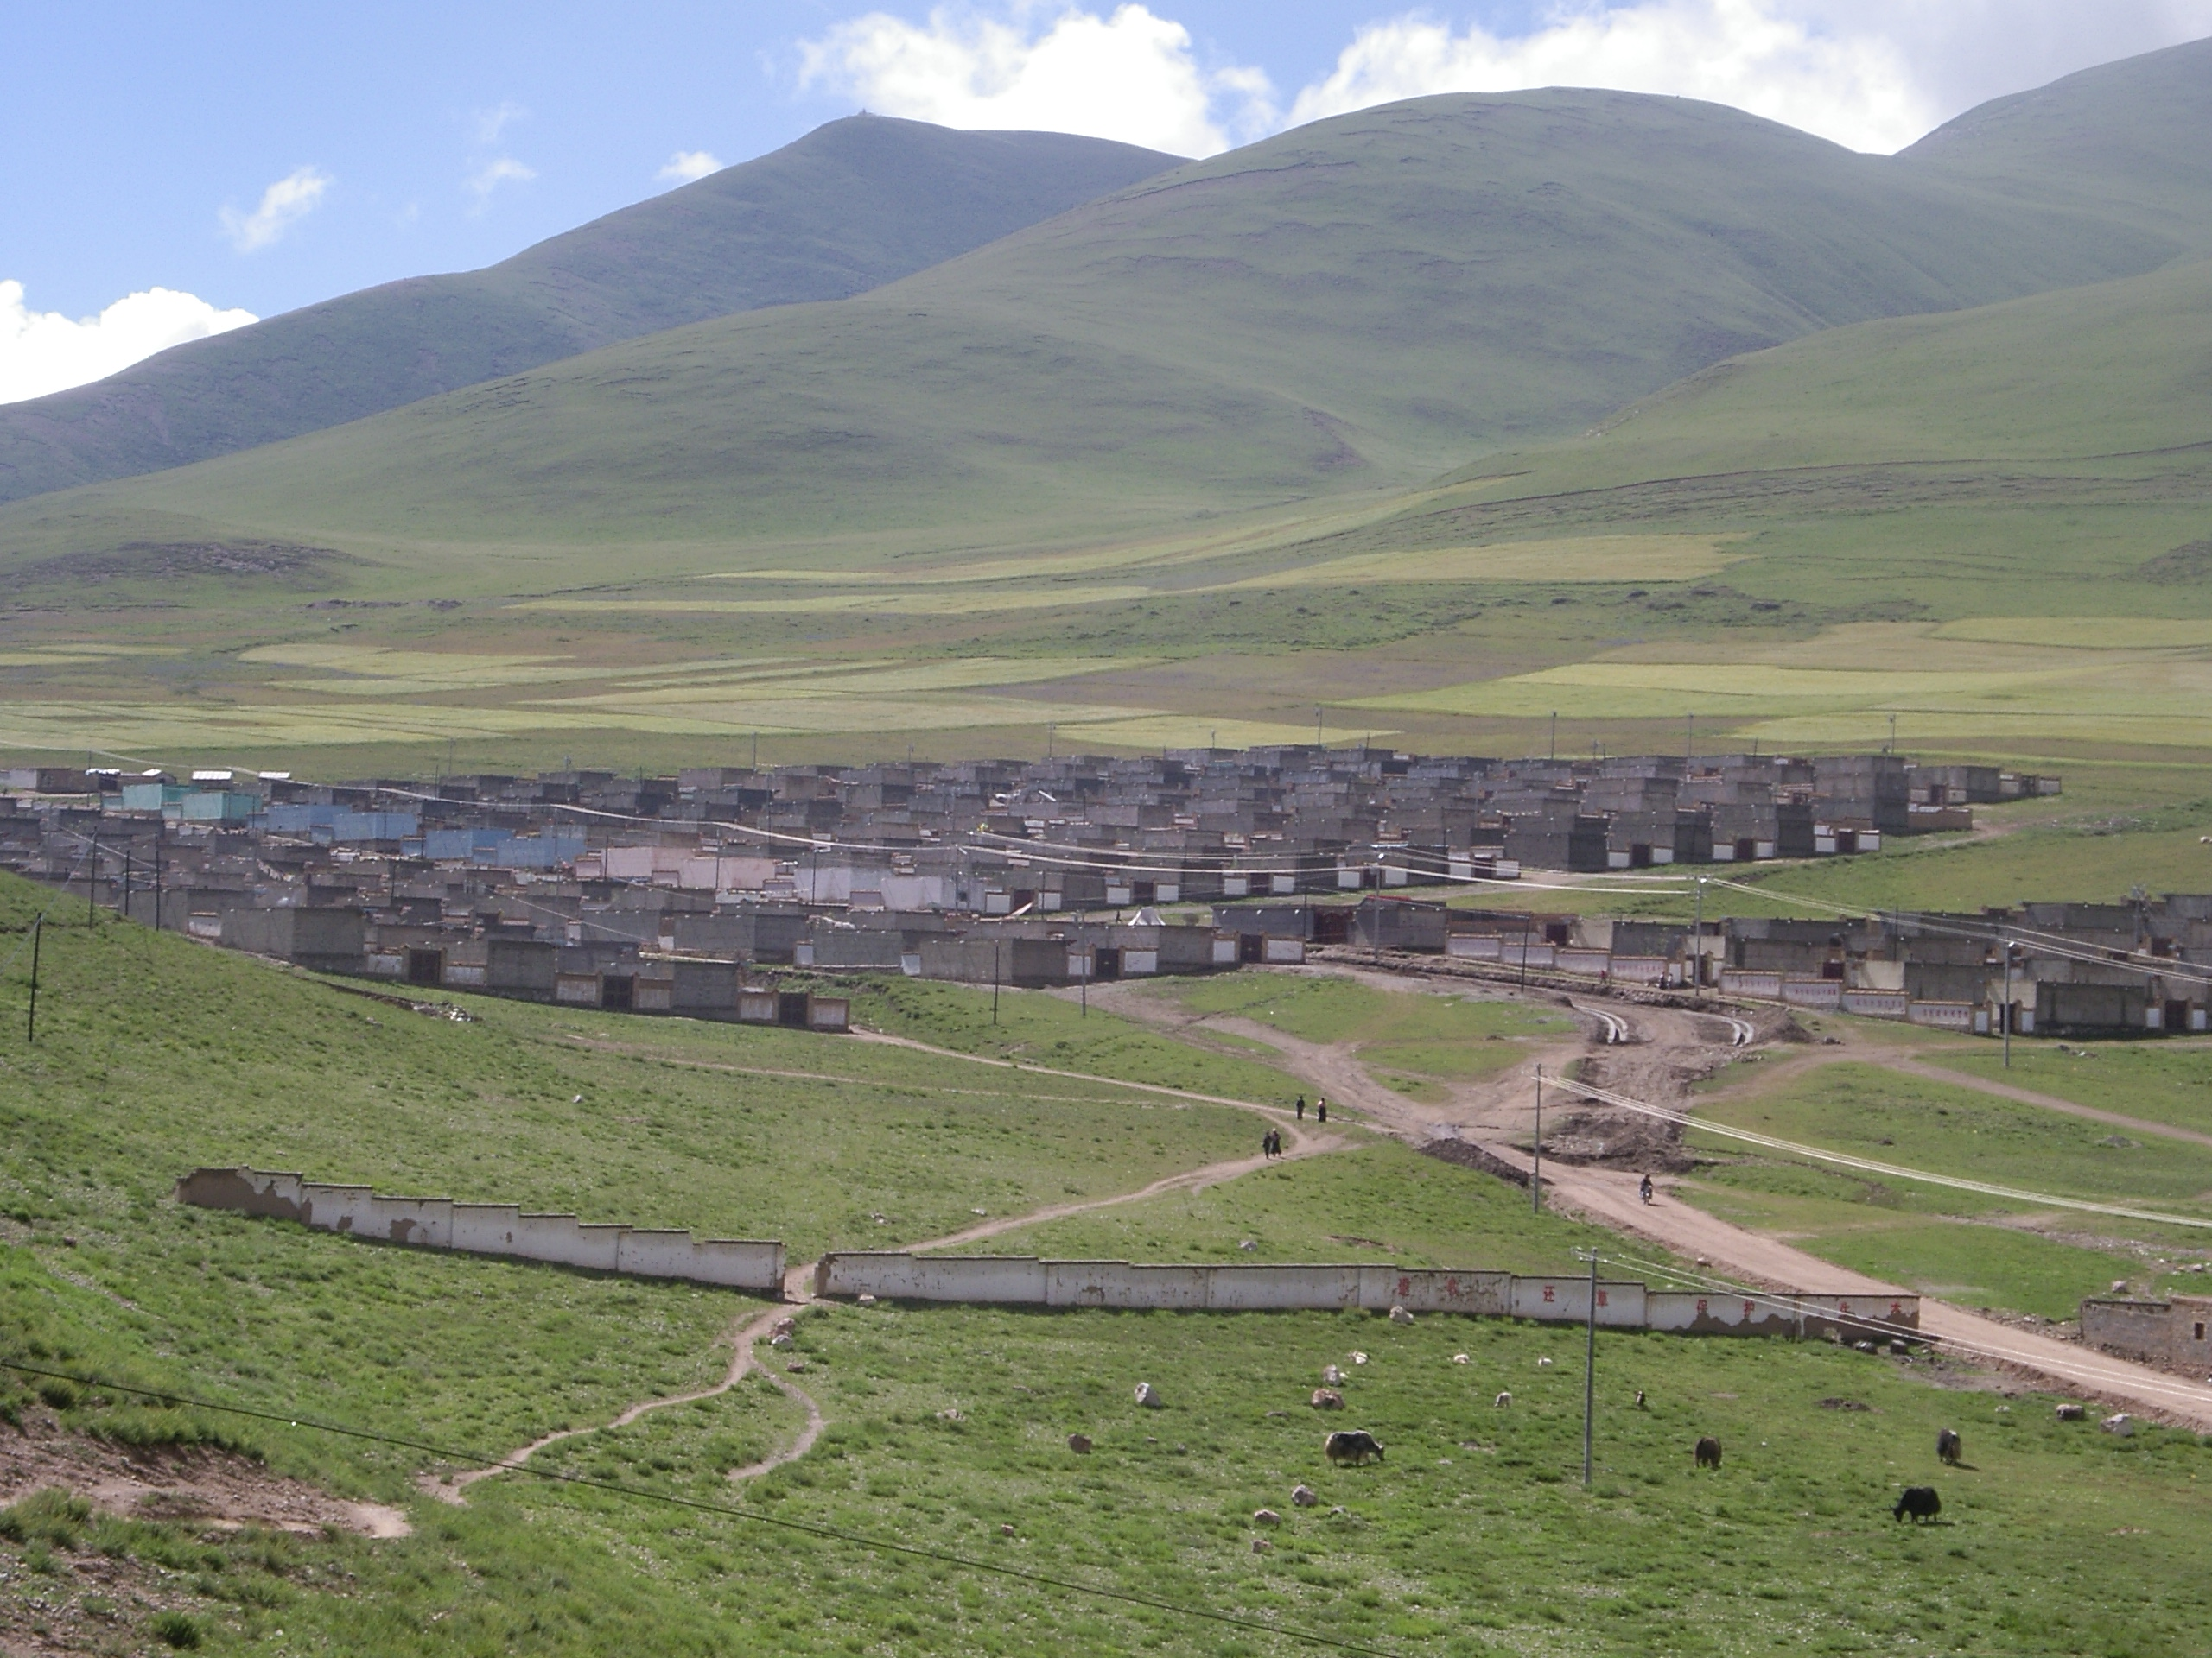
3) Rural Life Central in Tibet
Notes:
While the Tibetan plateau and cultural area are the size of western Europe,
the population (of about 8 million) is about the same as that of London.
Image if all of Europe was only inhabited by the people who currently live in London!
So it should be no surprise that (until 2000 at least),
over 75% of Tibetans were nomadic or partially nomadic—
this does not mean that they wandered aimlessly, but that they moved herds around between camps, and
lived away from settled communities, at least a significant part of the year.
Tibet had few big towns.
Even including the 3 big monasteries, which roughly doubled the population,
early 20th c Lhasa was home to under 50,000 people.

Slide 21
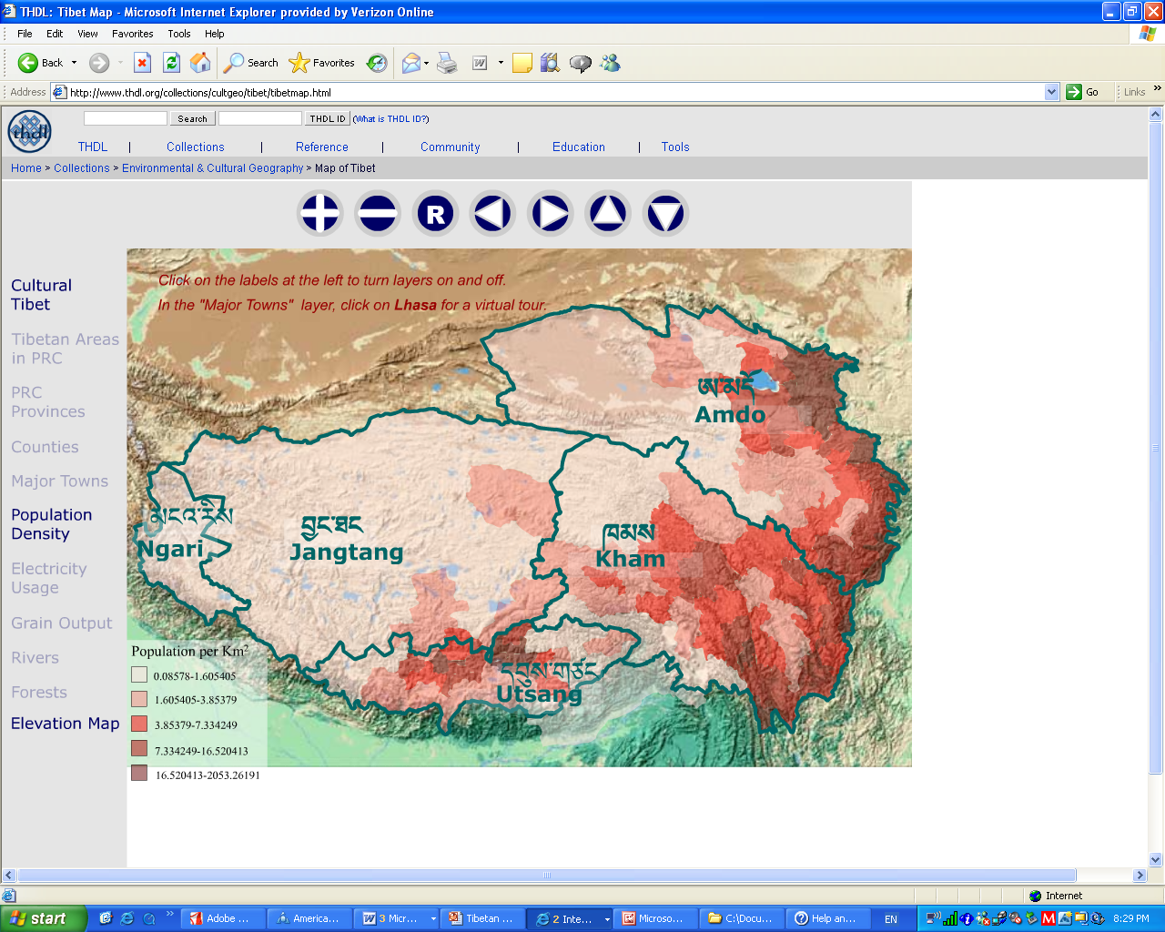
Notes:
THDL Link 2006: http://www.thdl.org/collections/cultgeo/asia/asiamap.html

Slide 22
Tibetan Land Use
Notes:
Map by Karl Ryavec

Slide 23
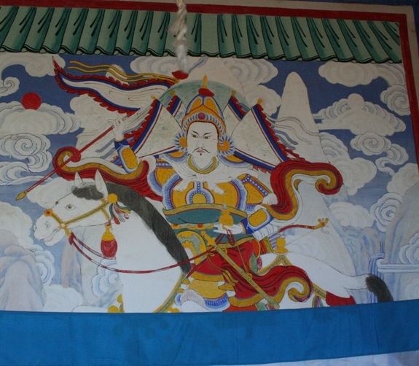
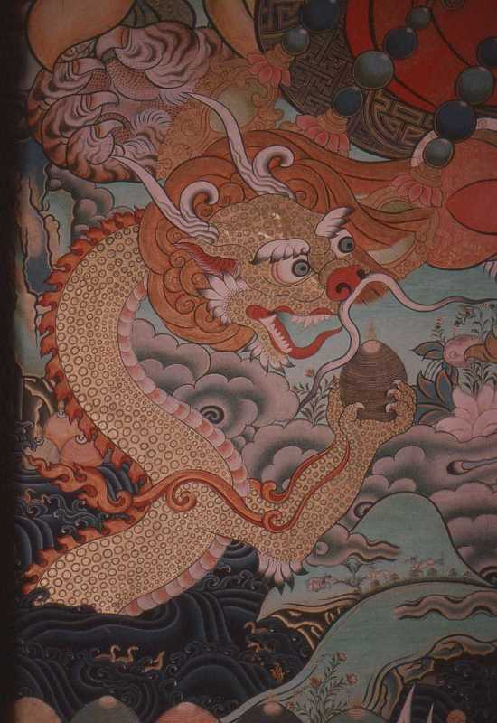
Nature Understood Differently
Notes:
While the rest of the world is now a majority urban dwellers---
Tibetans still mostly live in rural communities,
in one of the harshest environments in the world,
so of course the relationship to the land is going to be different.
Powerful gods and local spirits (lu, naga) are seen as truly influencing human life, and
imbuing the world with diverse and very different life forces
(even among modern activists for the environment).
Intense relationship to the land has been disrupted,
esp. since 2000 “develop the west” campaign in china,
with effort to settle the nomads, fence pastures, extract resources (mining, etc opened up by roads).

Slide 24
3) Tibetan Culture Shaped by Empire
Pugyel or Yarlung Dynasty (c. 600-c. 900)
Notes:
Unified a Tibetan cultural area that came to share a language, including a written language;
Shared conceptions of the world, later overwritten with Buddhism;
Shared narrative of origins, pointing back to the imperial family of Tibet

Slide 25
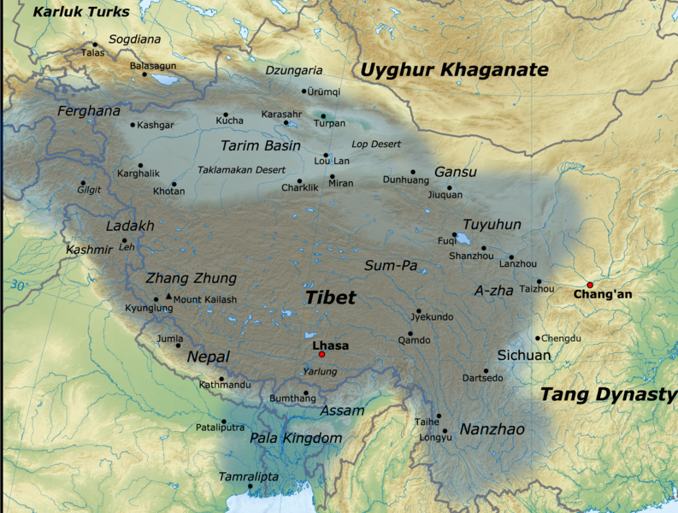
Ordos
Notes:
Tibetans based in Central Tibet spread out and incorporated, acculturated the rest of the Tibetan plateau.
Took the Tarim Basin, capturing the Silk Road, for about a century (long enough for Chinese in Dunhuang to learn to speak and write Tibetan)
Captured the Ordos bend in the Yellow River, shaping the later Xixia empire, and its influence on Mongol empire.
Held off Muslims in Central Asia, blocked eastward movement of Islam

Slide 26
650-950 Eurasian Empires
Notes:
Tibet was in communication with major civilizations,
Shaped Tibetan religion, medicine, astrology, art
Influences from Persia, India, China

Slide 27
5) Buddhism—Central to Tibetan Culture
Notes:
Dominated intellectual life, literary output, artistic media, architectural structures for a thousand years (11th-20th century)
It did NOT make Tibet a zone of peace---Tibetans fought, with each other mainly

Slide 28
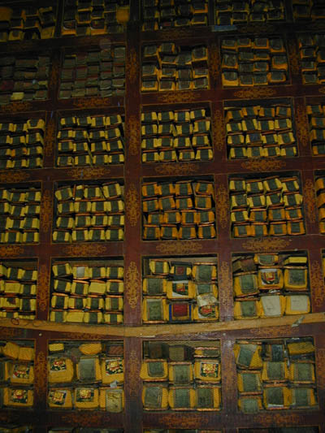
Tradition & Innovation
Book Printing (canon: c. 4500 titles in 300+ vols)
Five Fields of Science
Tibetan Medicine
Art & Architecture

Slide 29
6) Monasteries— Central to Tibetan Culture
Notes:
While Buddhism thrives in every village and almost every tent encampment,
Core repository for Tibetan Buddhist tradition is within monasteries—
Tibet is distinguished by having mass monasticism, where up to 25% of population might be monastic (almost all male)

Slide 30
Labrang Monastery, Amdo (Qinghai), home to 3,000 monks; red buildings are teaching & assembly halls, foreground are dorms
Notes:
Massive monasteries date back 11th c, when Tibetan recaptured the silk road and the tax revenue that came with it…grew steadily from then,
At the peak, roughly 60 institutions with over 500 monks each, some with as many as 10,000 monks (still one that big today)
numerous and diverse faculties of education (recognized by Jesuits) and 1000s of reincarnate lamas somewhat like chaired professors in this system
Allowed for maintenance of a massive infrastructure that supported huge literary and artistic production

Slide 31
7) Tibetan Culture Is Diverse
Religiously (Bon, Islam, shamanic, animistic traditions)
Socially (ranged from aristocratic to equalitarian; village-based communities, monastic polities, to centralized kingdoms)
Linguistically (internally to Tibetan and beyond)
Notes:
Religious Diversity: While the Bon tradition is variously described as the pre-Buddhist religion of Tibet and imitating Tibetan Buddhism, it is treated as VERY different than Tibetan Buddhism, and there is little mixing of families across (what looks to us) families who embrace these different traditions.
Islam is present in Central Tibet as a result of trading activity (from Kashmir and northwest China);
Islam in present in Amdo through diverse Muslim communities there, including Tibetans who have converted to Islam (as well as Mongol, Chinese and blue eyed brown haired Turkic Muslims from Central Asia)
Animistic traditions persist on the southern Himalayan borders, where animal sacrifice is critiqued by Buddhists
Shamanic traditions persist on Northwestern borders, where Mongolic communities have mixed with Tibetan Buddhism
Social Diversity: in central Tibet 100s of aristocratic families from earliest time to present;
some nomadic areas have kings, others are described as tribal and have their own laws that persist in the face of modern Chinese state efforts to overwrite some villages and nomadic communities were marked by equalitarian self-rule by elders;
some monastic polities (Labrang) controlled territory as large as Switzerland…

Slide 32
Spread of Romance Languages
Romanian
Notes:
Imagine Portugese and Romanians communicating easily

Slide 33
Linguistic Diversity
Amdo
Kham
Central Tibetan
Notes:
Language as old as English, People at eastern and western edges (Amdo and Ladakh) can understand each other better than people in the middle, where language evolved more quickly
Script spread & stayed throughout this range (except in Balti/Pakistan, where it disappeared with advent of Islam)
Three major languages differ even though script is the same in the same way Latin based languages spread from Rome to areas of conquest (Portugal, Spain, France, Romania) but in Tibet, the vernacular has never come to trump the shared written language, to spin off different versions of the written language.
like Europe, in diversity with some 25 “smaller” languages spoken on the plateau (Mongolic, Turkic, Tibeto-Burman, dialects of Chinese, Qiangic, Gyalrongic)

Slide 34
8) Tibetan Civilization Spread Abroad
Classical Tibetan language was one of the world’s great religious languages
Diffusion of Tibetan Buddhism also spread Tibetan medicine, art, architecture, etc.
Notes:
Tibetan script © 2005 Steve Taylor
License Creative Commons Attribution-ShareAlike 3.0 Allows modification and redistribution
Contributor Steph Holloway

Slide 35
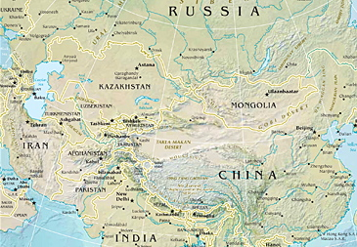
Spread of Tibetan Buddhist Culture
TIBET

Slide 36
Global Spread of Tibetan Culture
from 1580-1900 (spread to Mongolia)
over 220 years, at a rate of nearly 7/ year:
1500 monasteries built in (Inner and Outer) Mongolia
from 1912 -1950 (spread to China Proper)
over 38 years, at a rate of nearly 1/ year:
some 32 dharma centers built in China Proper (Shanghai, Beijing, Chengdu, etc)
from 1959-1984 (spread worldwide)
452 dharma centers in 35 years, almost 13/year: worldwide (South Asia:167, Euro-America: 235; Chinese diaspora: 24, South America: 13, Africa: 7)
Since 1984: growth too fast to keep up with…

Slide 37
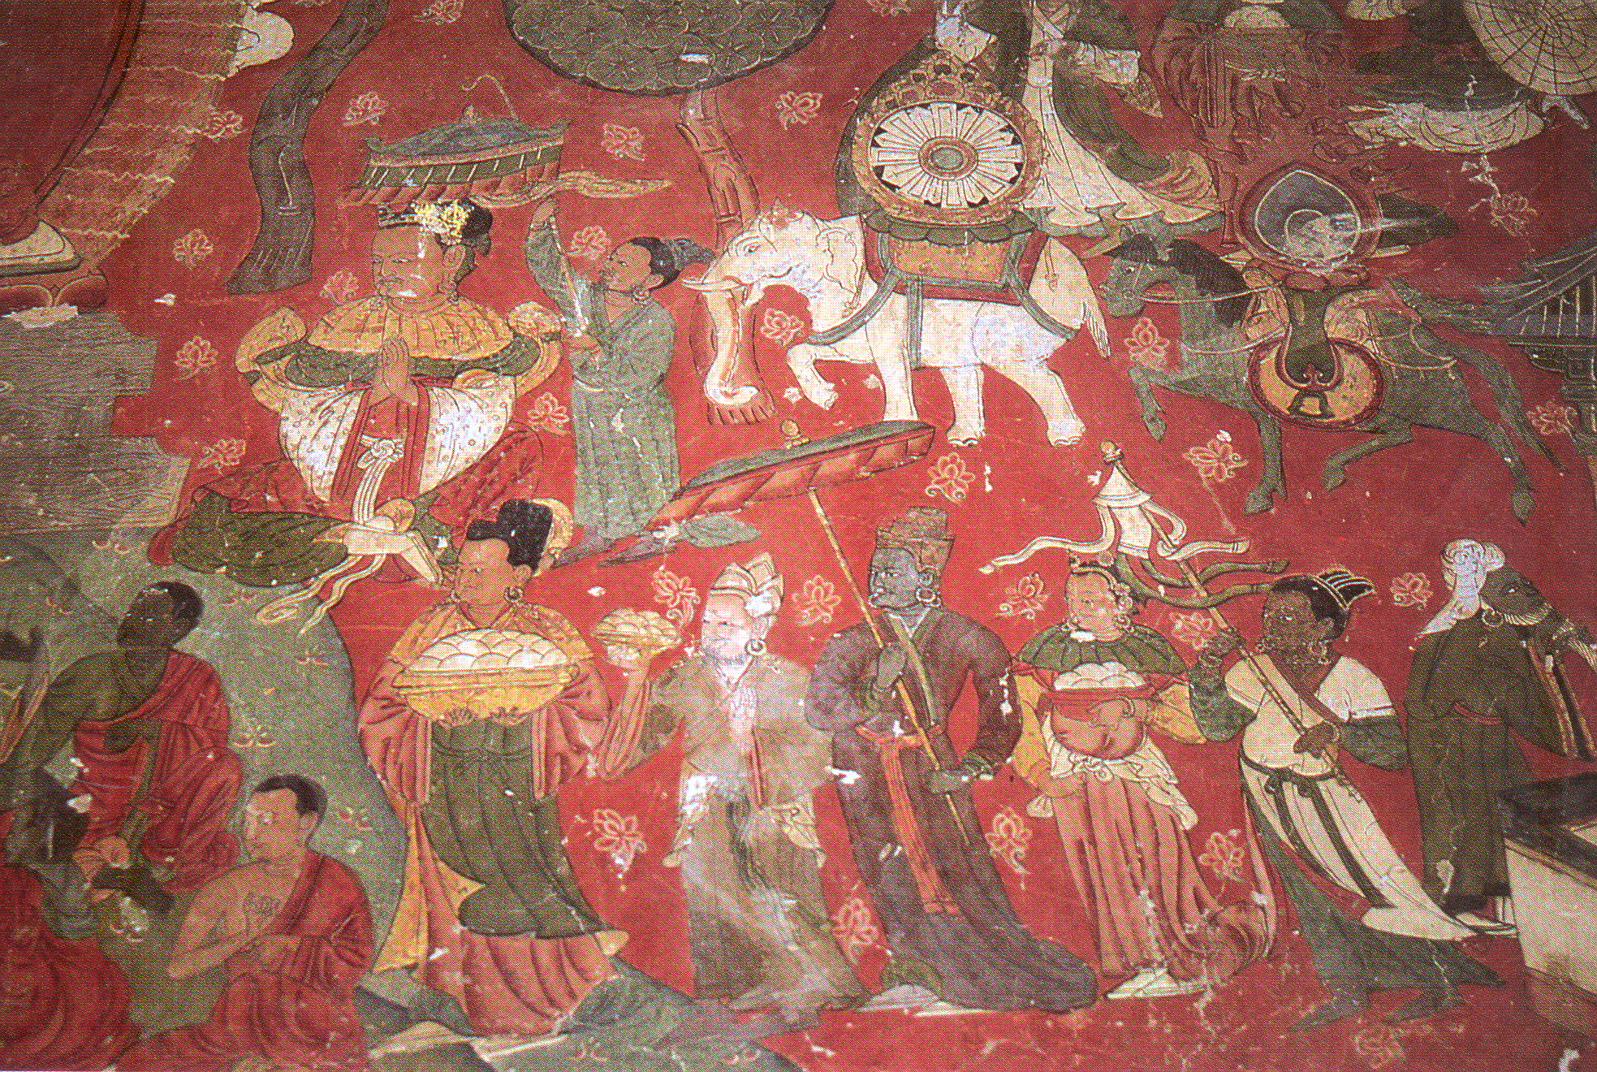
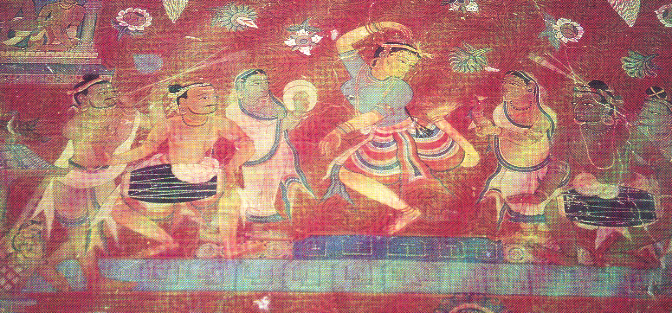
9) Tibet Was Not Cut Off from World
Connected to China, Central Asia, India, Tanguts, Mongols, Kashmiris, Armenians, Nepal, Catholic Europe, Britain, Russia, etc.
Notes:
Imperial period: early medicine (including knowledge of Galenic tradition), studied Chan (Chinese) Buddhism, Indic Buddhism and medicine
Tibetans took the silk road in the 11th c., trade with Arabs (pearls from Kokonor),
encountered Mongols (who brought them to court where Europeans met them for the first time)
Tibetan horse-tea trade with Ming China 14th-17th century
Armenian community in Lhasa until 17th c.,
European missionaries and Hindu & Kashmiri traders into the 18th c.,
Nepalese & Chinese merchants from the 18th c.,
British merchants in the 19th & 20th c.
products and amounts of trade (coral came from the Red Sea, amber from Russia, tea from China….
Traded for Tibetan musk, gold, wool, medicinal products, even white yak tails for Santa’s beard

Slide 38
10) Tibetan Culture Is Accessible
Notes:
Tibetan culture is accessible—and not just NYC….my home state of Alabama just hosted the Dalai Lama, and has Tibetan Buddhist centers!

Slide 39
Tibet in NYC
Buddhism everywhere in America, esp. NYC
Material culture in our museums (Rubin Museum of Art, Newark and Metropolitan Museums—Arms and Armor—and American Museum of Natural History, Jacques Marchais)
Tibetan Food in Queens http://tibet.edublogs.org
Modern art in galleries, movies at the MoMa this year, dance, opera, poetry, and on the web
Notes:
Largest Tibetan community outside of Asia…

