Slide 1
Top Ten Things to Know about China in the World Andrew J. Nathan
Actually, China was never sleeping. It was a great land empire, which suffered a “century of humiliation” (conventionally 1842-1949) during the period of Western expansion. But things are changing now….

Slide 2
1. China is rising economically

Slide 3
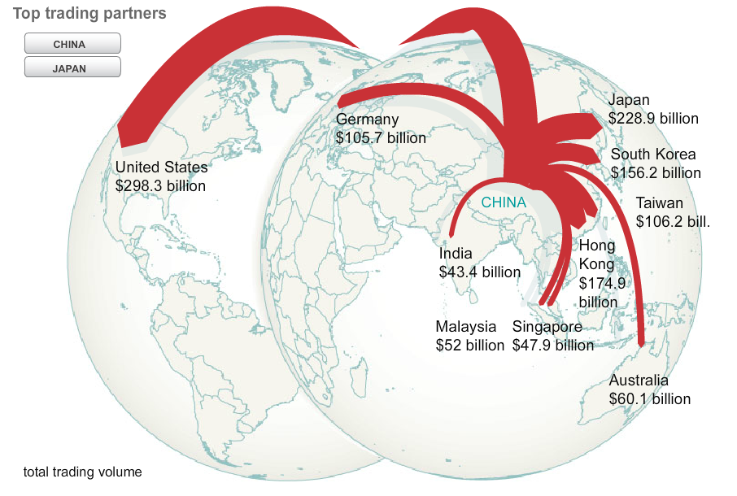
Largest trading nation
2013

Slide 4
Chinese overseas investment

Slide 5
One Belt One Road

Slide 6
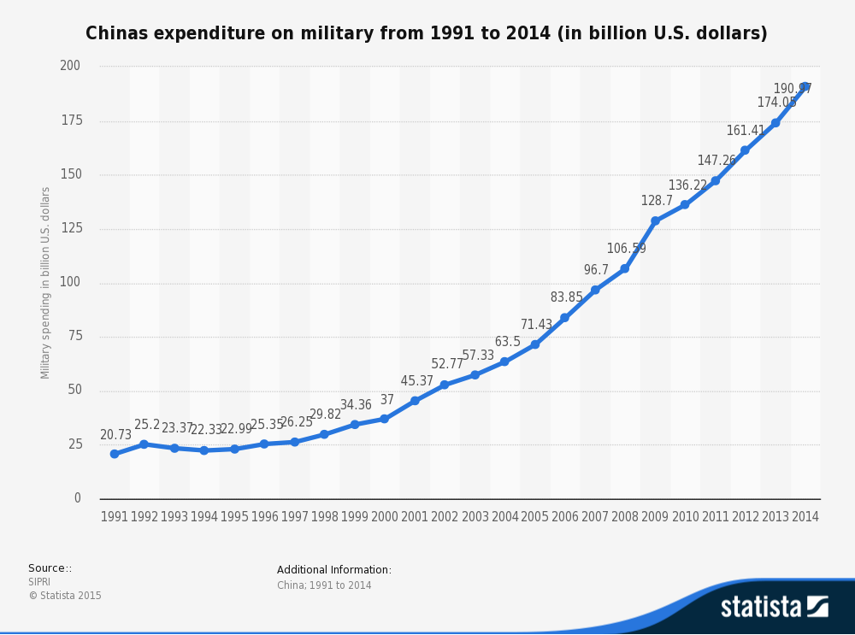
2. China is rising militarily

Slide 7
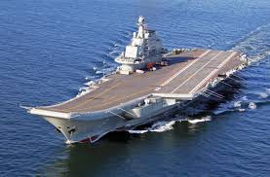
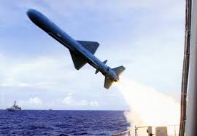
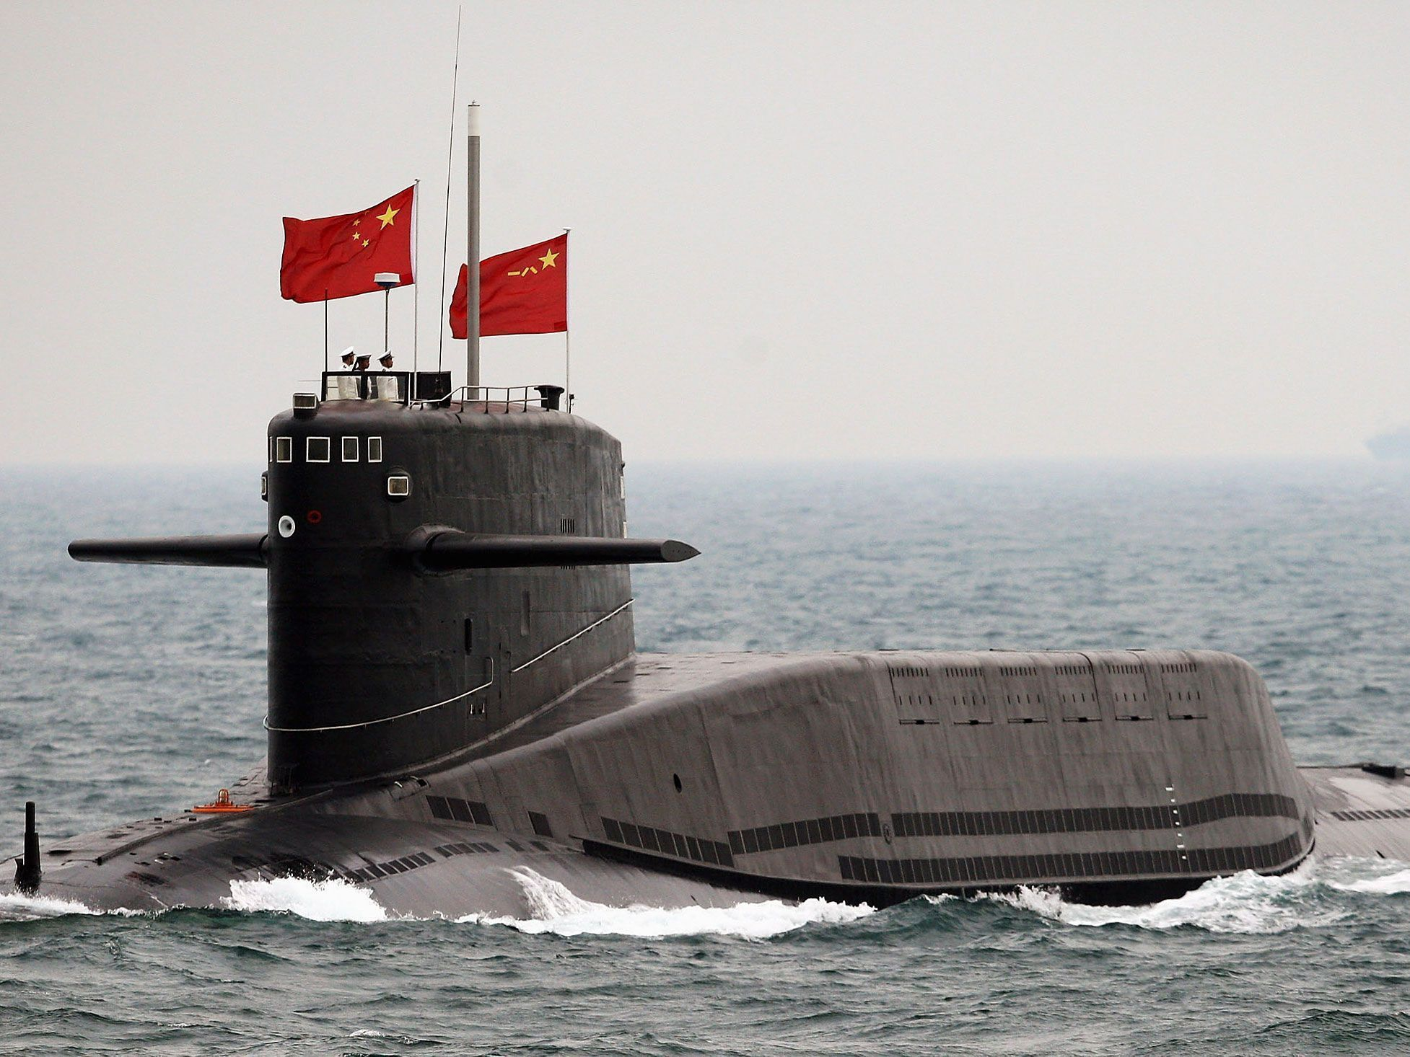
Capable new armaments

Slide 8
China’s missile ranges

Slide 9
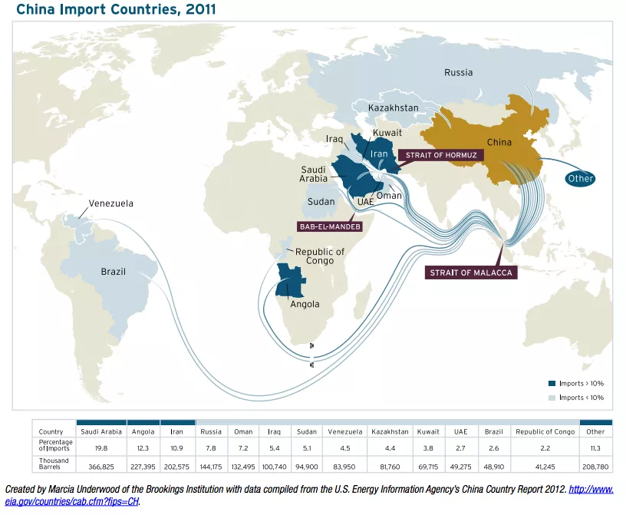
3. Unstable suppliers, vulnerable supply lines

Slide 10
4. Big, dangerous neighbors
 | Population (million) | Historic clashes | Dates | Border dispute
Russia | 135 | Border clashes | 1969, 1971 | Settled
Japan | 127 | Invasion of China | 1937-45 | Ongoing
The Koreas | 74 | The Korean War | 1950-53 | Ongoing?
Vietnam | 95 | Chinese incursion, maritime disputes | 1974, 1979, 1988 | Ongoing
India | 1,267 | Border war | 1962 | Ongoing

Slide 11
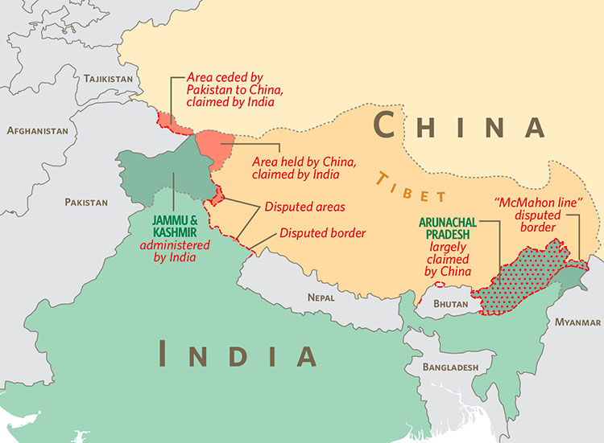
Ongoing border disputes

Slide 12
5. Smaller, unstable neighbors
 | Population (million) | Problem | Potential Impact
North Korea | 25 | Unstable regime | War, refugees
Laos | 7 | Weak govt | Trafficking
Myanmar | 57 | Weak govt, ethnic unrest | Refugees, trafficking, insecure investments
Pakistan | 202 | Weak govt | Terrorism, insecure investments
Afghanistan | 33 | Weak govt | Terrorism, insecure investments
Three Central Asian Rpblcs | 33 | Weak govt, ethnic unrest | Terrorism, insecure investments, Uighur support

Slide 13
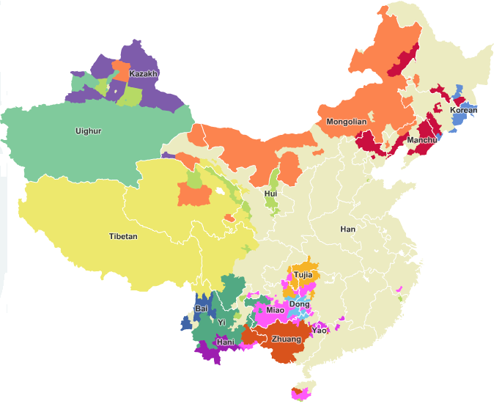
6. Ethnic diversity: 55 national minorities (plus the Han)

Slide 14
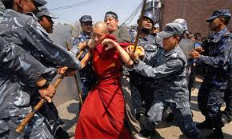
Dissatisfied minorities
Tibet unrest 2008

Slide 15
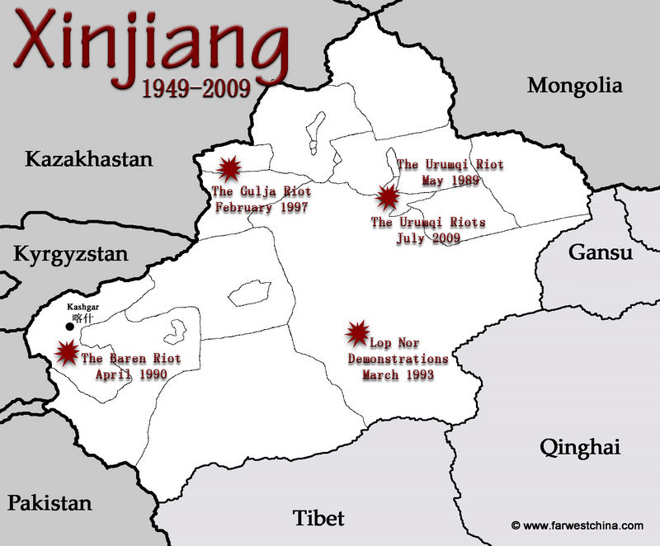
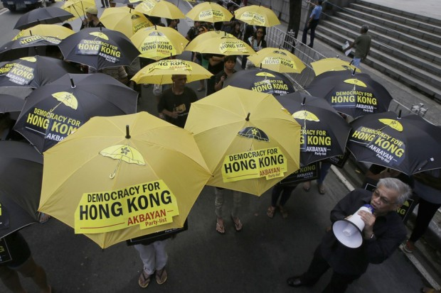
Uneasy peripheries
Hong Kong Umbrella Revolution

Slide 16
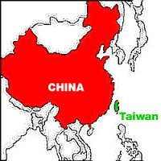
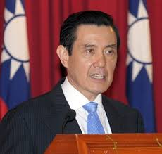
7. Territorial integrity: Taiwan

Slide 17
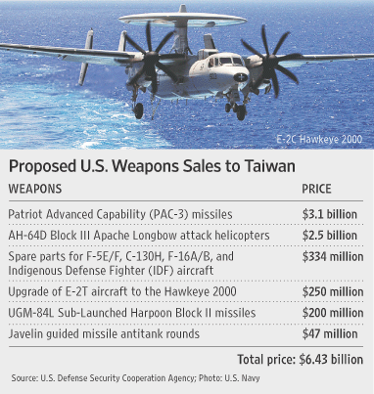
2016 Taiwan presidential candidates
U.S. arms sales to Taiwan

Slide 18
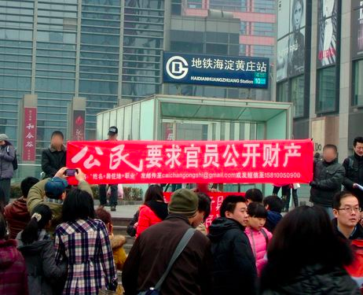
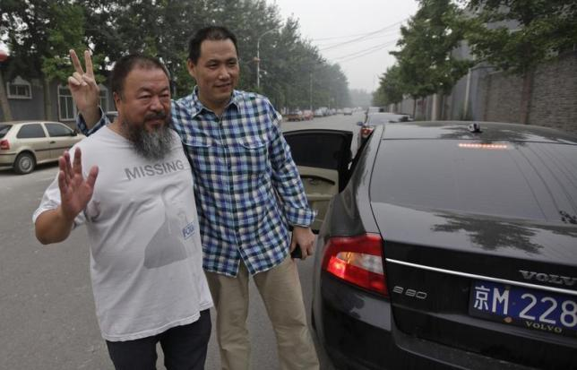
8. Threats to regime stability
Tiananmen 1989
New Citizens Movement
Ai Weiwei and Pu Zhiqiang

Slide 19
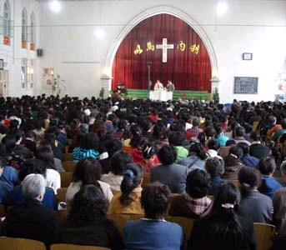
Western cultural influences

Slide 20
9. U.S. Encirclement?

Slide 21
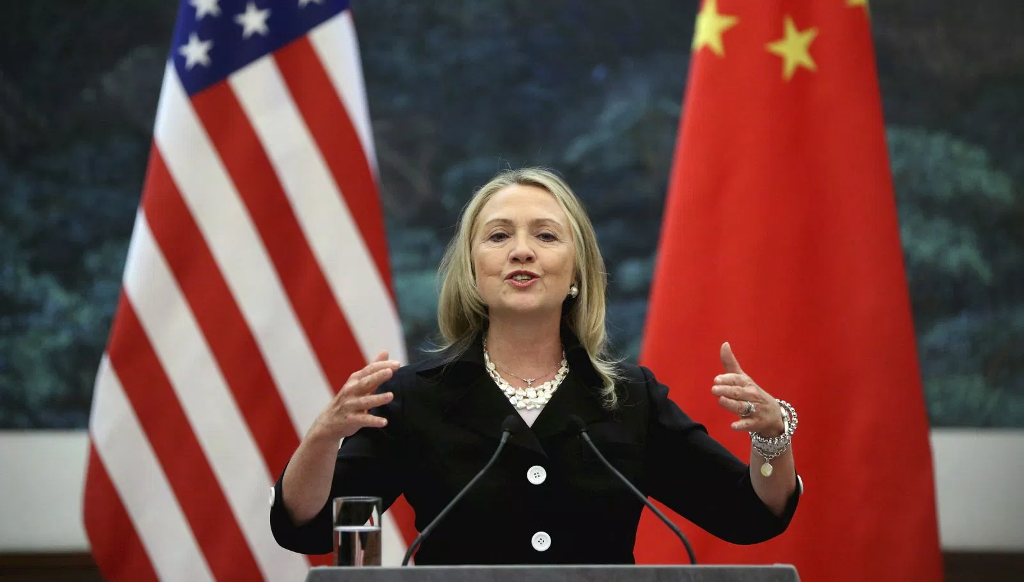
The “Pivot to Asia”

Slide 22
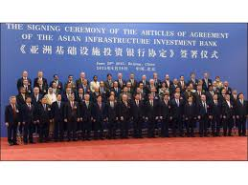
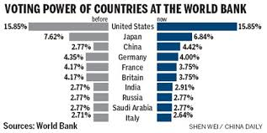
Who calls the financial shots?

Slide 23
10. What balance in Asia?

Slide 24
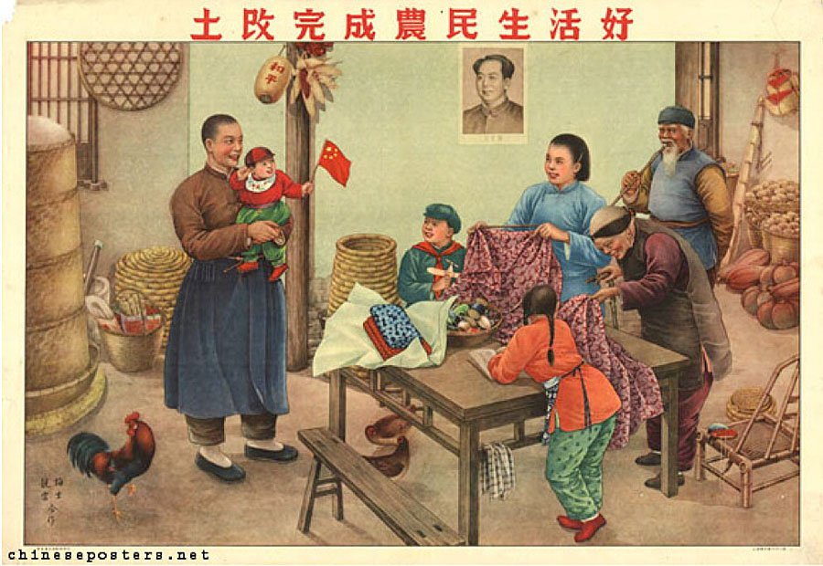
The China Dream?

Slide 25
Or Rule the world?

