Slide 1
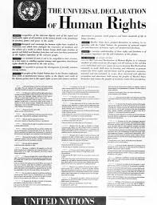
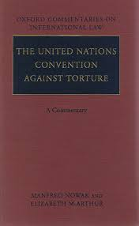
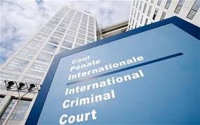
China and Human Rights:
The Top Ten Things to Know
Human rights: an ideal with deep historical and wide cultural roots, but in the modern sense a body of international law and institutions created post-WW II, centered on the UN, and promoted by an international social movement

Slide 2
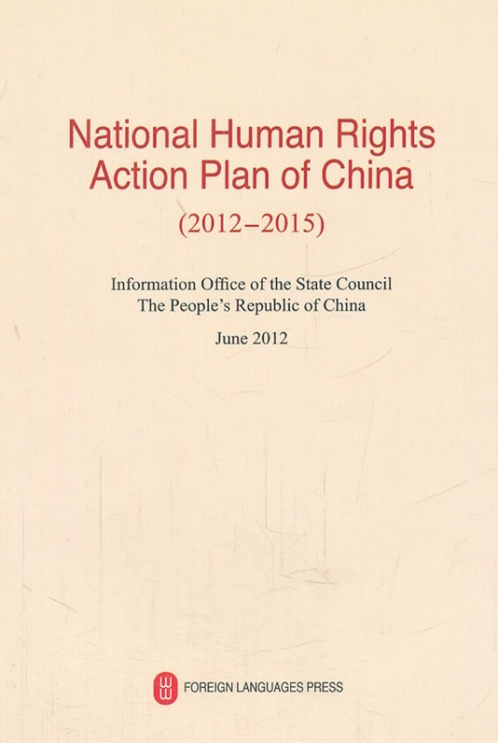
China Supports Human Rights in Principle
Ratified major HR treaties
International Covenant on Economic, Social, and Cultural Rights
Genocide Convention
Refugee Convention
Slavery Convention
Convention Against Torture
Convention on the Elimination of All Forms of Discrimination Against Women
Convention on the Elimination of All Forms of Racial Discrimination
Convention on the Rights of the Child

Slide 3
China Participates in UN Human Rights Council
and Treaty Bodies

Slide 4
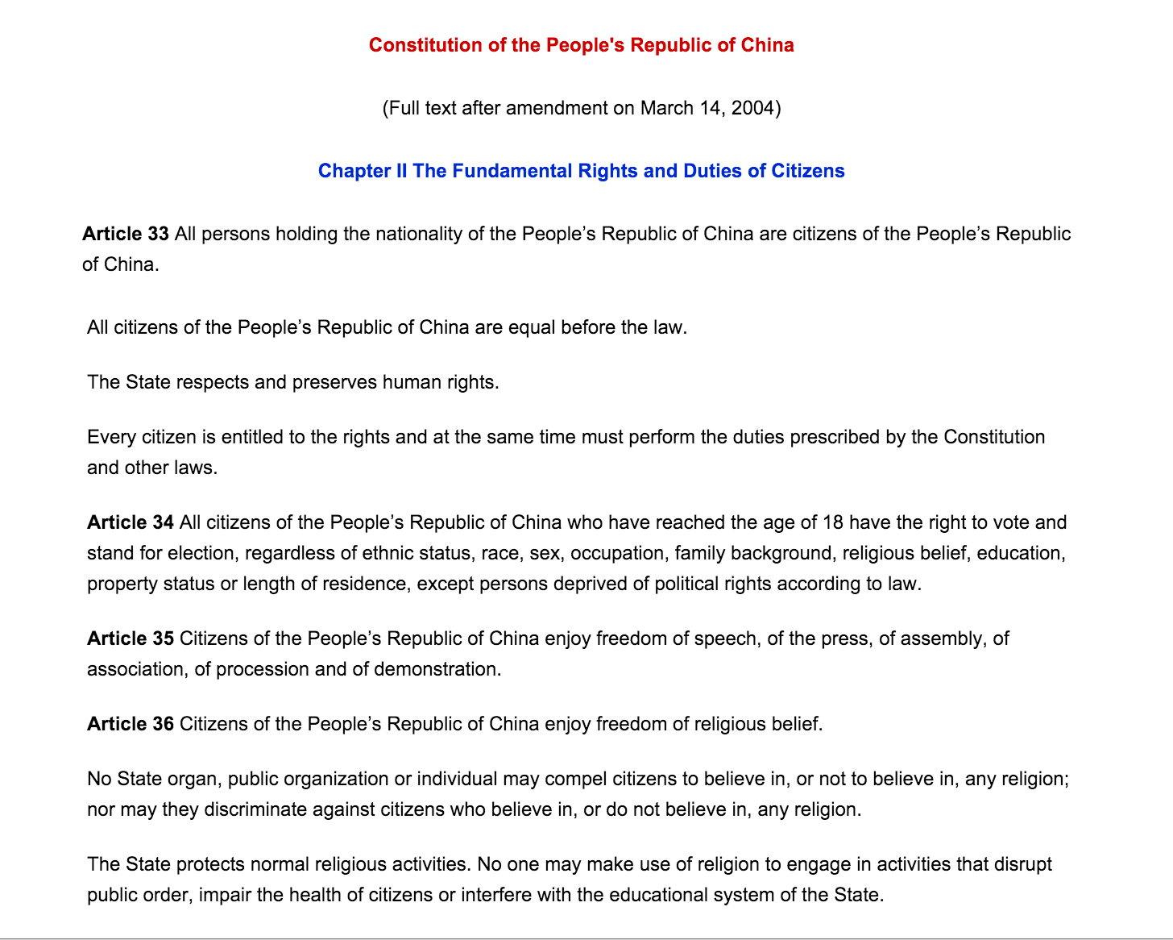
PRC constitution
Chapter II, Articles 33-56: “Citizens’ rights”
2004 amendment:
“The state respects and preserves human rights”

Slide 5
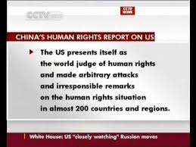

Slide 6
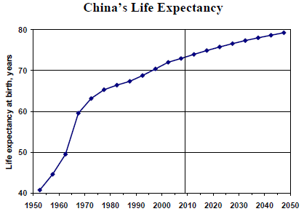
2. Economic, Social, and Cultural Rights: Progress

Slide 7
ESC achievements
(with qualifications)
Mandatory free education: 9 years (not really free)
Literacy: 96.4% of persons age 15 and over can read and write
85% covered by health insurance (diverse benefits, system under construction)
Forty hour work week (not always enforced)
Unemployment rate: 4% (not counting rural underemployed)
Mandatory age of retirement: 50-65 depending on gender (does not apply to rural workers, self-employed, and is too early)
2000 newspapers, 3000 TV stations (censored)
46% of population on Internet (censored)

Slide 8
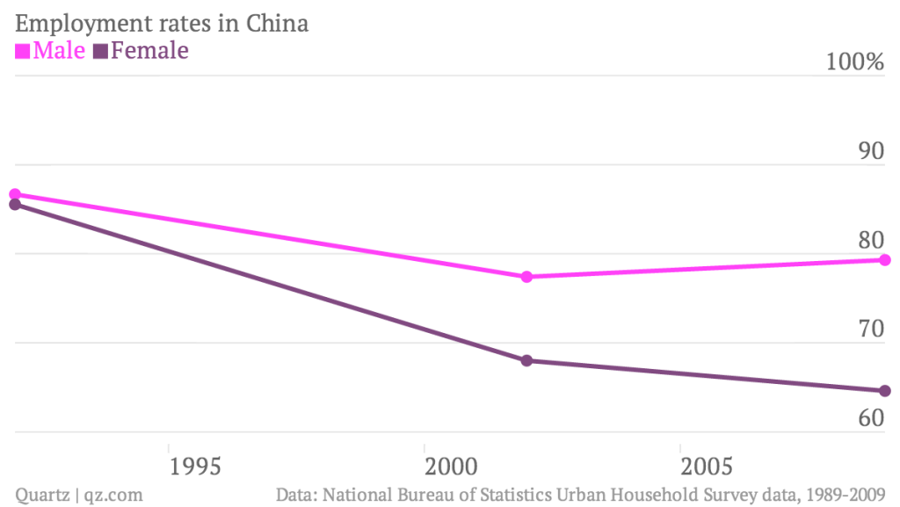
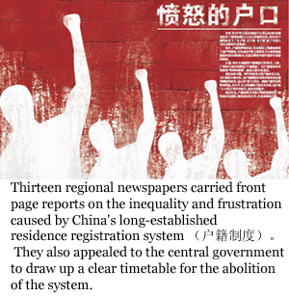
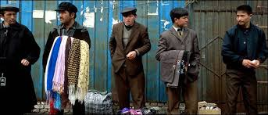
3. But discrimination is a widespread problem

Slide 9
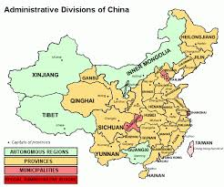
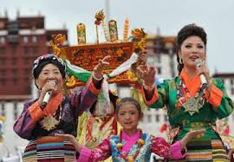
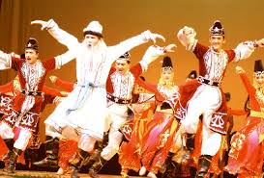
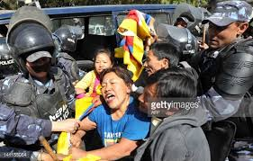
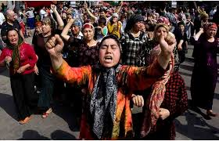
4. Self-Determination: China recognizes “internal” SD
International Covenant on ESC Rights, International Covenant on C&P Rights, Common Article 1: “All peoples have the right of self-determination.”
Law of the People’s Republic of China on Regional National Autonomy: “Regional autonomy means that the minority nationalities, under unified state leadership, practice regional autonomy in the areas where they live in concentrated communities and set up organs of self-government for the exercise of the power of autonomy.”
… but does not work well.

Slide 10
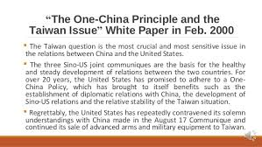
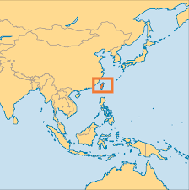
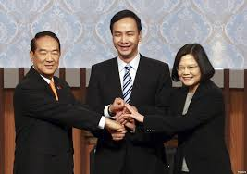
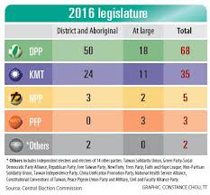
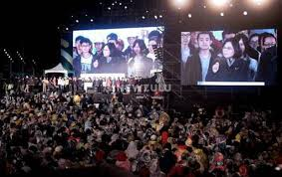
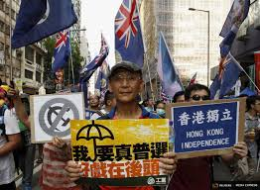
“External SD” is denied
Even a Hongkong independence movement

Slide 11
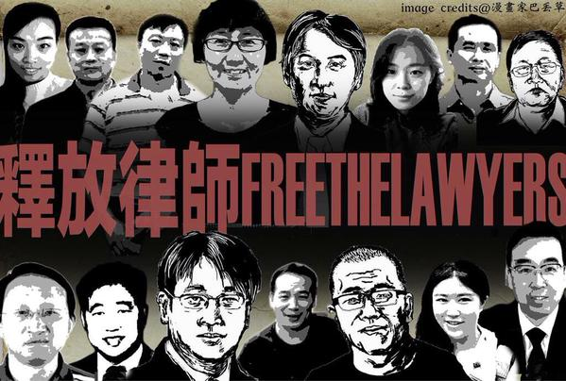
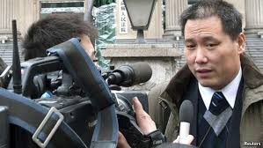
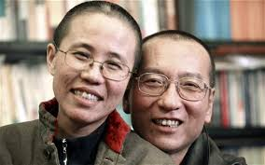
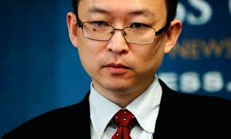
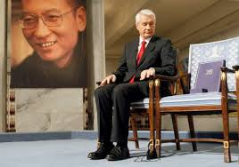
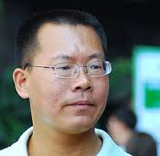
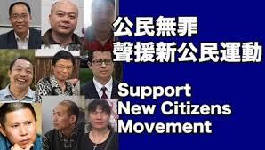
5. Civil and Political Rights Are Abridged

Slide 12
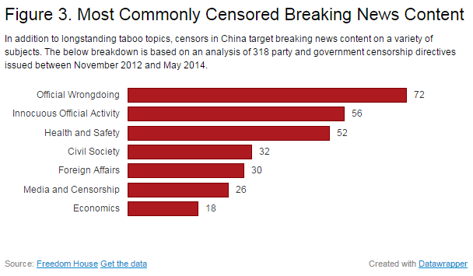
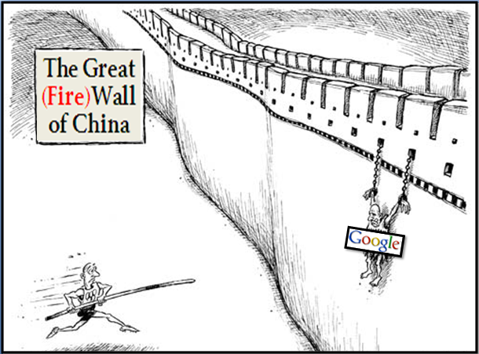
Information is controlled

Slide 13
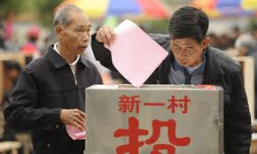
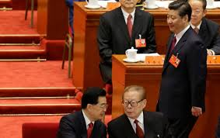
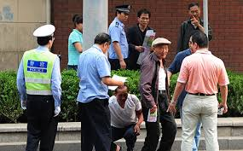
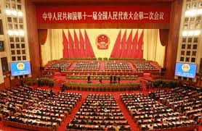
Petitioning and voting at the grassroots
The Party choses its own successors and leads the state

Slide 14
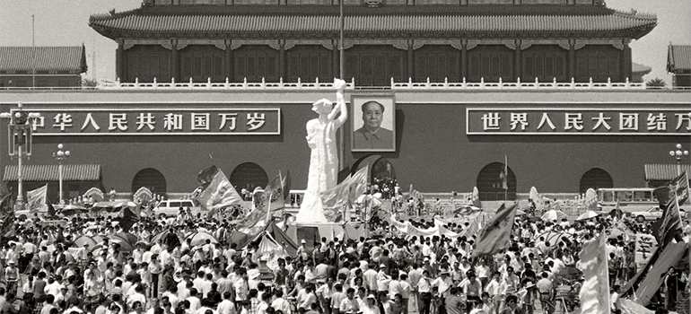
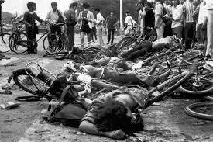
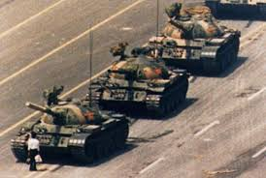
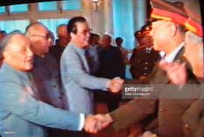
6. Tiananmen 1989: Democracy Denied

Slide 15
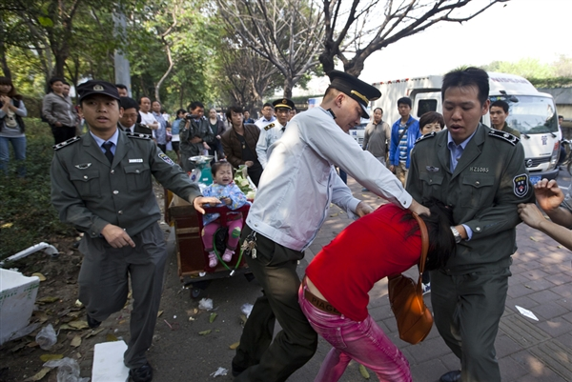
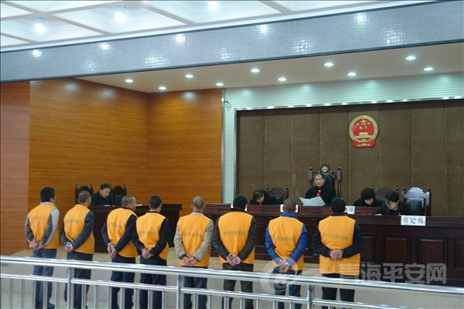
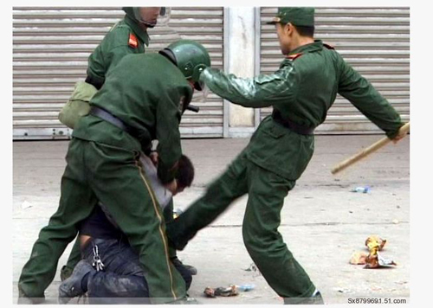
7. Due Process Remains Deficient
200,000 lawyers
200,000 judges
99% conviction rate in criminal cases
10% citizen success in suits against government

Slide 16
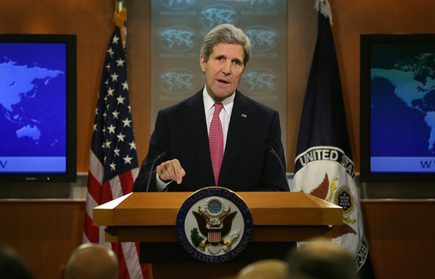
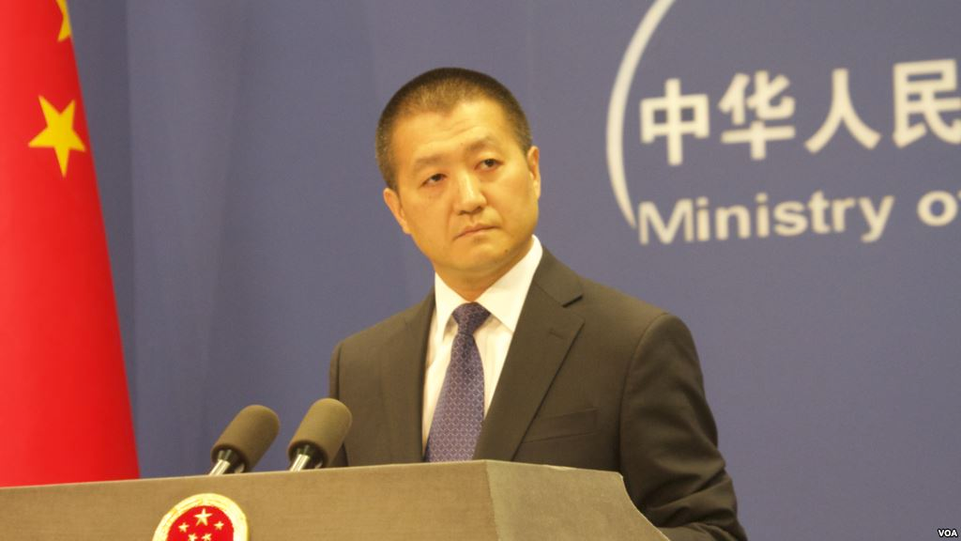
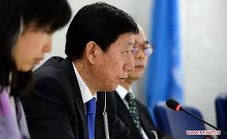
8. Human Rights as a Diplomatic Battle
In the HR regime, states have used their sovereignty…
to agree to a compromise of sovereignty…
which makes HR a diplomatic battleground.

Slide 17
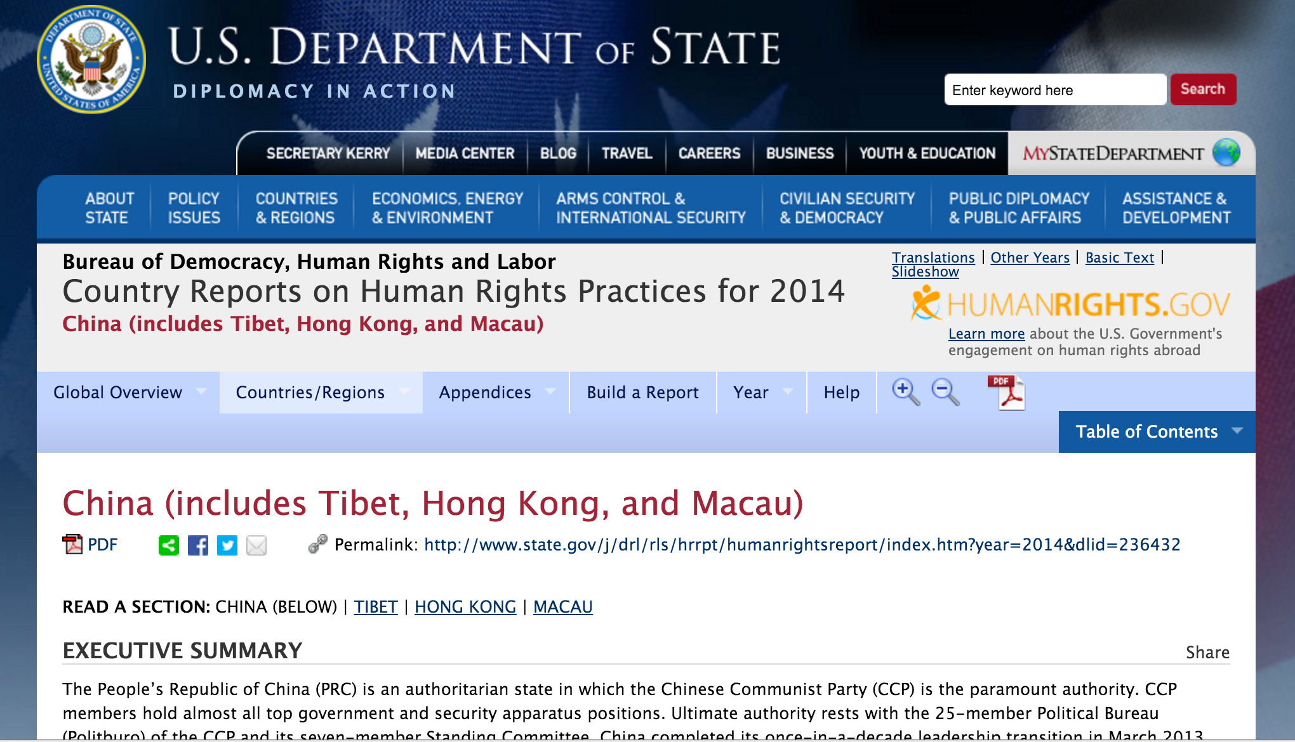
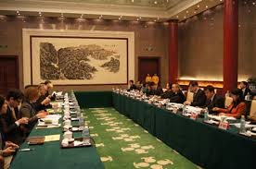
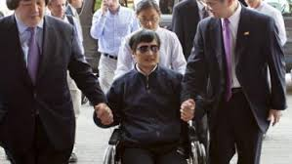
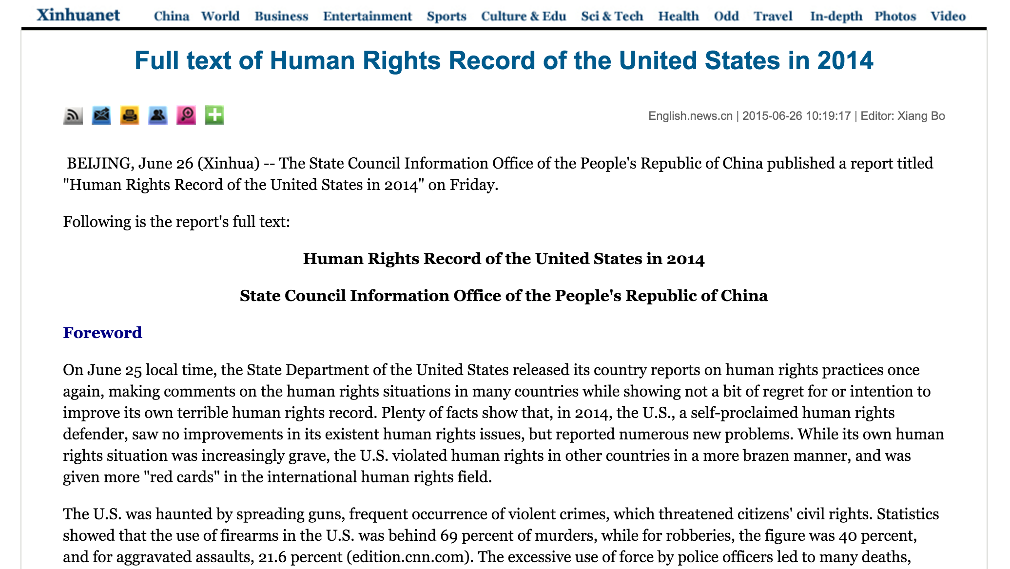

Slide 18
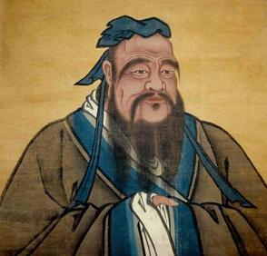
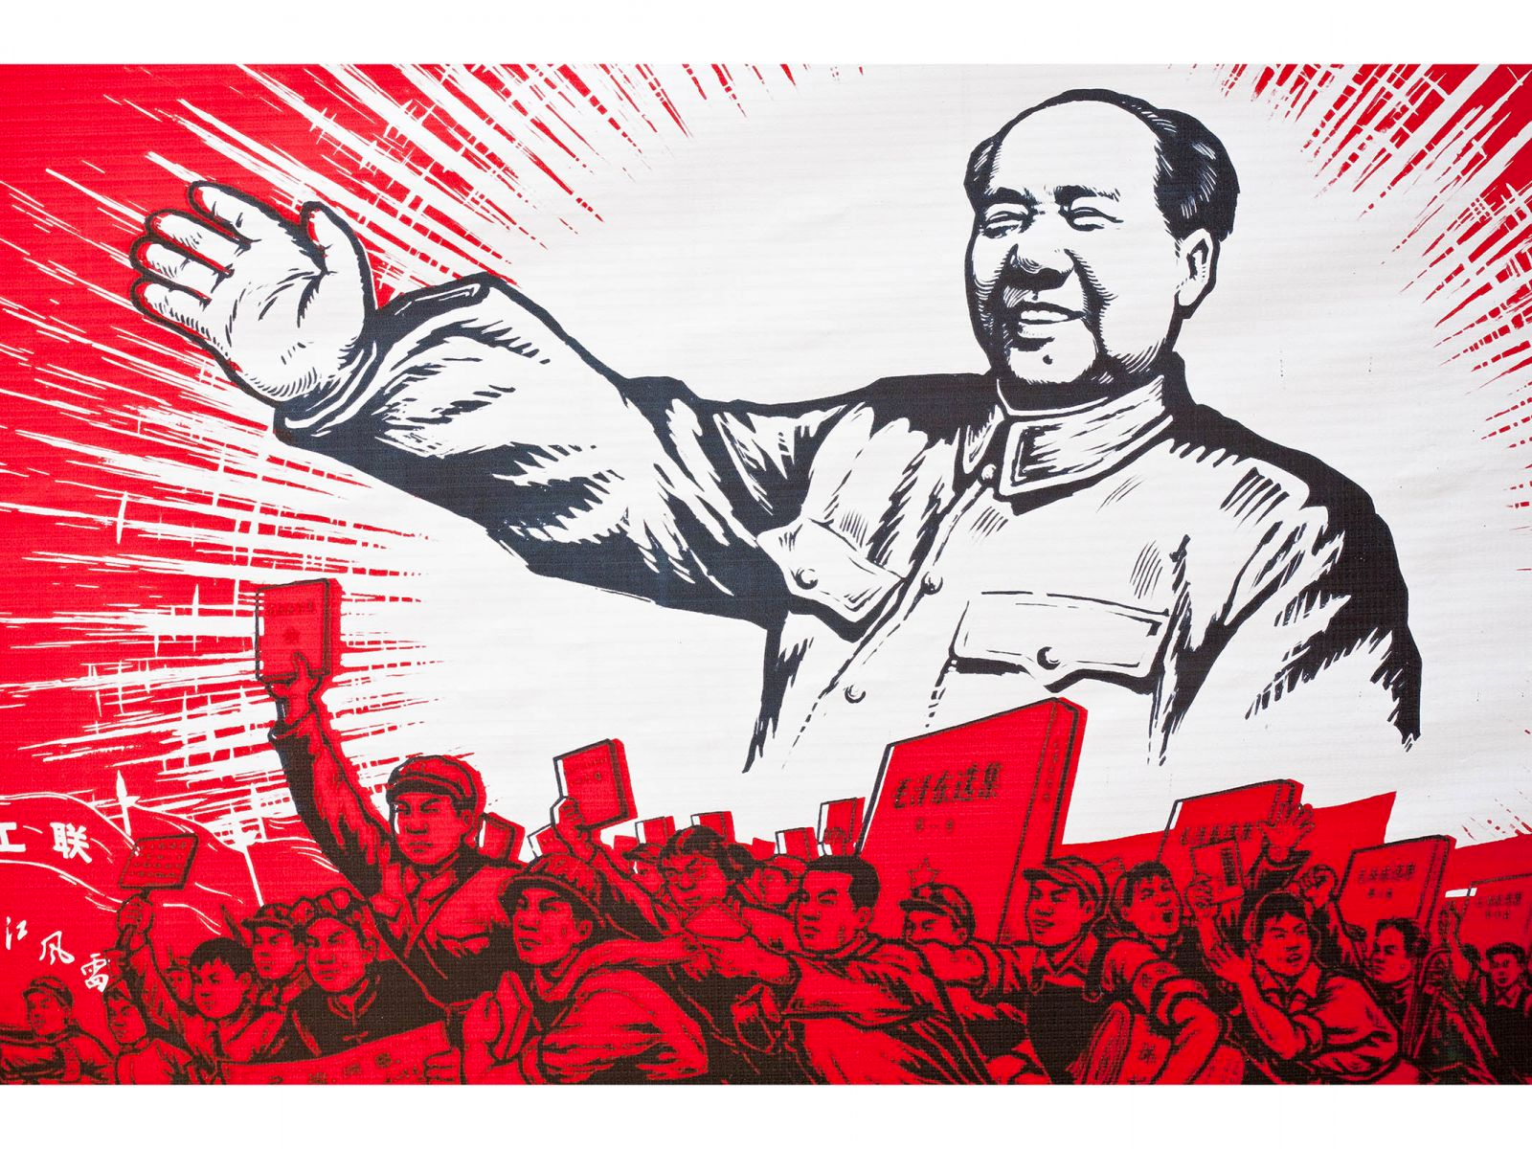
9. Cultural Relativism Debate:
Is HR Western or Universal?

Slide 19
Asian Values or Universal Values?

Slide 20
10. Possible Future Trajectories
Economic: the regime is committed to progress
“New normal”: ESC rights continue to advance
Soft landing: ESC rights advance slowly or stall
Hard landing: ESC rights regress
Political: the regime fears progress
Resilient authoritarianism: continued repression
Maoist revival: worse repression
Liberalizing reform: liberalization of media, speech, association
Democratic transition: ambiguous, depending on stability

