Slide 1
Top Ten Things to Know about Korea in the 21st Century
By Charles K. Armstrong

Slide 2
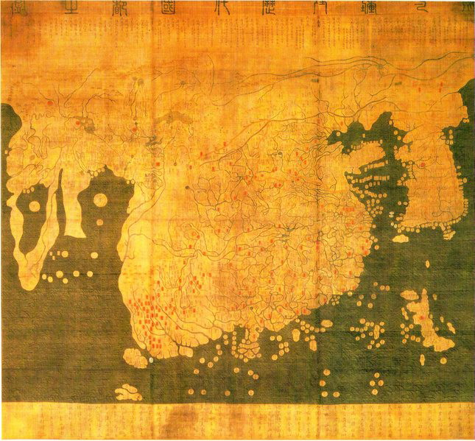
Korea is Not a Small Country

Slide 3
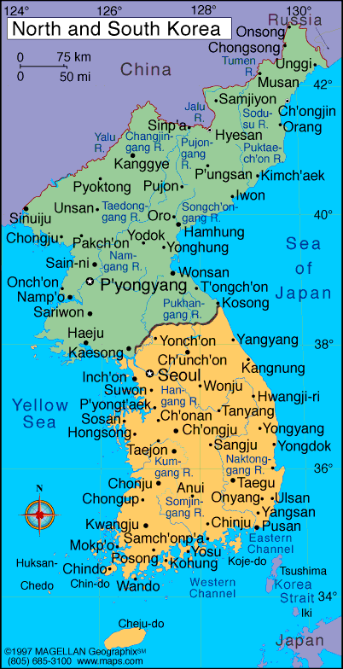
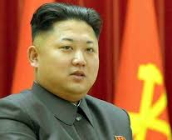
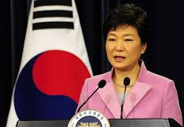
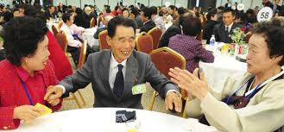
Koreans Are One People, But Their Country Has Been Divided Since 1945

Slide 4
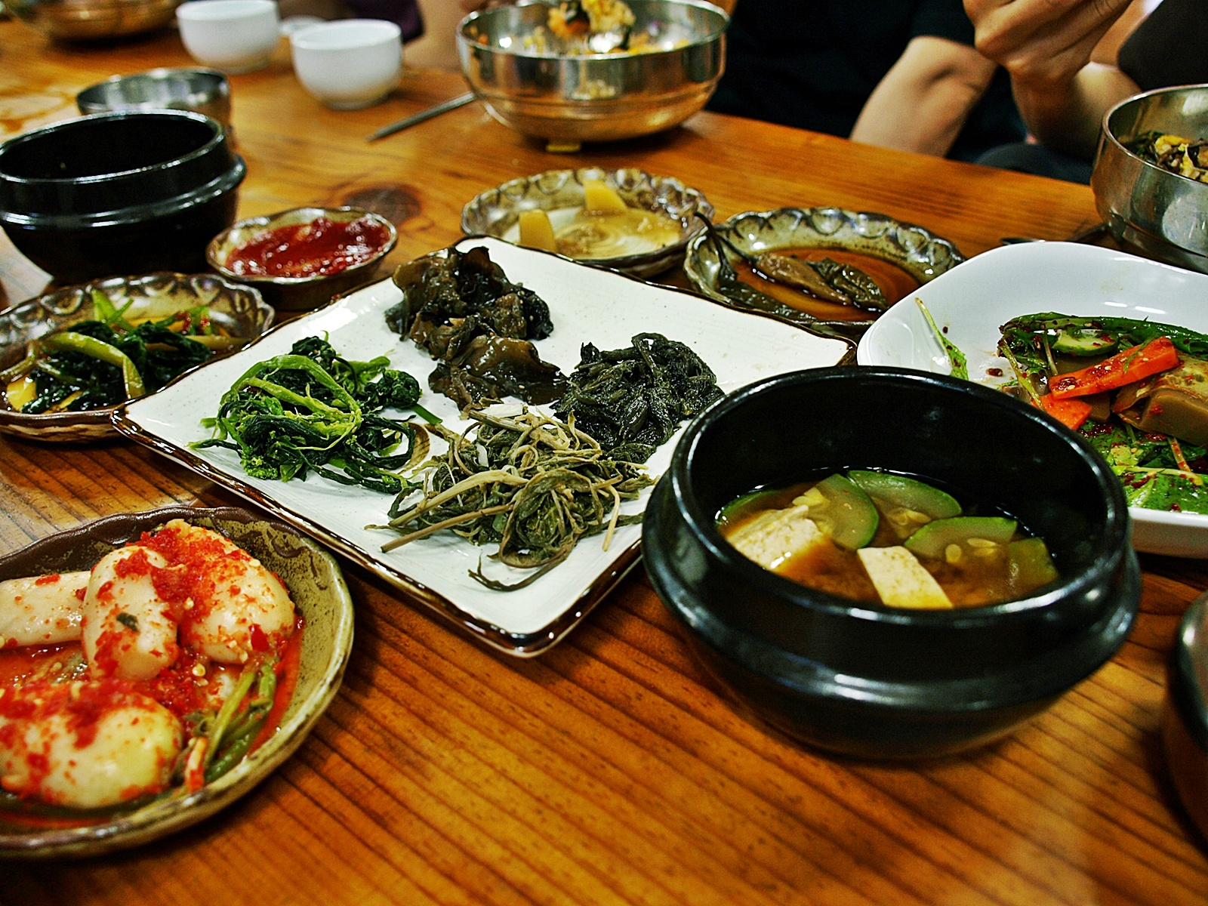
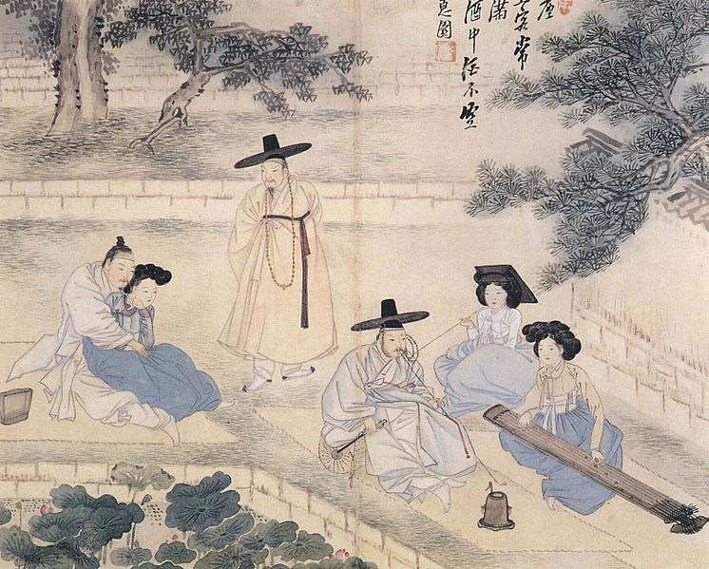
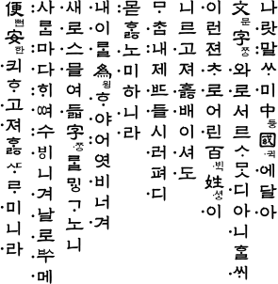
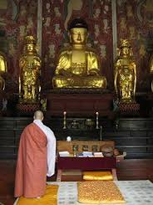
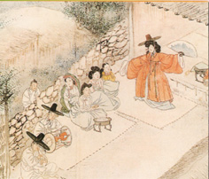
Korean Culture is Distinctive From That of Its Neighbors, China and Japan

Slide 5
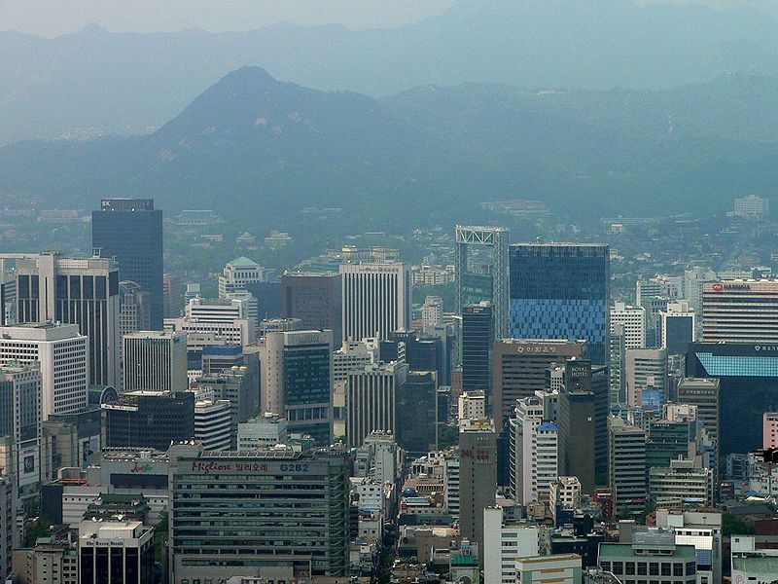
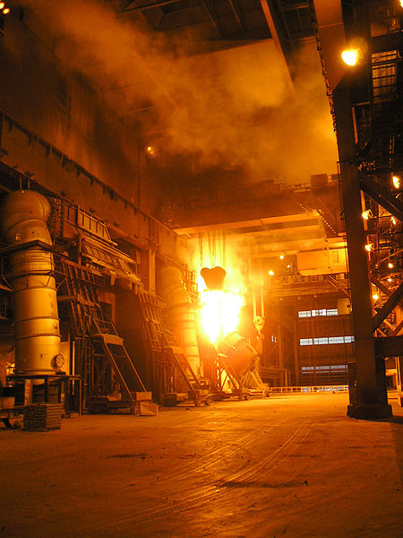
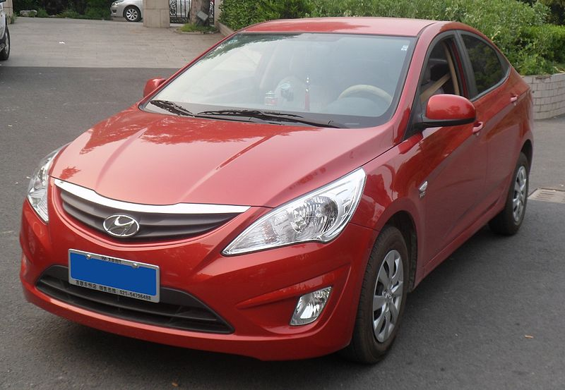
South Korea Is the World’s 13th Largest National Economy

Slide 6
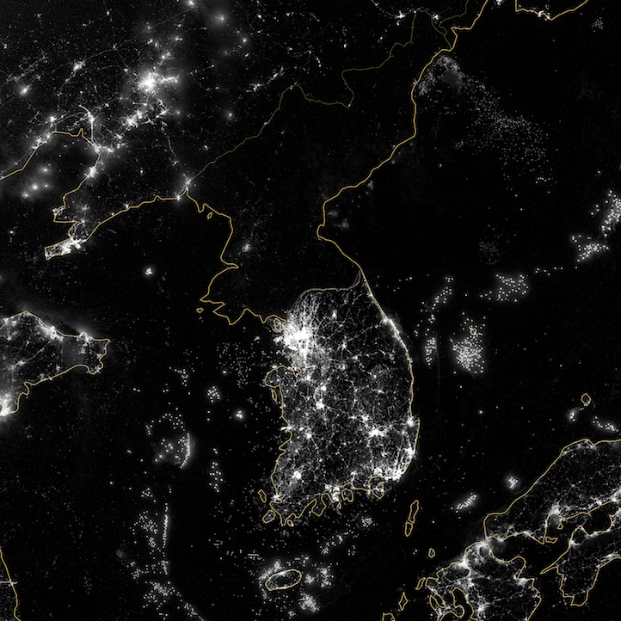
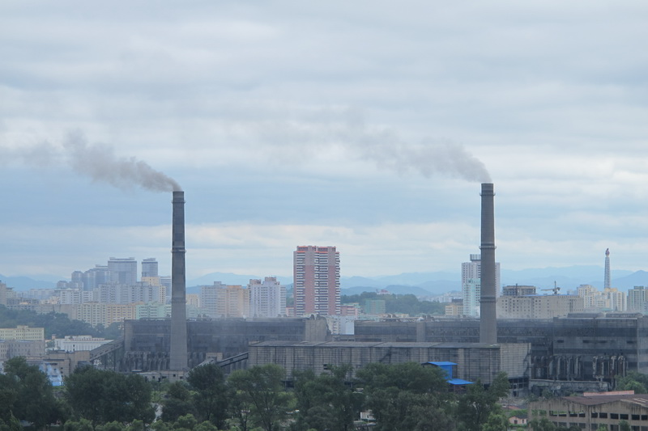
North Korea Was Ahead of the South Economically Until the Early 1970s

Slide 7
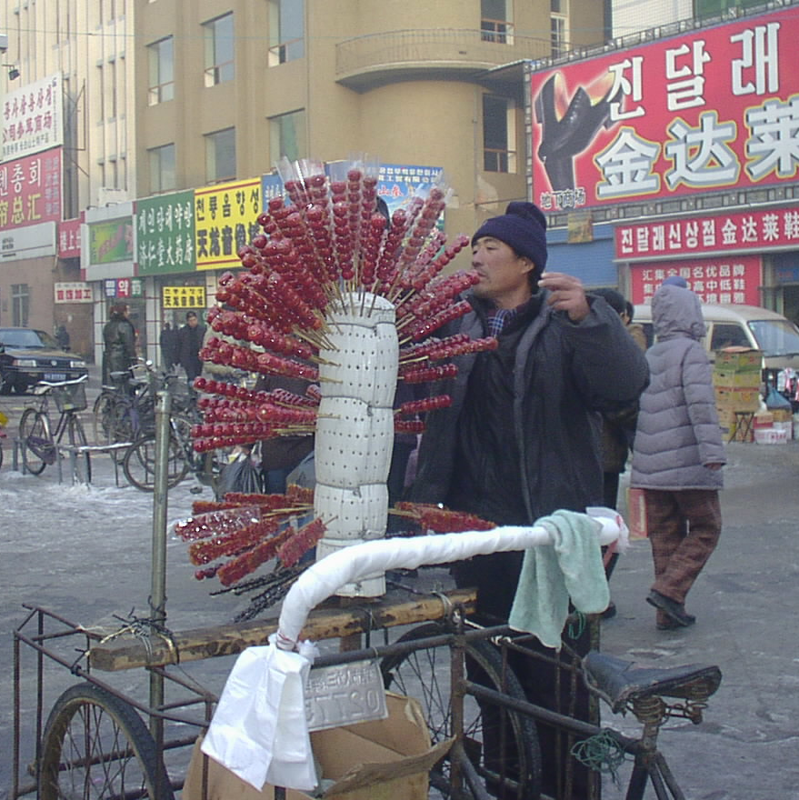
There are More Than Five Million People of Korean Descent Outside of the Korean Peninsula

Slide 8
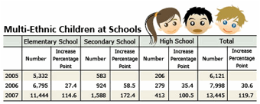
South Korea is Becoming a Multi-Cultural Society
Surge in number of foreign residents: 210,000 in 2000 to 854,000 in 2008 (2% of population)
Rise in number of “international marriages”: 12,188 in 1998 to 38,491 in 2007

Slide 9
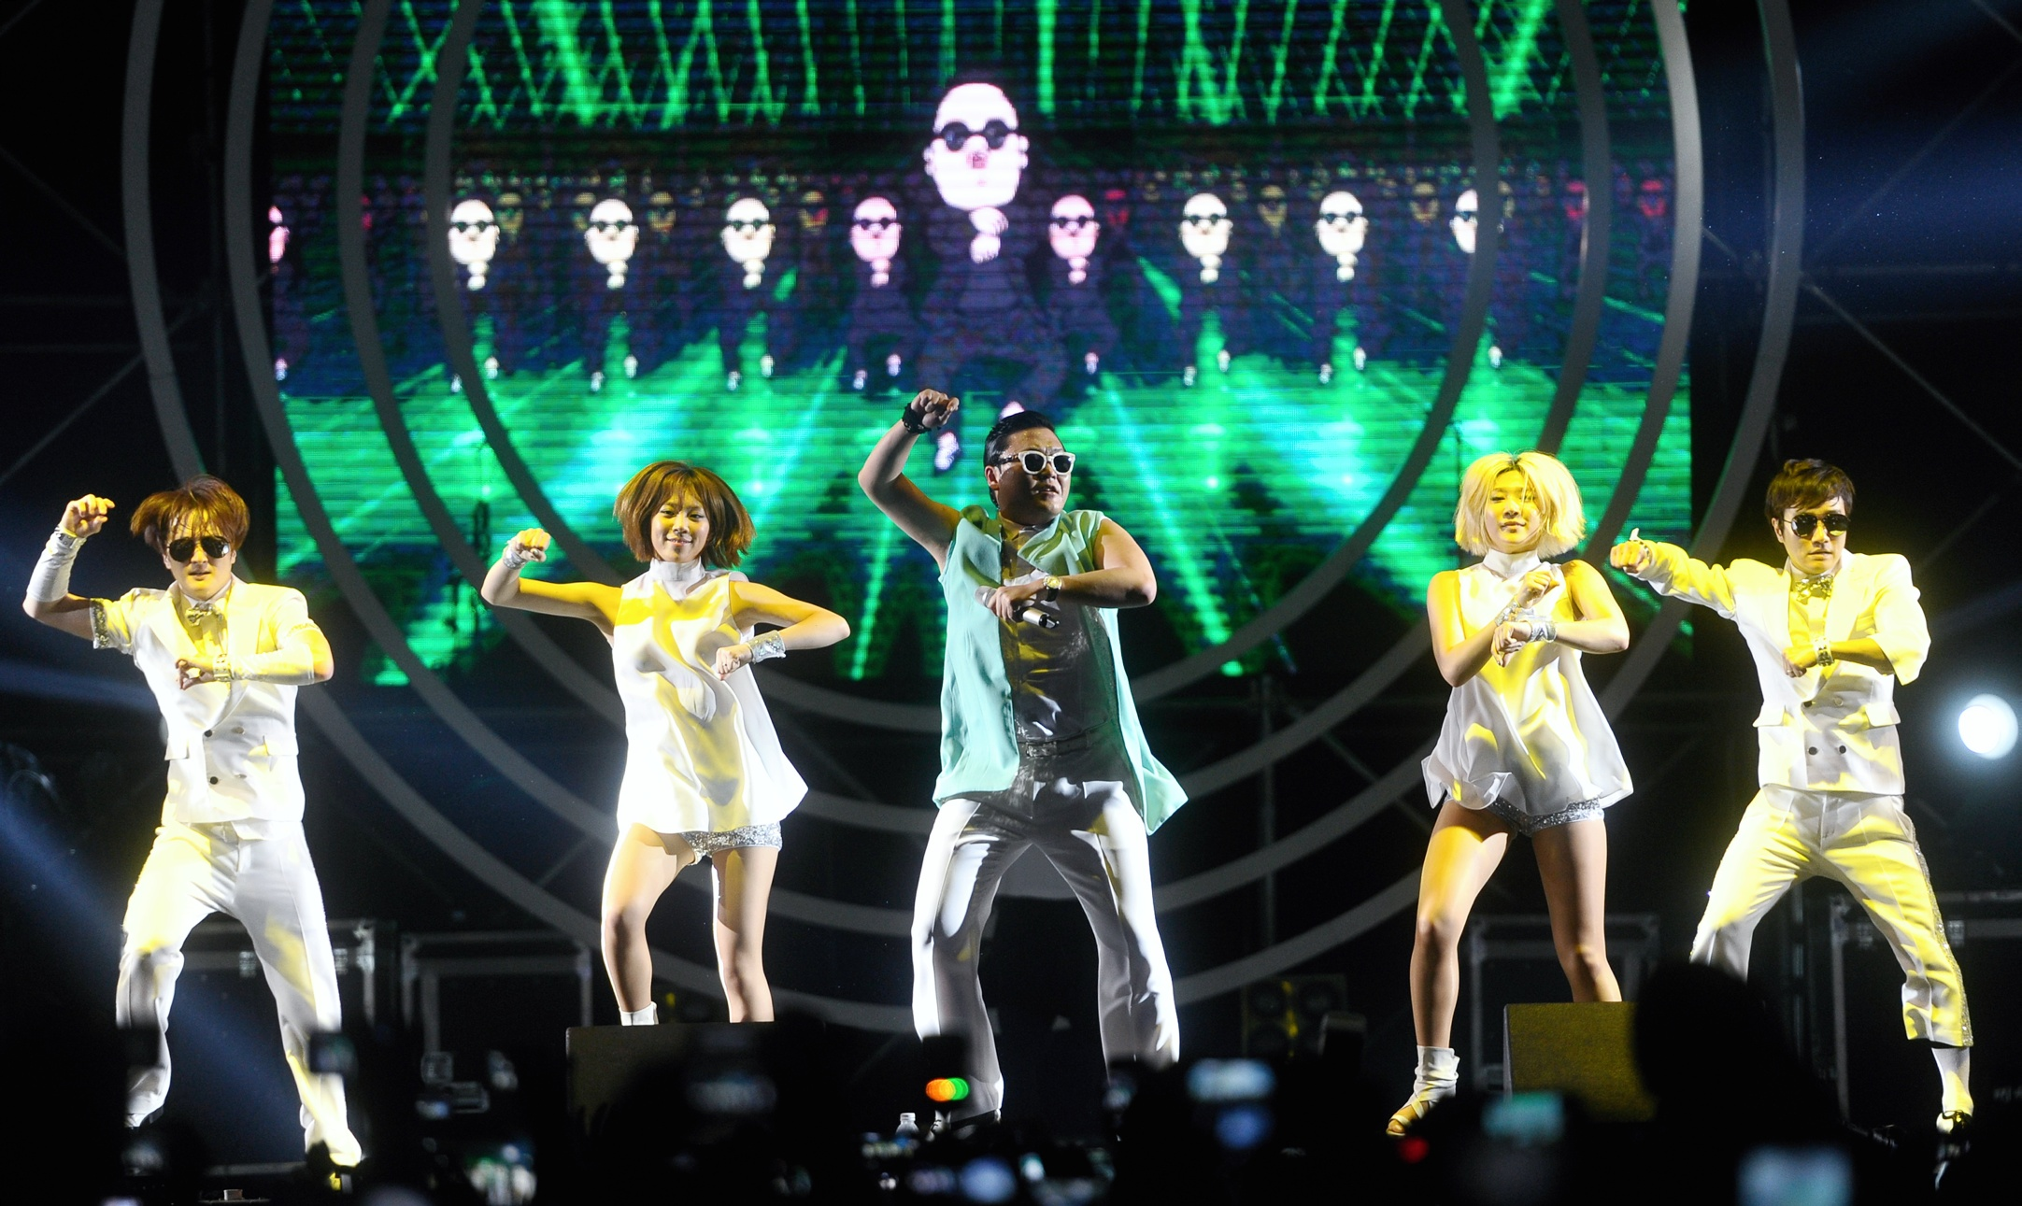
Korean Pop Culture is Sweeping the Globe

Slide 10
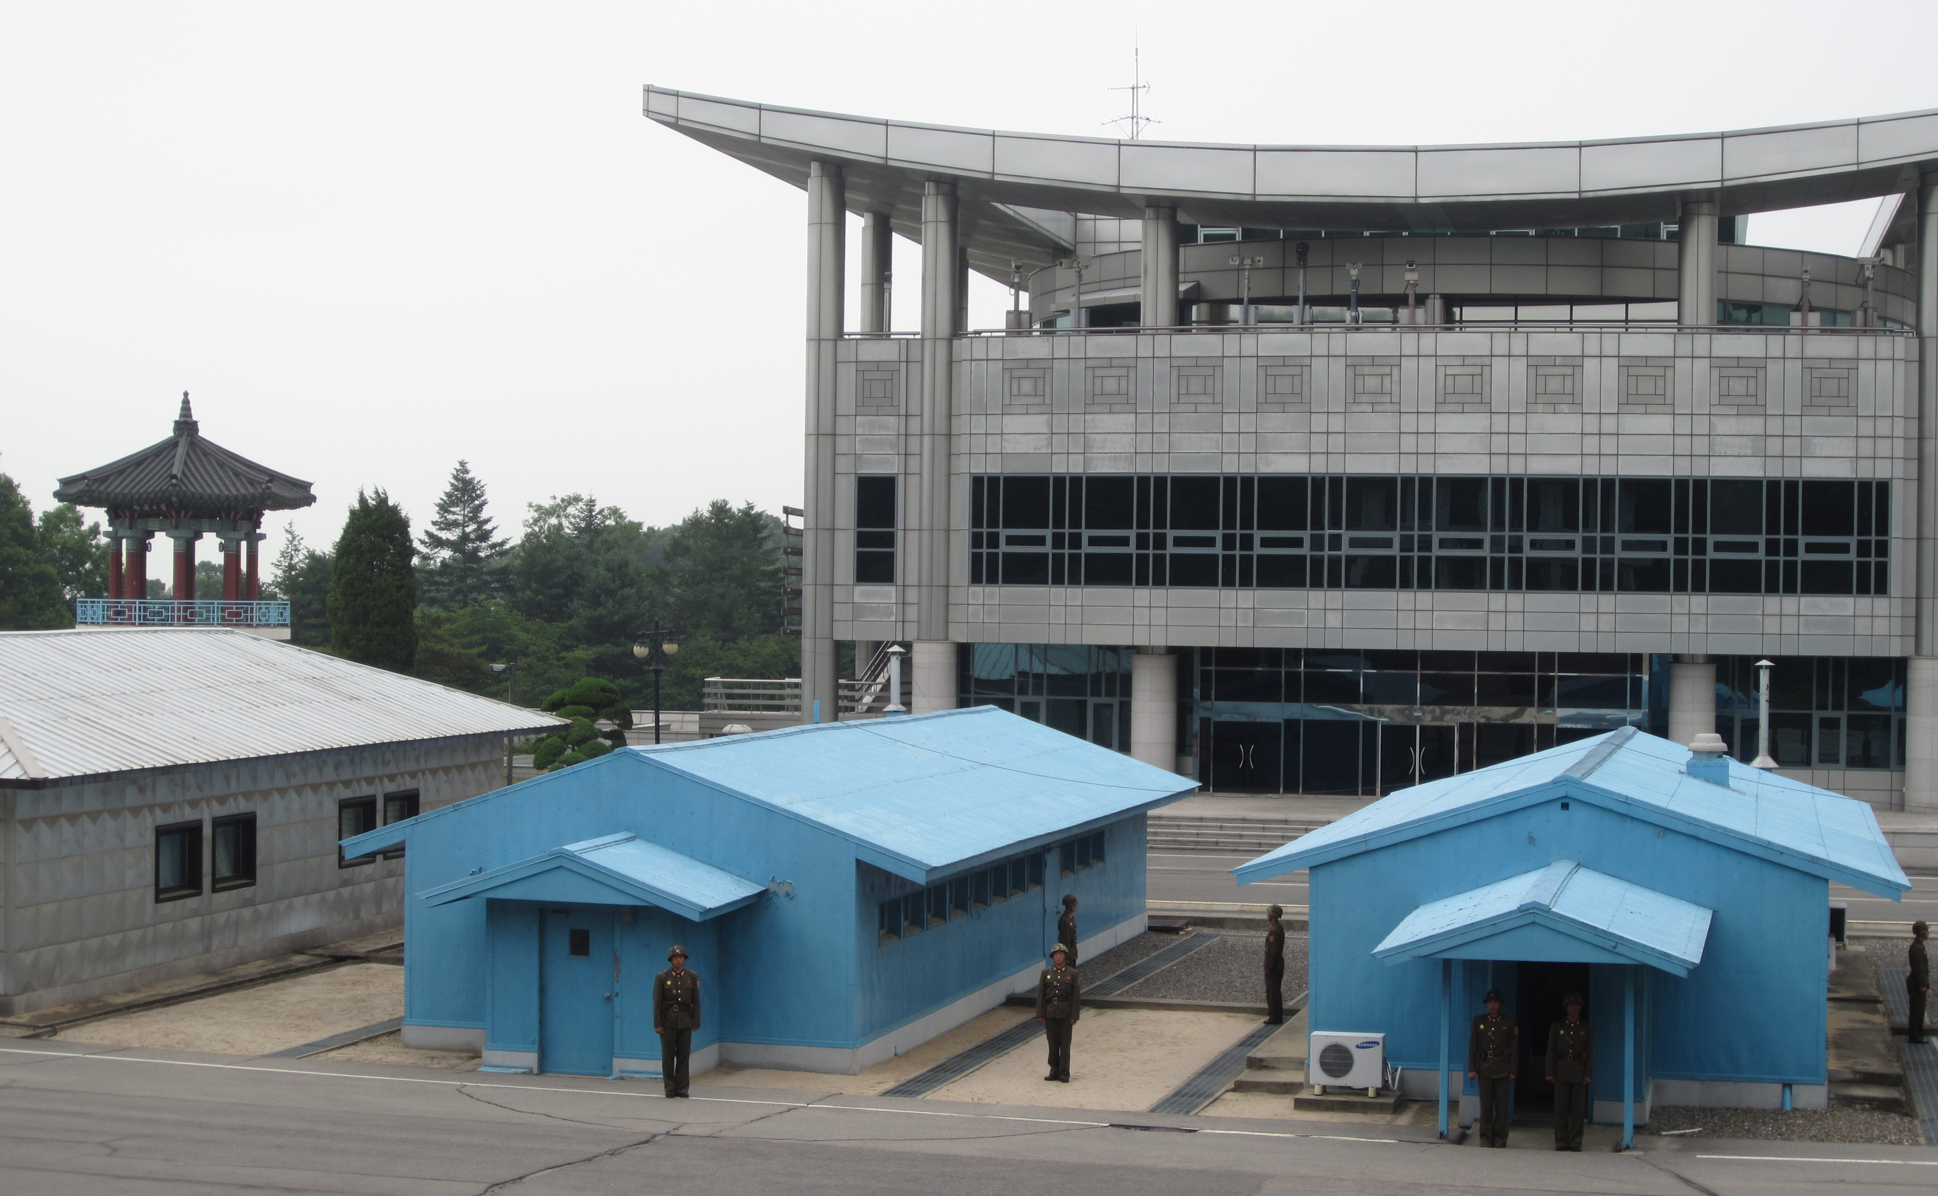
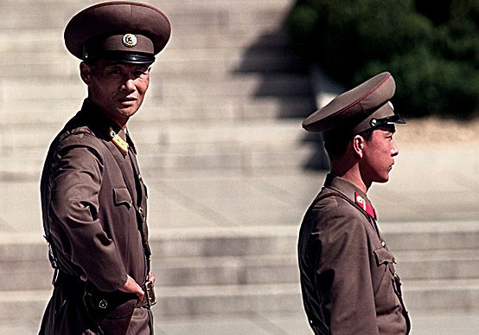
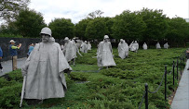
The Korean War is Not Over

Slide 11
Korea is On the Move!
South Korea is becoming an increasingly important actor in East Asia and the world
South Korea has become an aid donor to developing countries
Korean society continues to evolve and its culture increasingly well-known around the world
The future of North Korea and North-South relations is still uncertain, but
A unified Korea of 75 million people could a much more powerful force in the world.

