Slide 1
Top Ten Things to Know About Vietnam
Professor Duncan McCargo

Slide 2
1. Vietnam is a country and not a war.

Slide 3
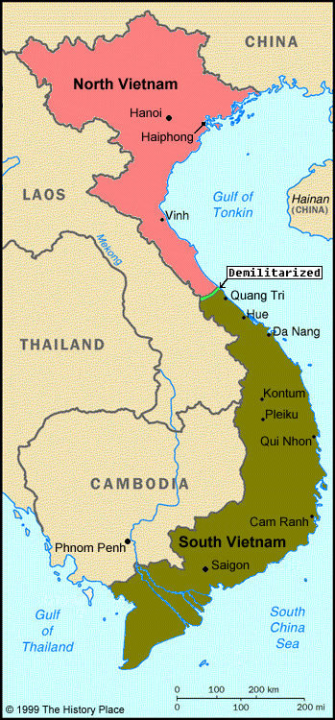
1. Vietnam is a country and not a war.

Slide 4
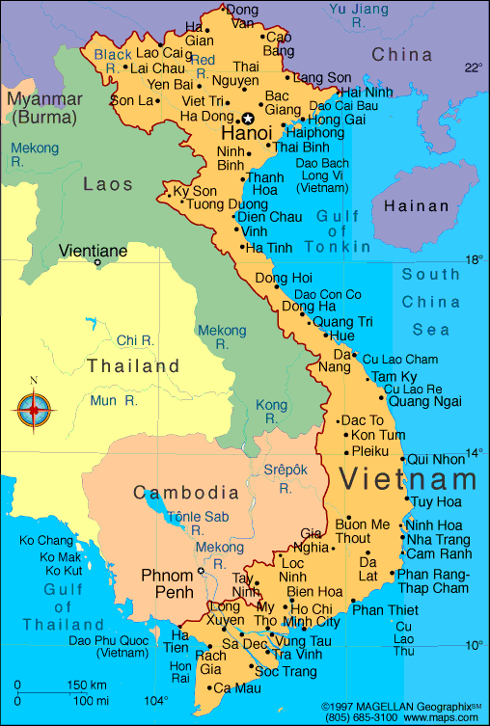
1. Vietnam is a country and not a war.

Slide 5
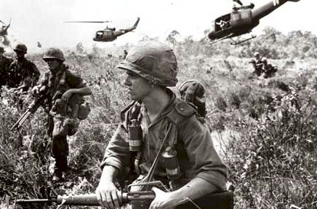
2. Vietnamese people don’t hate America.

Slide 6
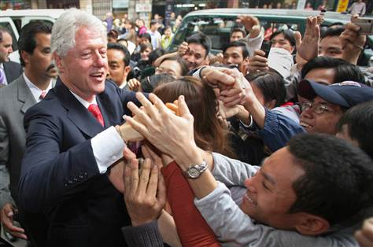
2. Vietnamese people don’t hate America.

Slide 7
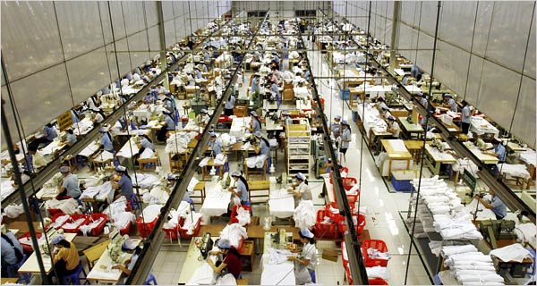
3. Vietnam has a very dynamic economy.

Slide 8
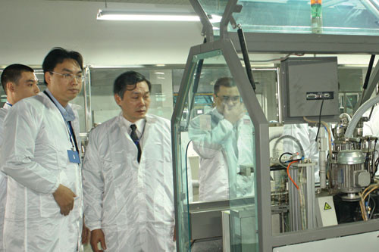
3. Vietnam has a very dynamic economy.

Slide 9
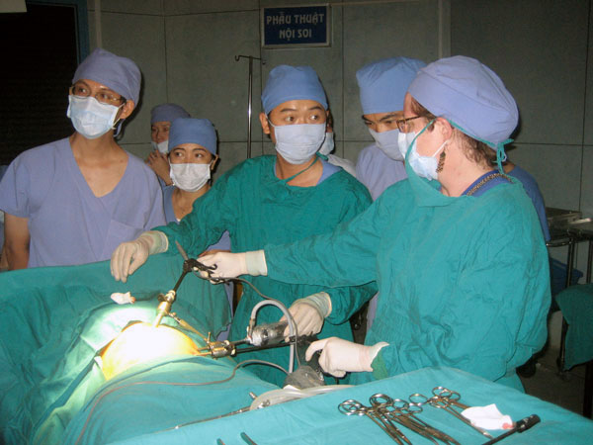
4. Vietnam has excellent public services.

Slide 10
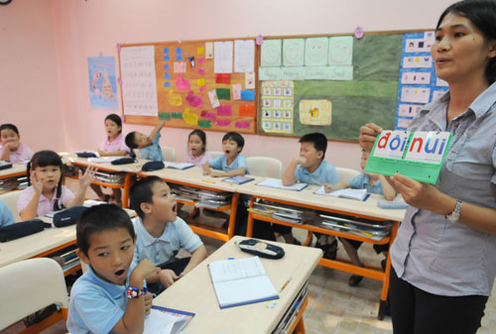
4. Vietnam has excellent public services.

Slide 11
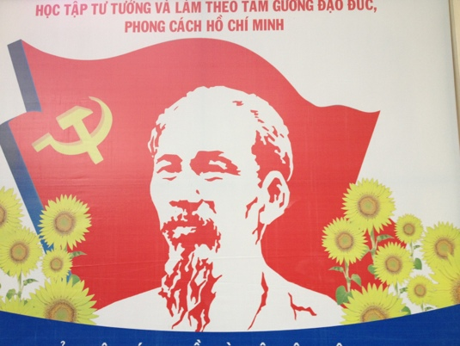
5. Vietnam is a one party state.

Slide 12
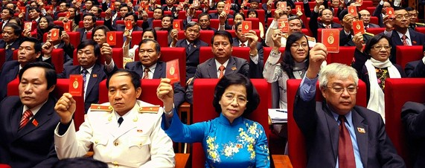
5. Vietnam is a one party state.

Slide 13
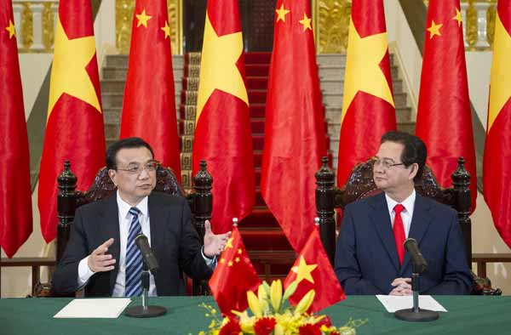
6. Vietnam has a complex relationship with China.

Slide 14
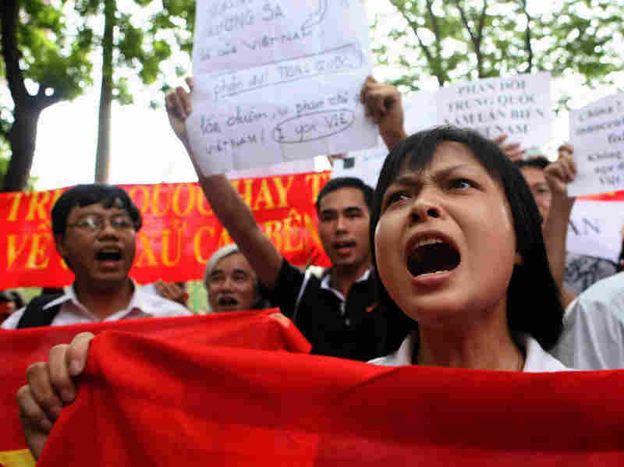
6. Vietnam has a complex relationship with China.

Slide 15
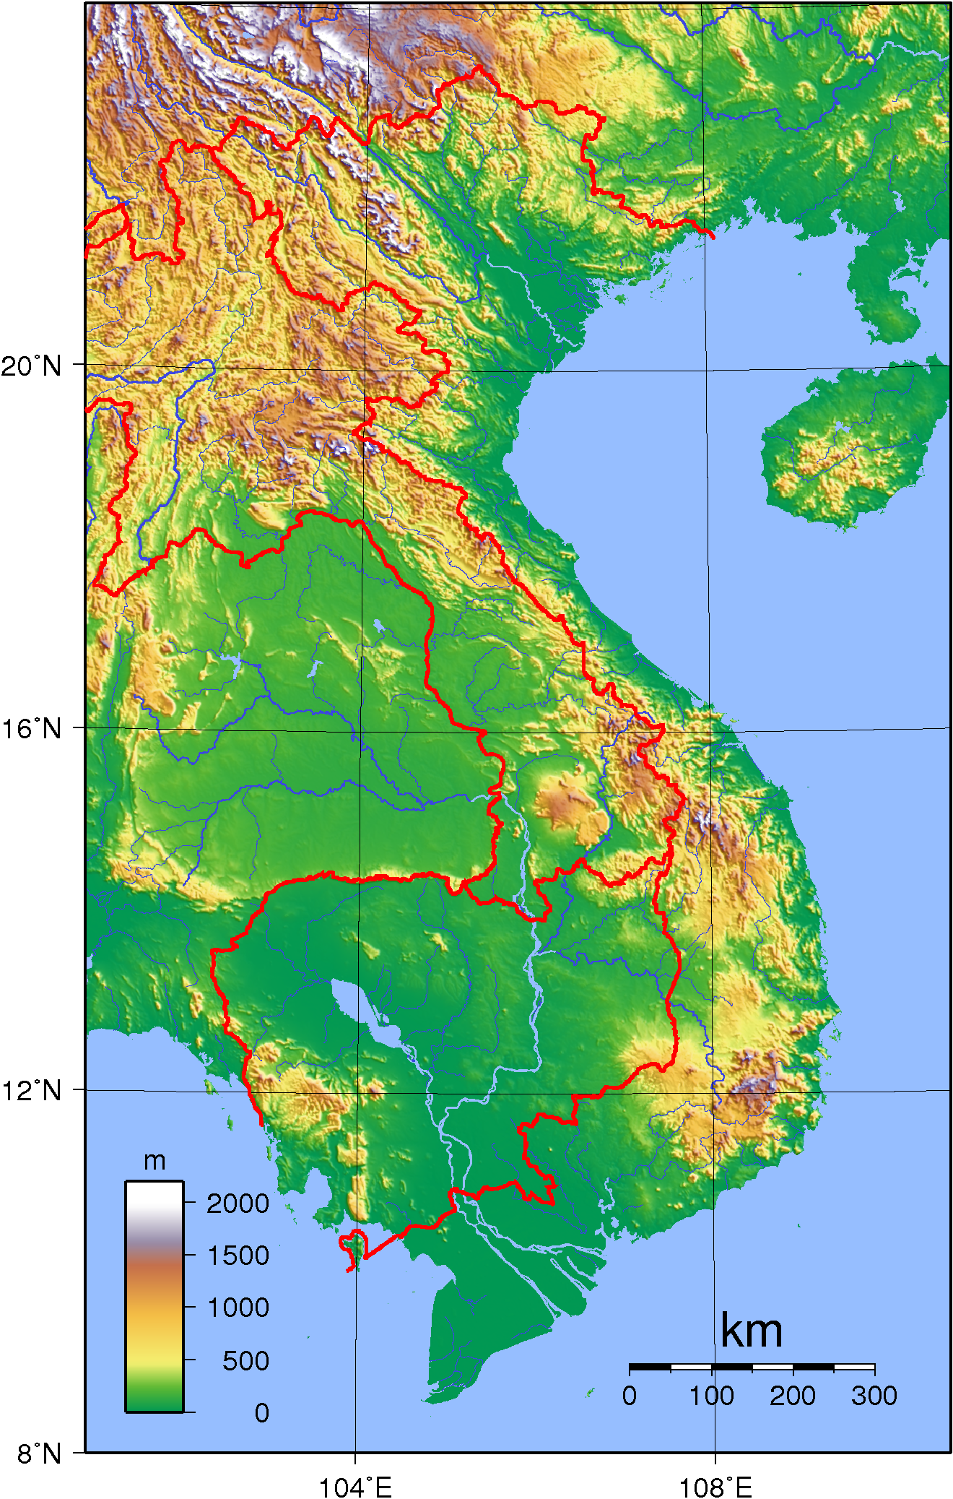
7. North and South Vietnam are strikingly different.

Slide 16
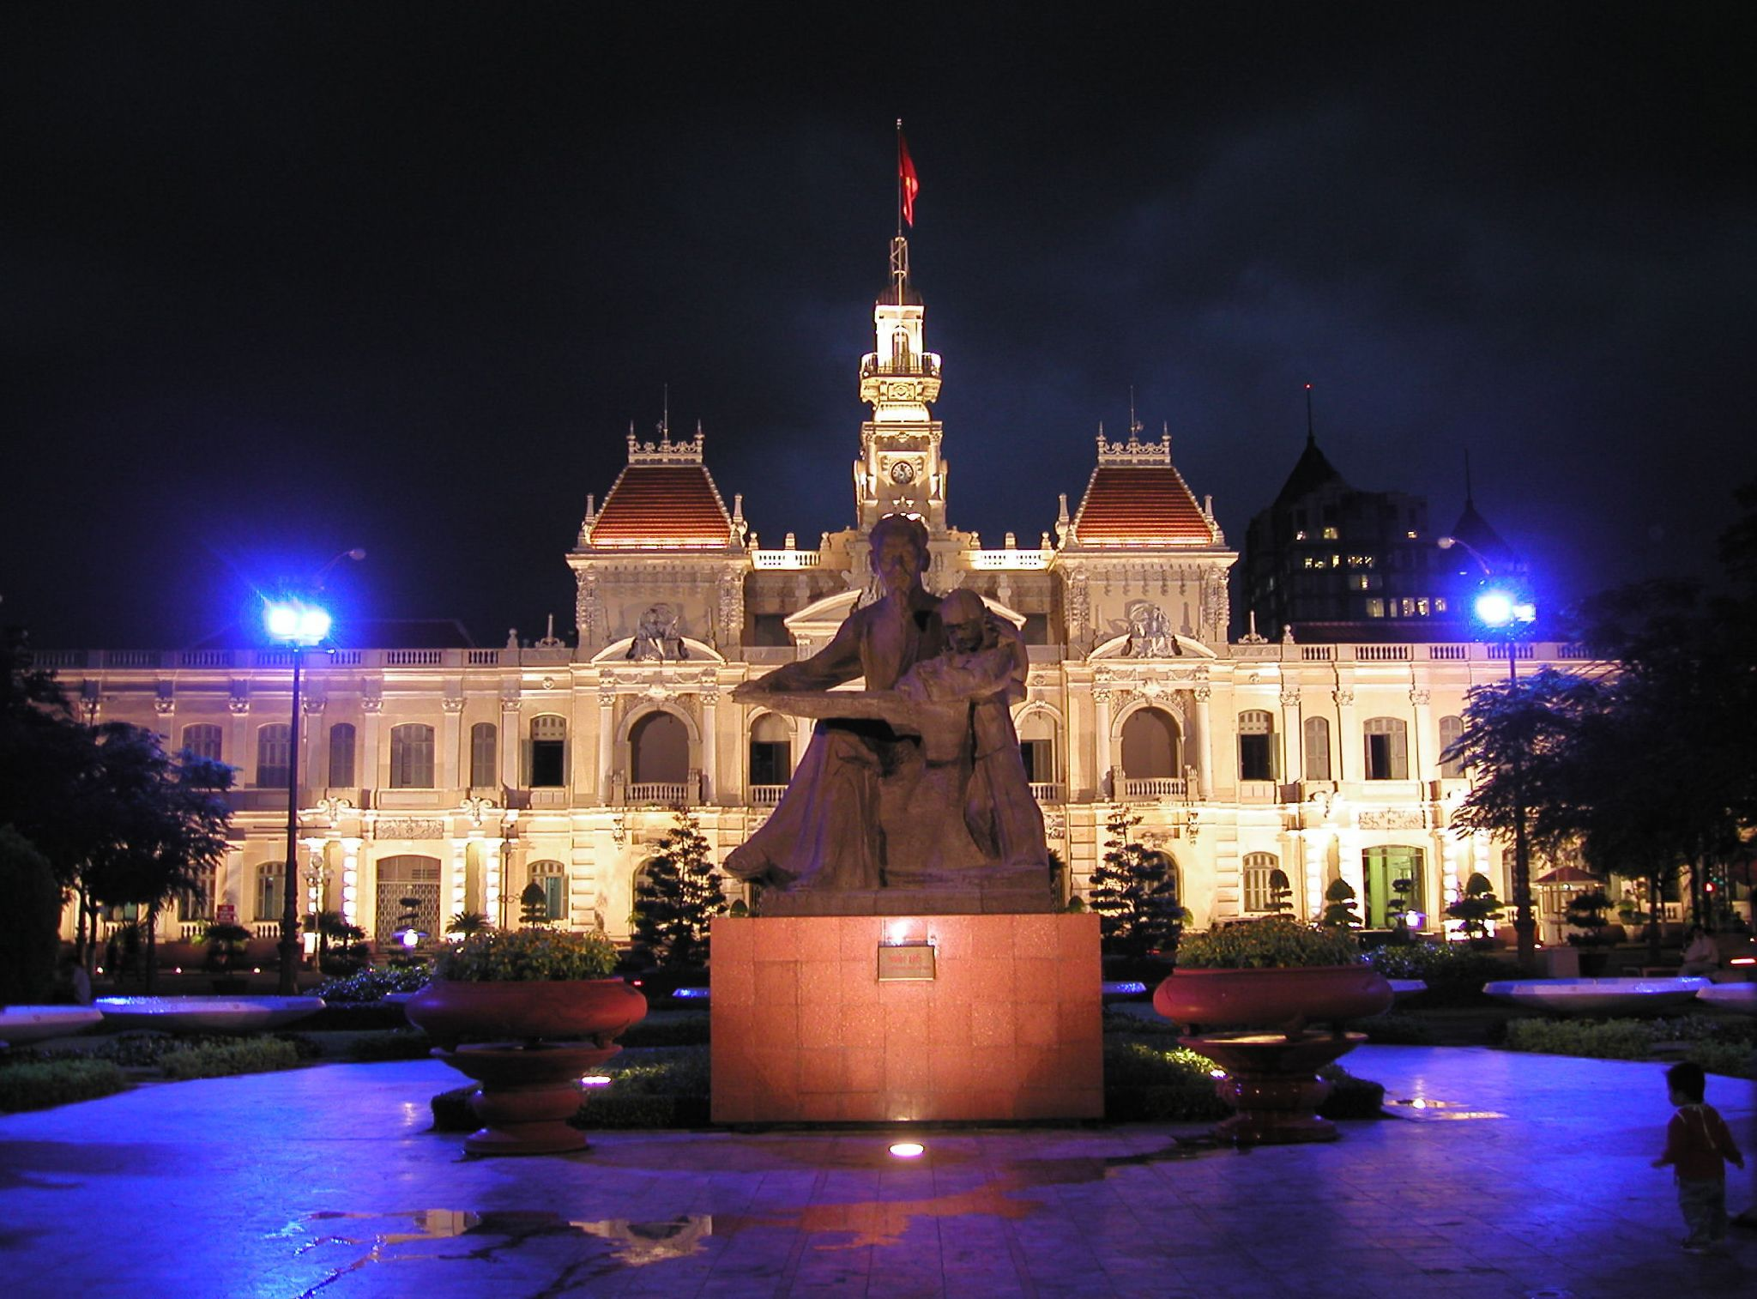
7. North and South Vietnam are strikingly different.

Slide 17
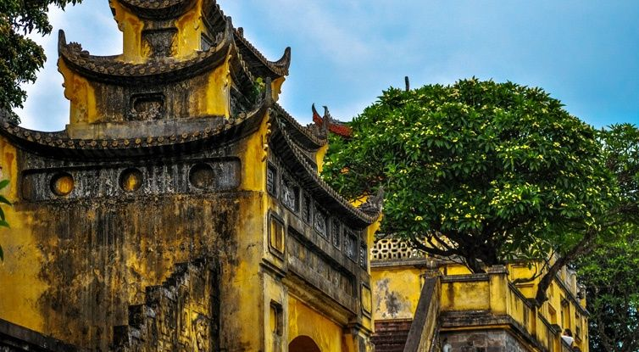
7. North and South Vietnam are strikingly different.

Slide 18
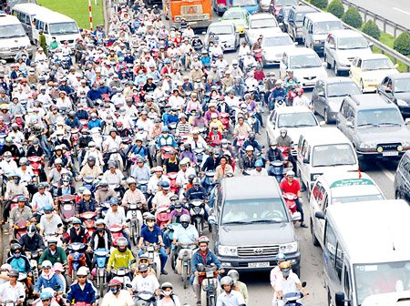
8. Vietnam has terrible traffic.

Slide 19
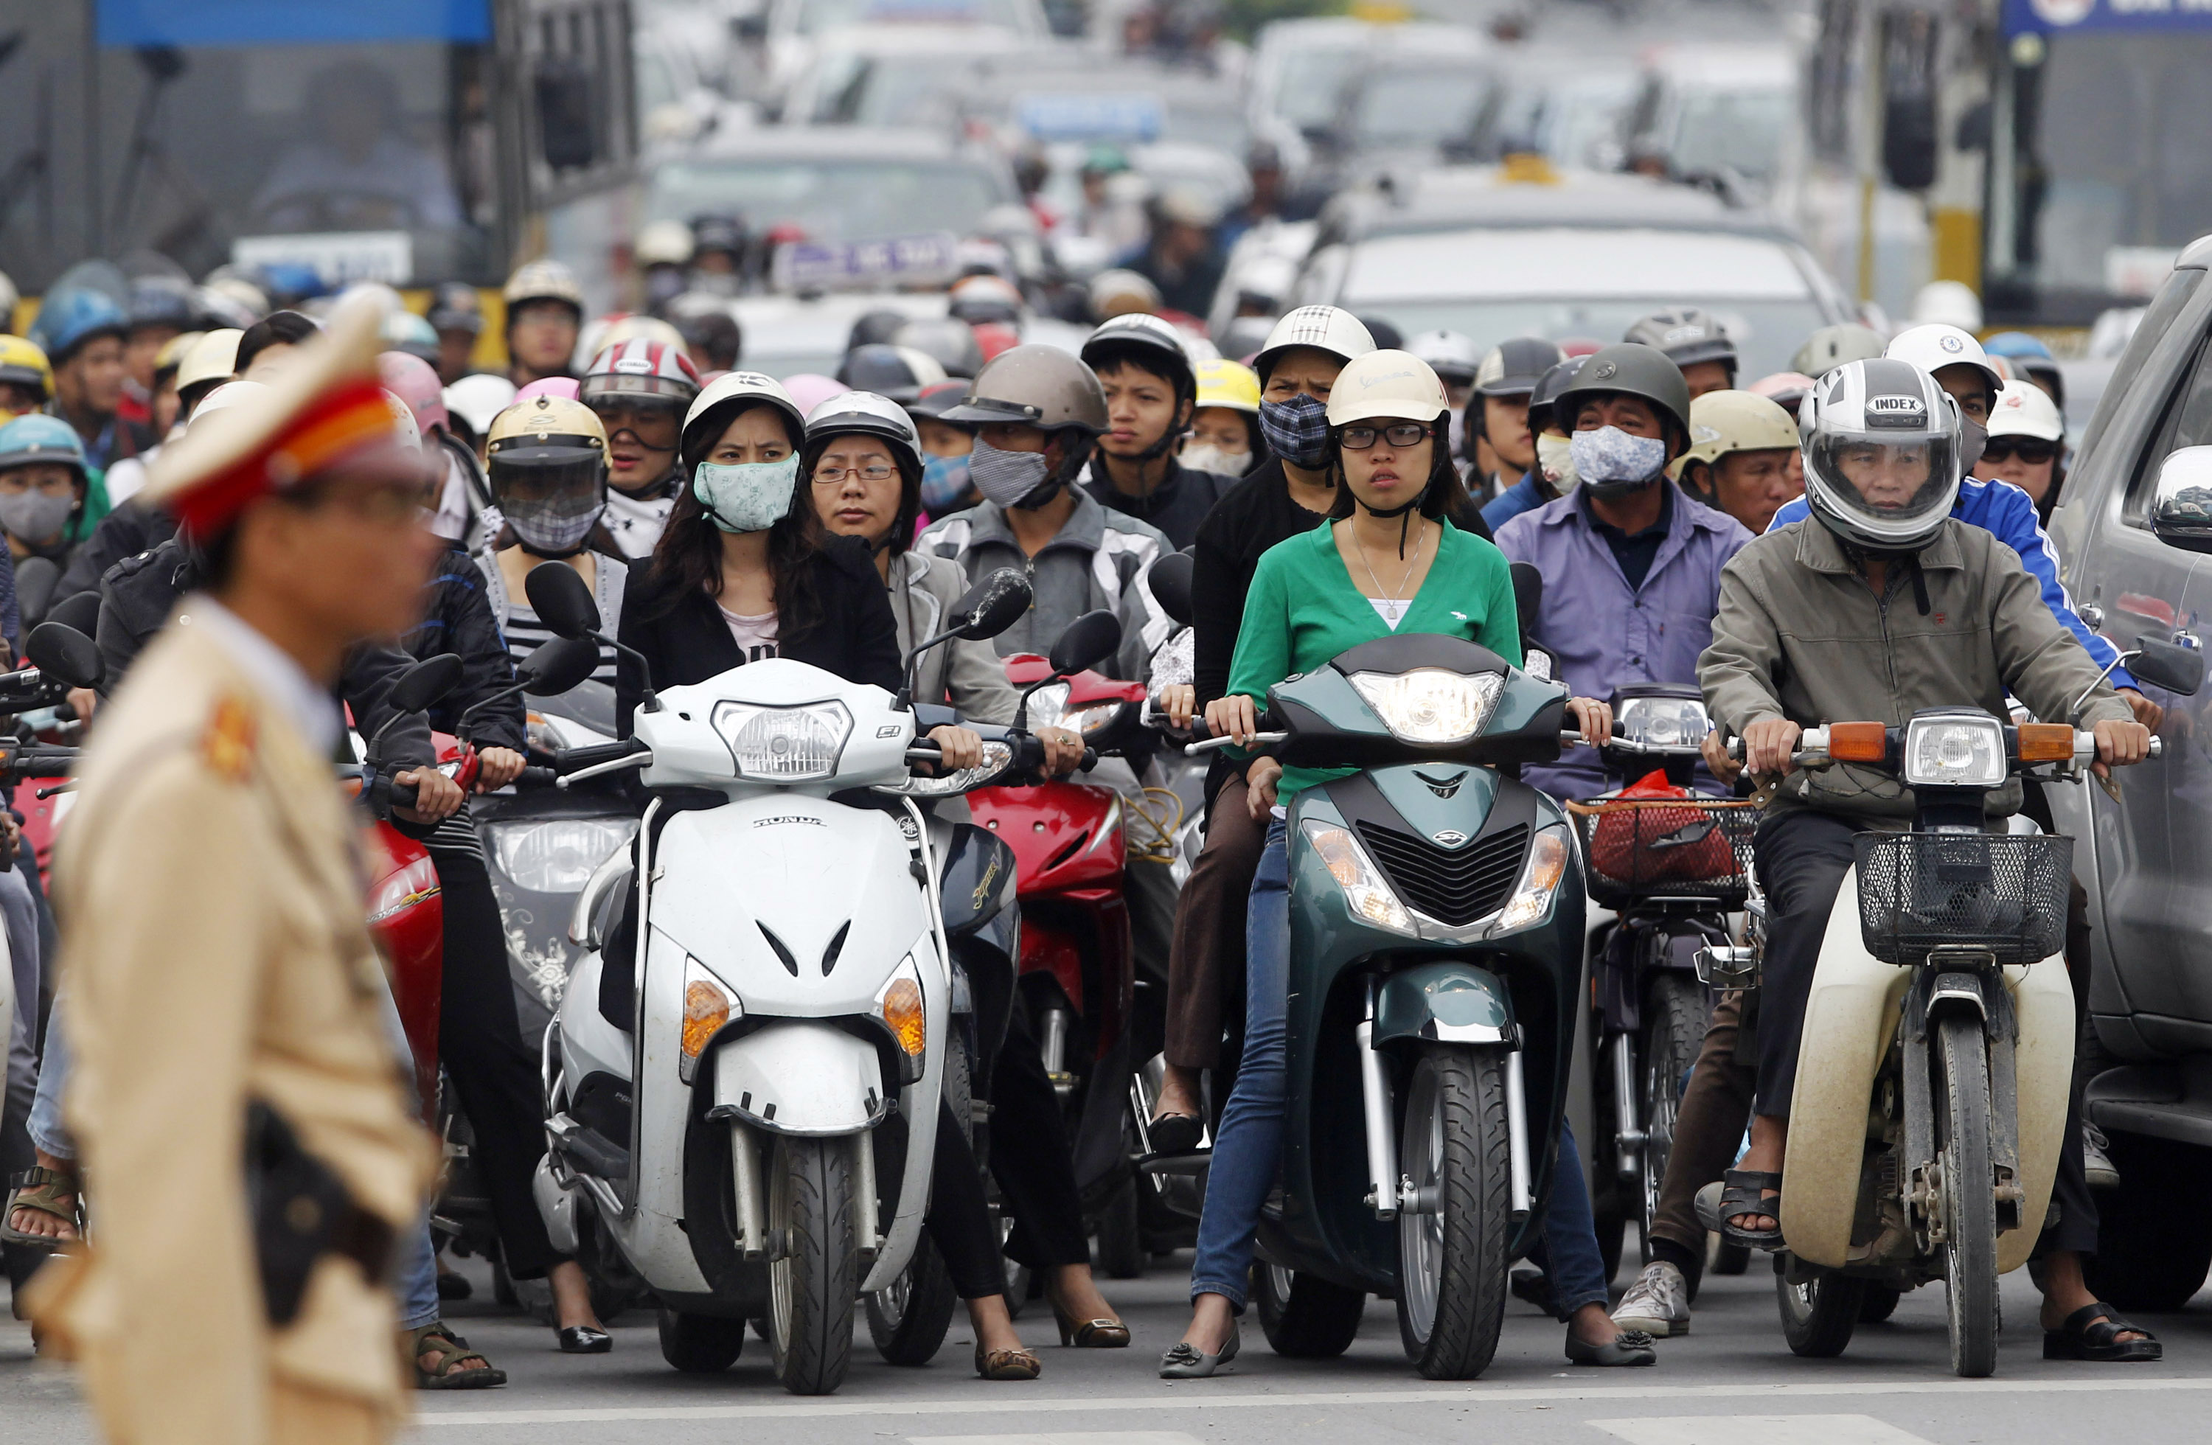
8. Vietnam has terrible traffic.

Slide 20
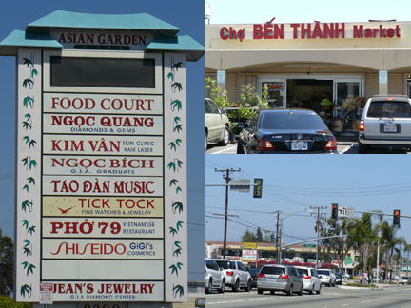
9. There are more than three million Overseas Vietnamese.

Slide 21
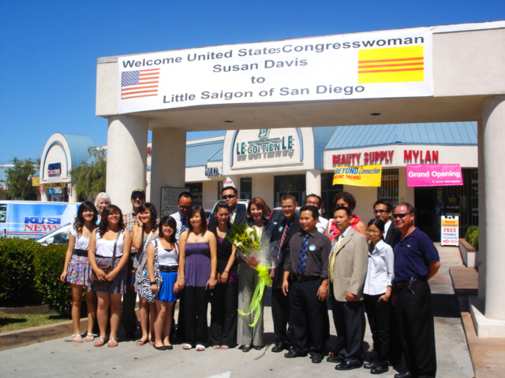
9. There are more than three million Overseas Vietnamese.

Slide 22
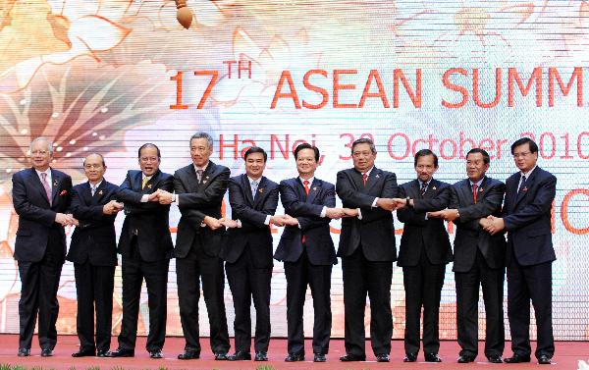
10. Vietnam is crucial to the future of Southeast Asia.

Slide 23
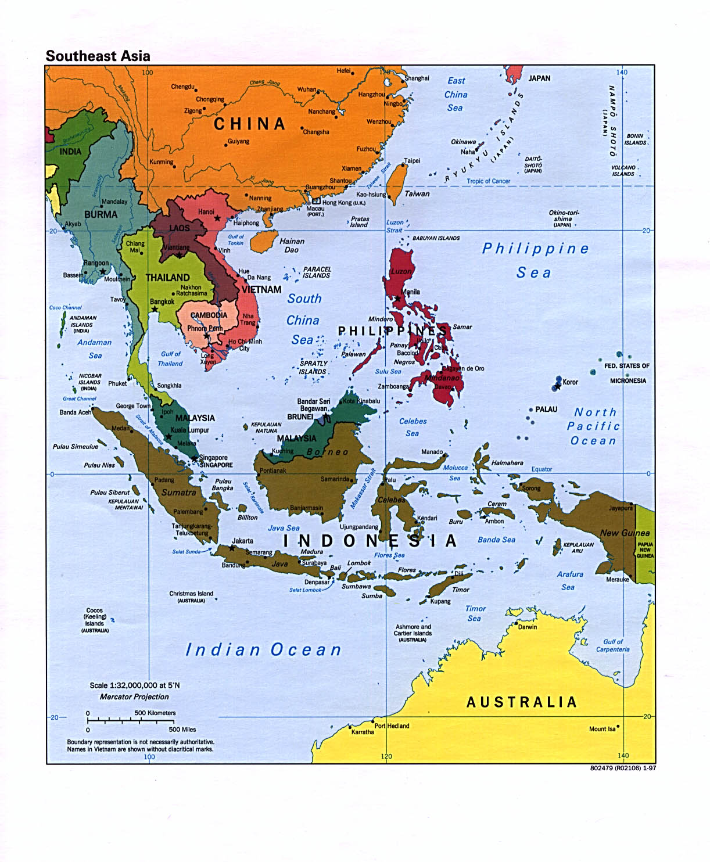
10. Vietnam is crucial to the future of Southeast Asia.

